Slide 2
iPECS Cloud V5.0

Slide 3
Cloud v5 Feature Overview
Azure Action Directory Sign In
Azure Action Company Directory Integration
LIP Phone over TCP connection

Slide 4
Azure Active Directory integration
Overview
By synchronising your Azure Active Directory (AAD) to the iPECS Cloud platform
It is possible to login to the customer manager portal either as a
user or manager using Office 365 login details.

Slide 5
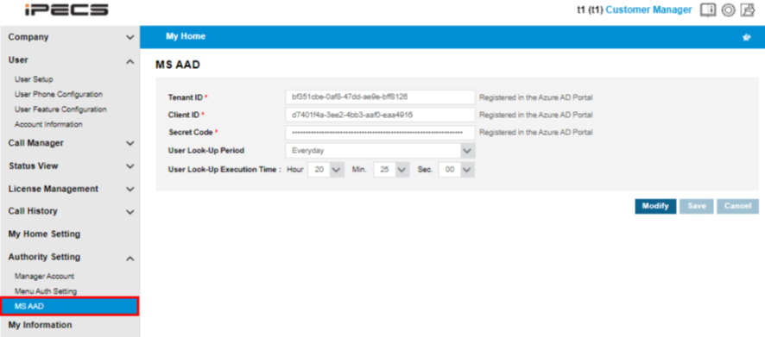
Azure Active Directory integration
Customer Manager Portal > Authority Setting > MS AAD
Tenant ID: The unique ID assigned to the customer with an active Azure Active Directory service subscription.
Client ID: The unique ID assigned to the API registered in the AAD portal for AAD User Lookup.
Secret Code: This code is generated for the API in the AAD portal.
Notes:
Full AAD guide available on Pragma Knowledge base.

Slide 6
Azure Active Directory integration
Customer Manager Portal > User > User Setup
A users AAD ID can be manually entered or found using the user lookup.
After entering the AAD ID and saving. The user can log in to the customer user portal using their AAD ID.

Slide 7
Azure Active Directory integration
Customer Manager Portal > My Information
Using the same process as user setup, within this menu you can manually enter or select from the dropdown which user you would like to use their AAD ID to log into the customer manager portal.

Slide 8
Azure Active Directory integration
Customer Manager Portal > Company > Company Directory
After synchronising with AAD the customer’s company directory will be updated with their contacts stored within AAD.
The information in red above is synchronized to the AAD user information and can not be modified in the company directory menu.
Other information can be updated in Company Directory menu.

Slide 9
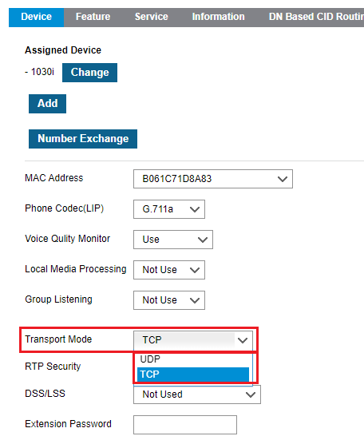
LIP Phone TCP Connection
On the iPECS Cloud platform LIP handsets use IPKTS (iPECS proprietary protocol) over UDP in default.
In cloud version 5 there is the option to enable TCP for registration of handsets. A TCP connection is slower than UDP but has more reliable packet delivery and packets that lost are attempted to be recovered. This is not the case when using UDP
Customer Manager Portal > User > User Setup > Device tab > Transport Mode

Slide 10
iPECS One v2.5

Slide 11
iPECS One v2.5 overview
Company Directory visibility
Native mobile contacts integration
Guest access through iOS
New Spaces background settings
Bluetooth Headset integration
Call recording start/stop for ACR
iOS CallKit enhancement
New version notification

Slide 12
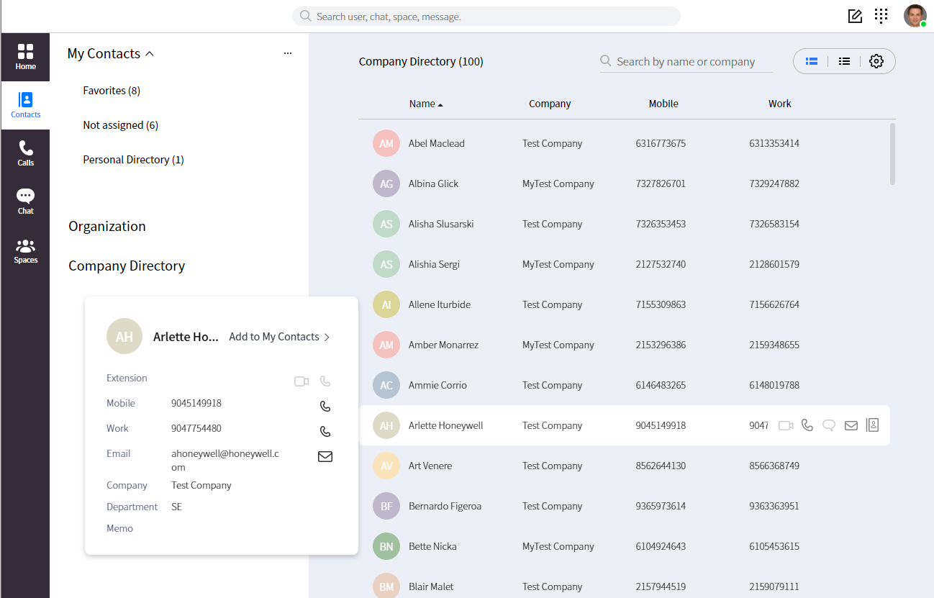
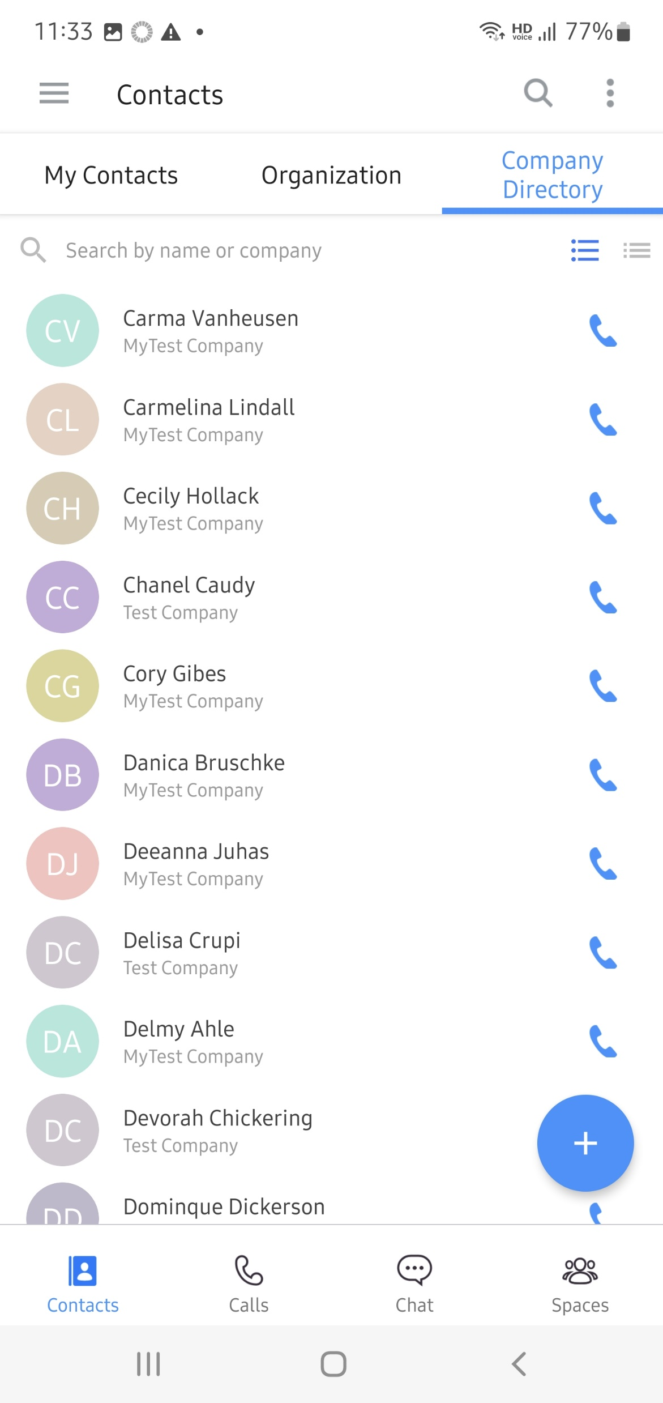
Company Directory
The company directory is now visible in the Contacts tab within iPECS One.
These are the contacts stored within the Company Directory on the cloud portal and shared across all users.
Notes:
Max. 3K contacts visualized in the directory.

Slide 13

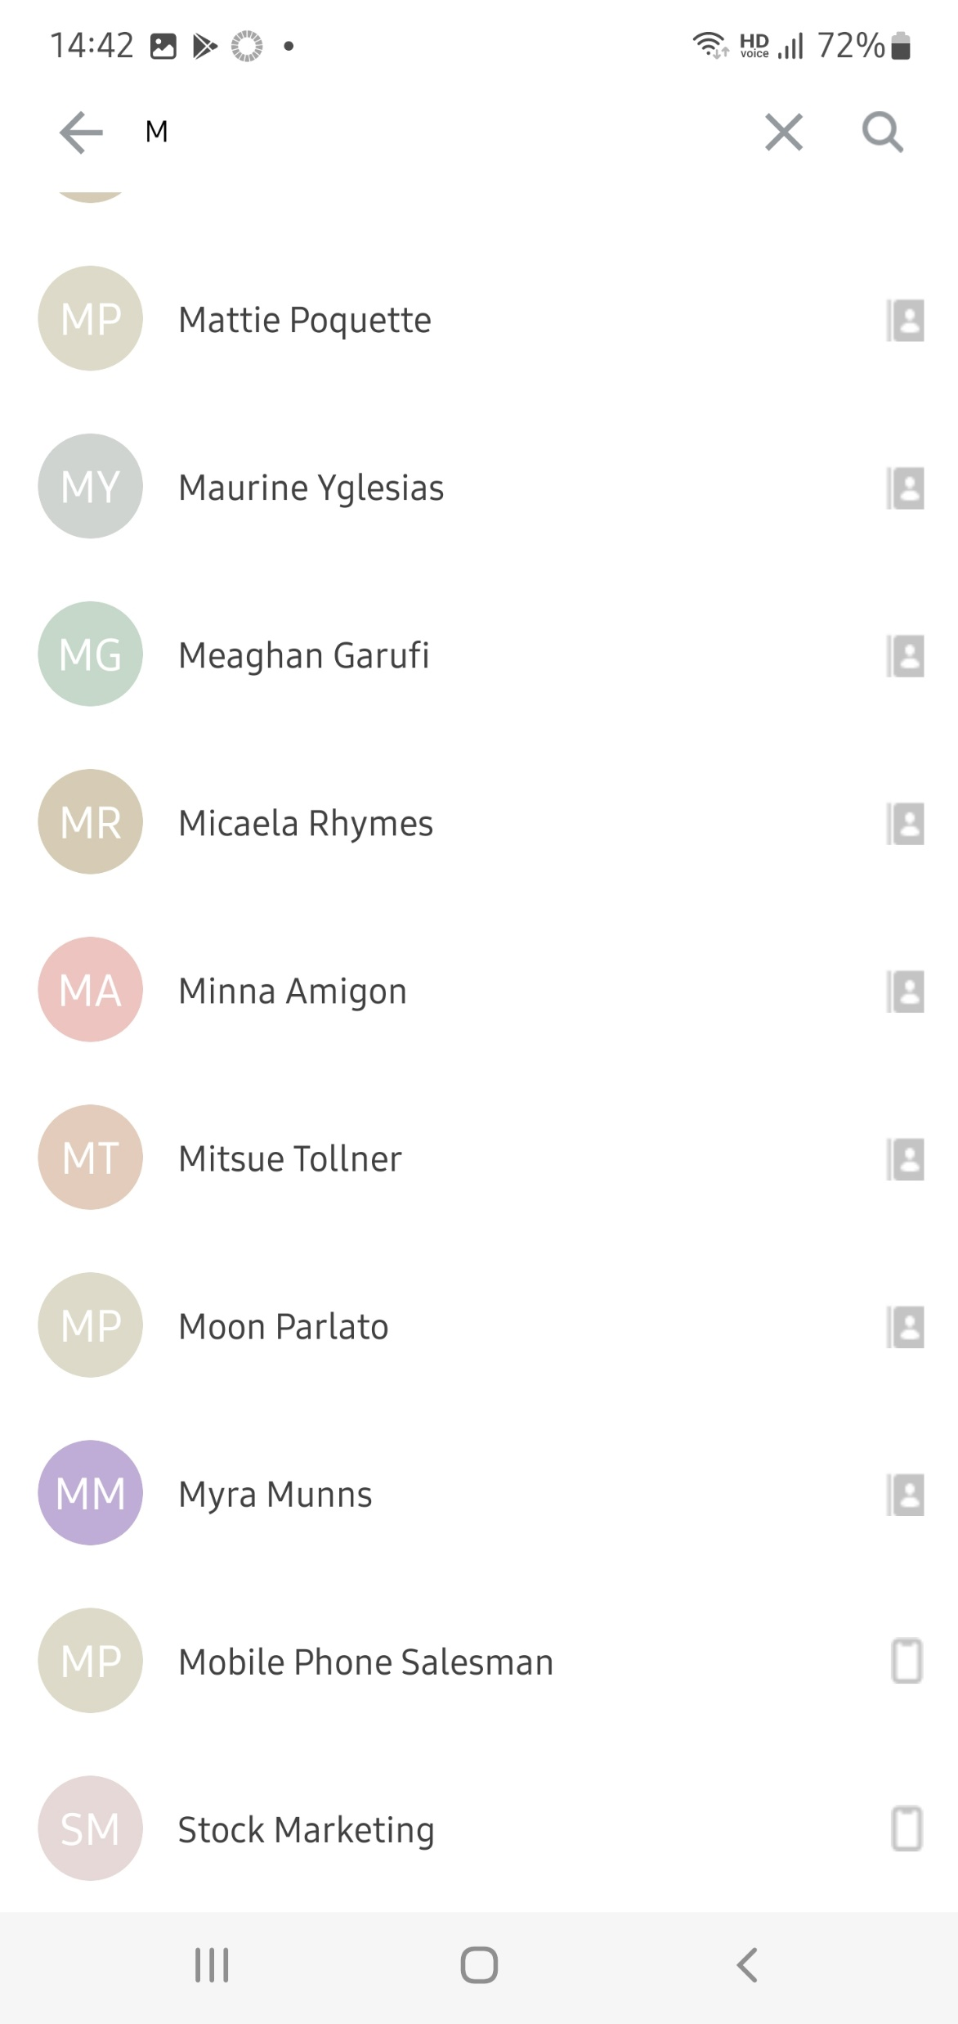
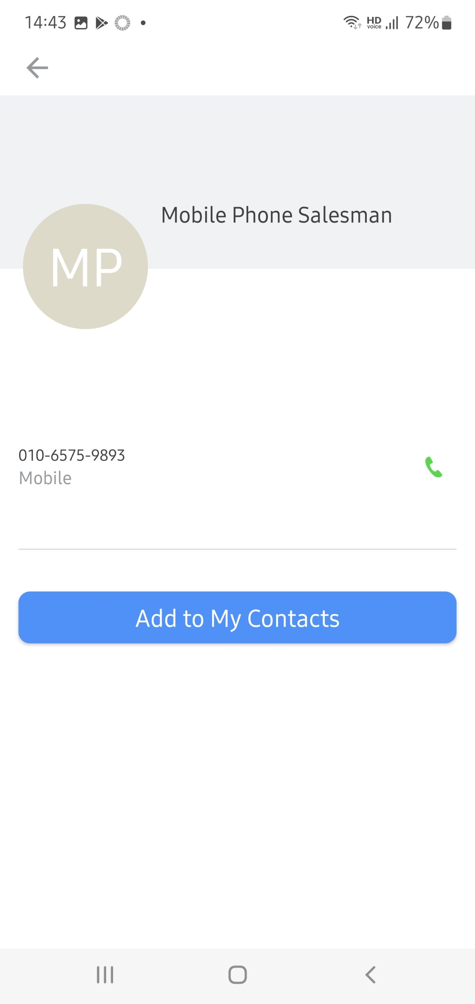
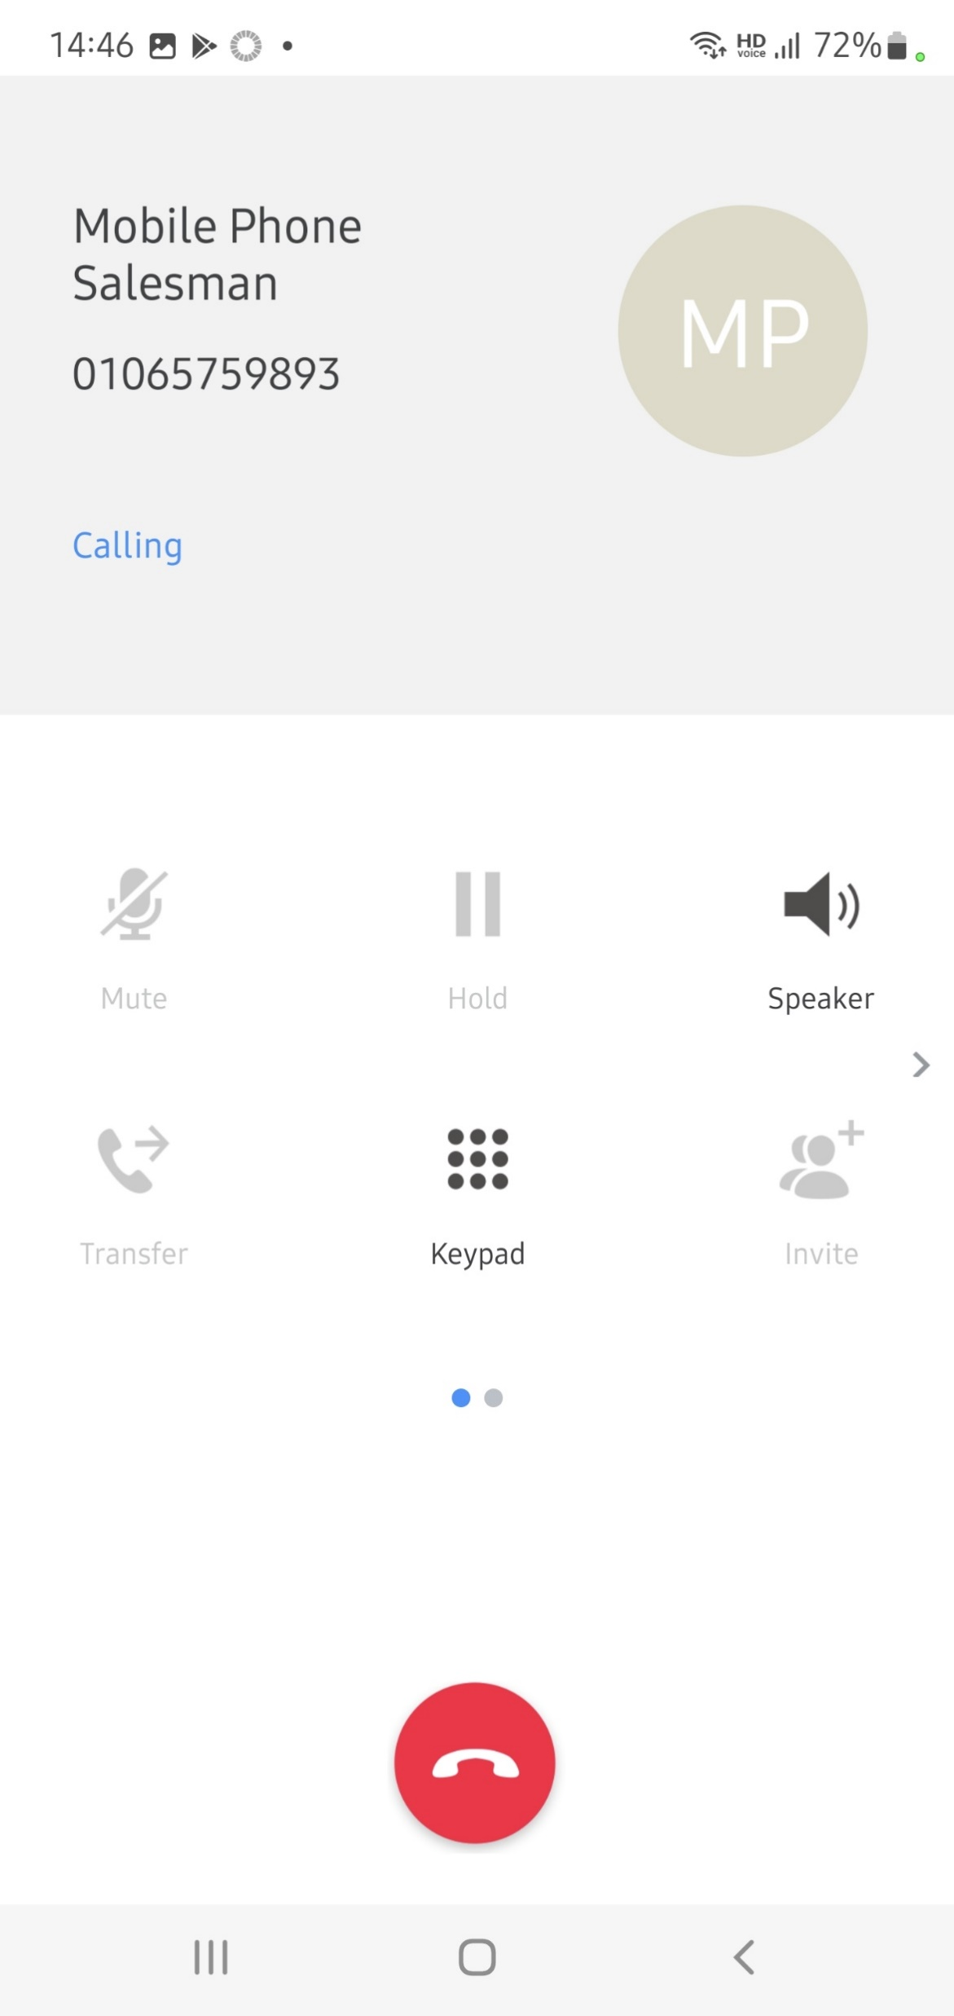
Native Mobile Contacts
Mobile phone contacts are now integrated to iOS and Android devices.
Mobile
Phonebook

Slide 14
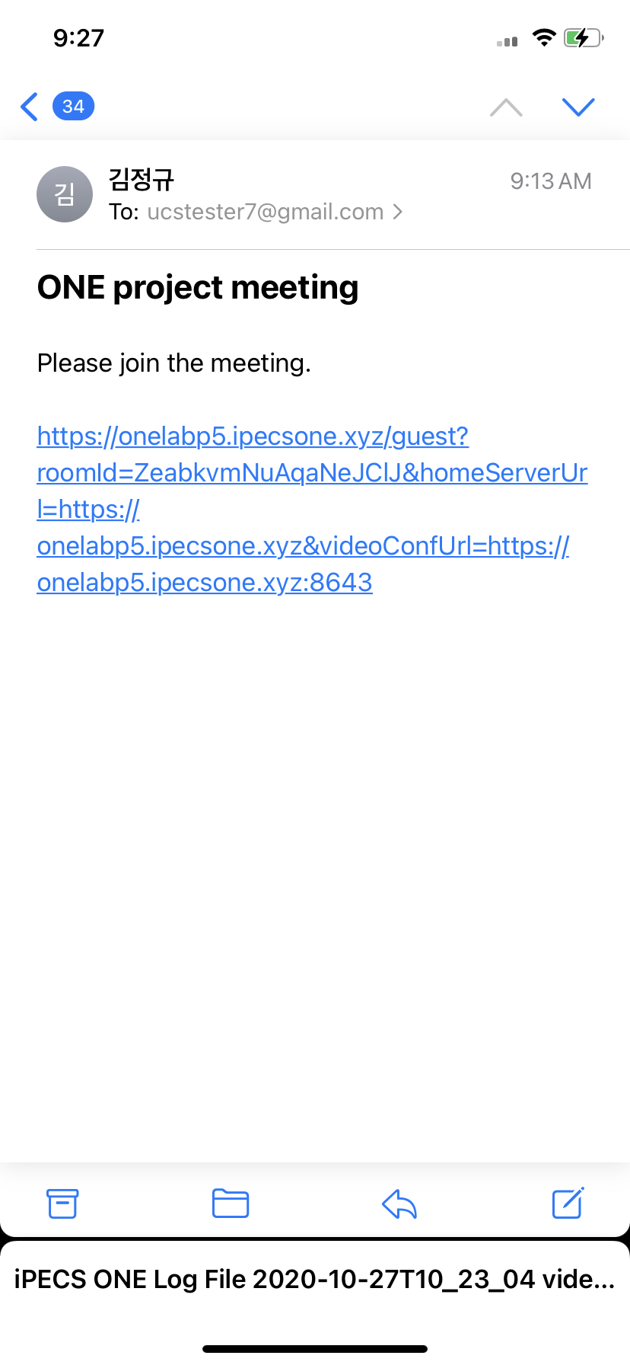
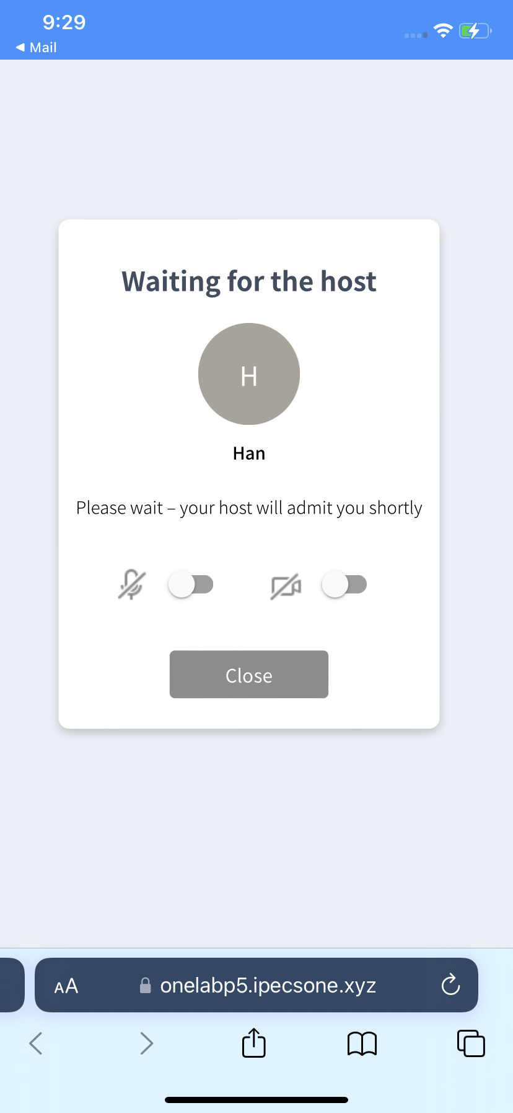
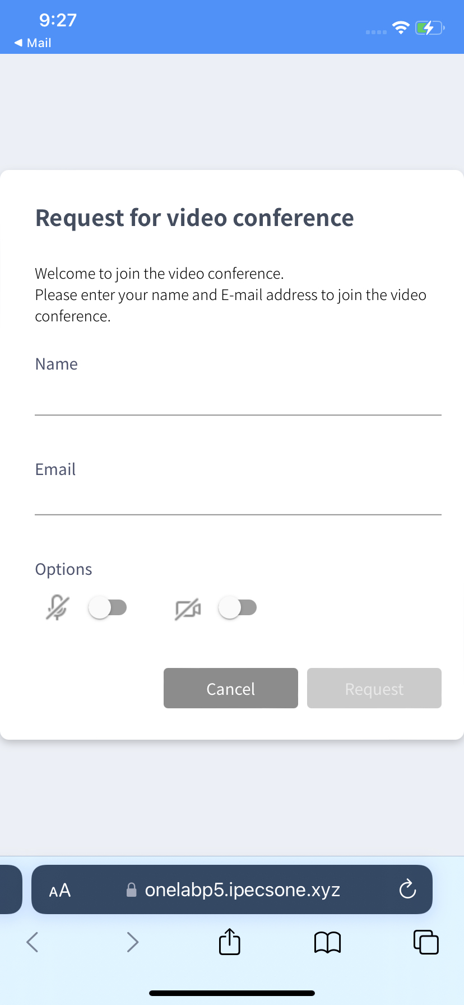
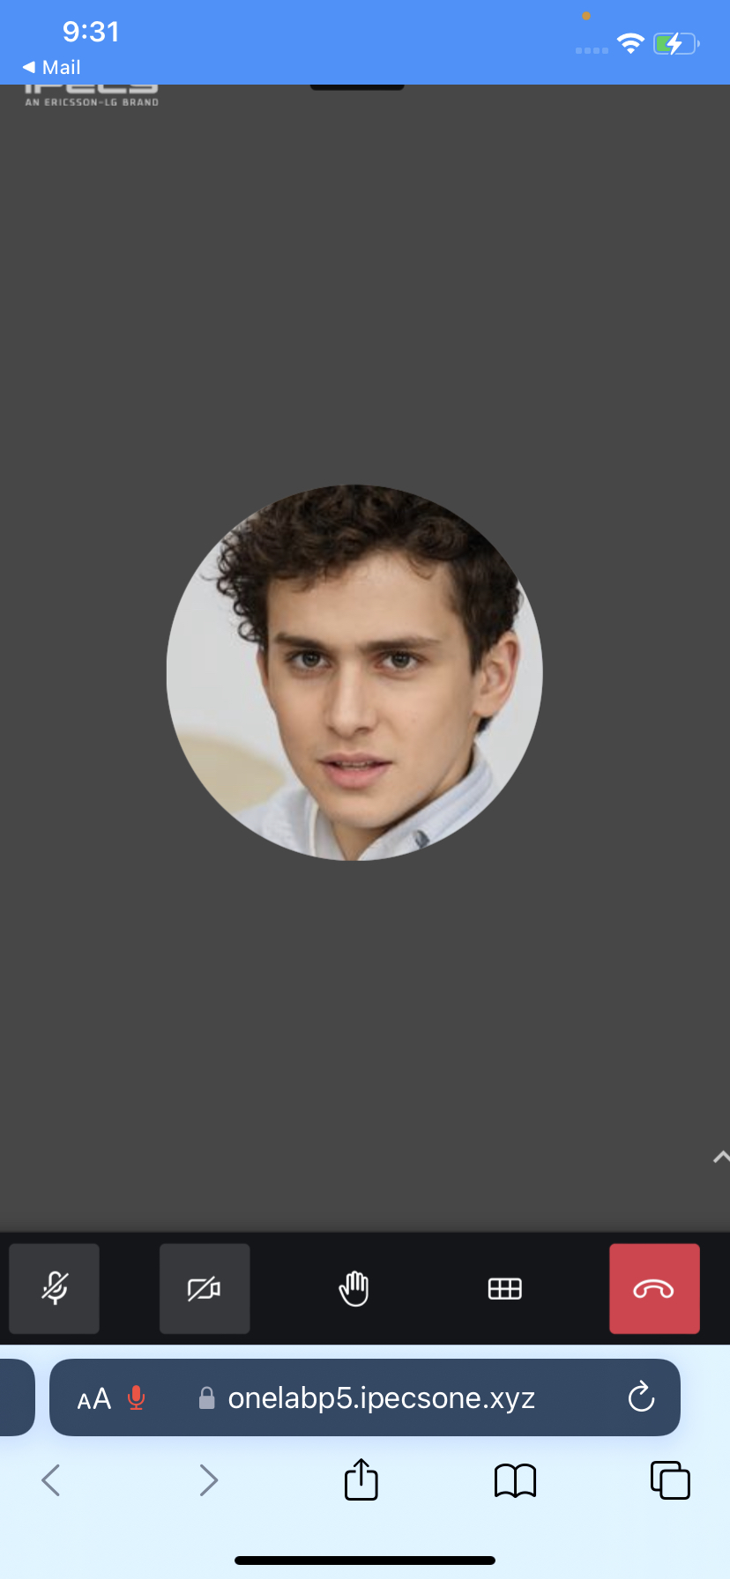

iOS Guest Access
Guests joining a Spaces video conference from a mobile Web browser now have full control with the new mobile guest access feature.
Guests (non-iPECS One collaboration users) can join a Video Conference by clicking the guest URL link in the invitation e-mail.

Slide 15
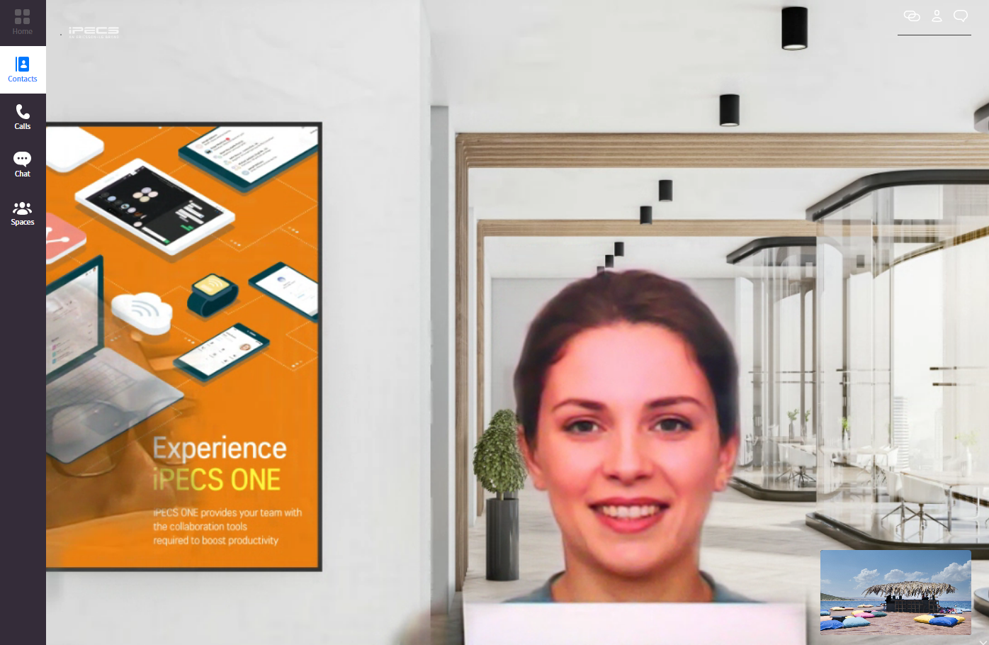

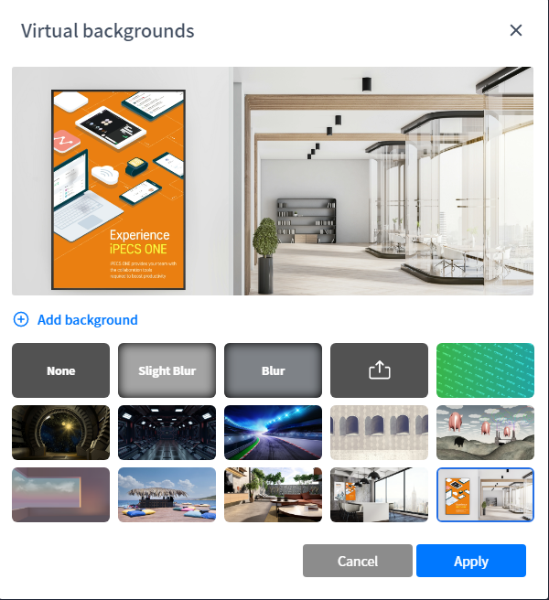
Spaces background config
Background customisation is available for iPECS One Web Clients.
Background blur or Background image change
Images can be uploaded. These images are stored locally.
Choose a background

Slide 16
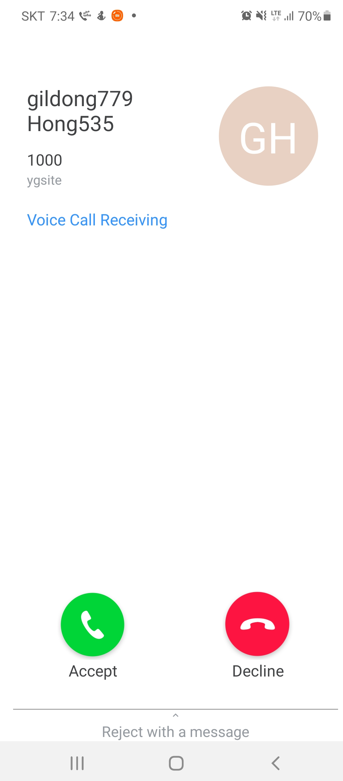
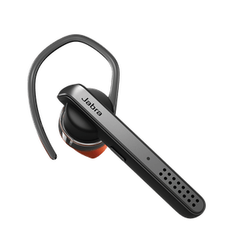
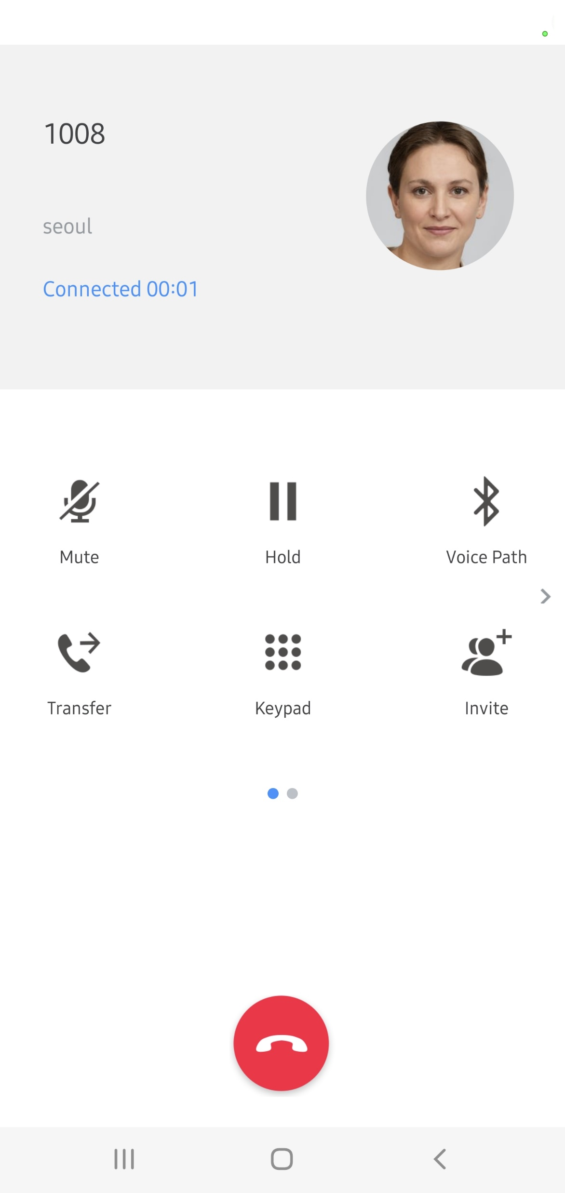
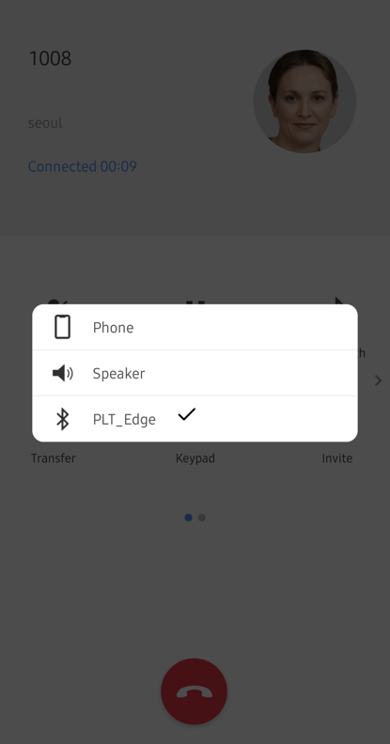

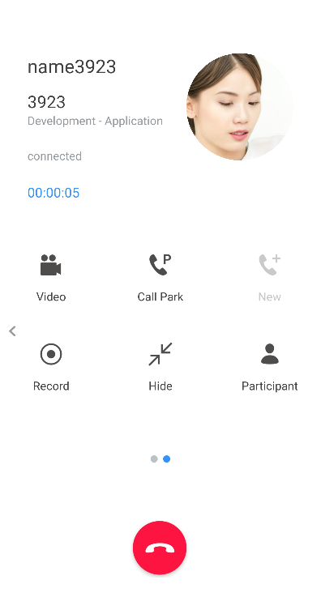
Bluetooth Headset Integration
Bluetooth Headset Integration is now available on iOS and Android devices.
Audio path selection during calls : Mobile phone / Speaker / Bluetooth headset
Call control using bluetooth headset buttons : To answer / end calls
Answer Calls with Bluetooth headset
Audio path selection
End call with bluetooth headset

Slide 17
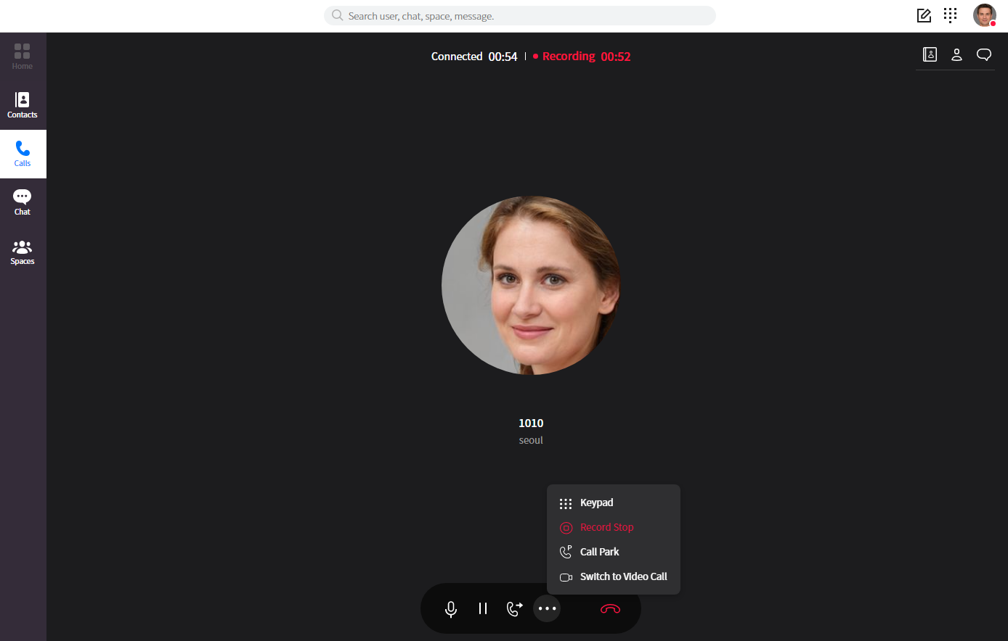
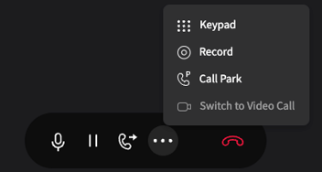
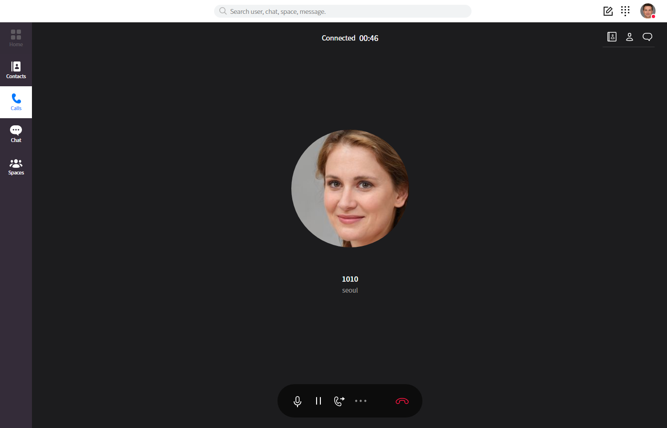
Call Recording Start / Stop
It is now possible to stop and start call recording for iPECS One users with ACR enabled.
Restart Call recording
Stop Call recording

Slide 18
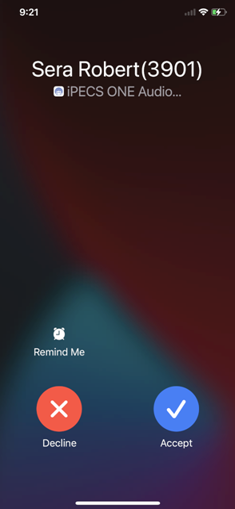
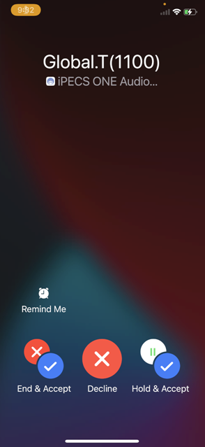
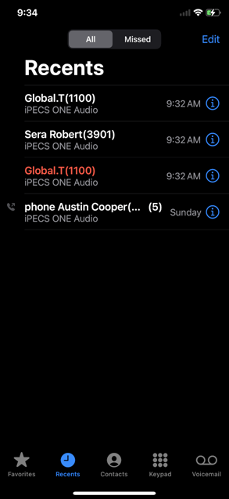
iOS CallKit Enhancement
iOS Callkit enhancements bring:
iPECS One calls showing in the native call log for incoming calls.
The native call UI is shown on iPECS One calls.
Make iPECS One calls from the native call log.
Any call placed or received with ONE client will be logged into the phone logs like a normal (native) call.
Incoming call
ONE incoming during ONE call
Click to call
in native call log

Slide 19
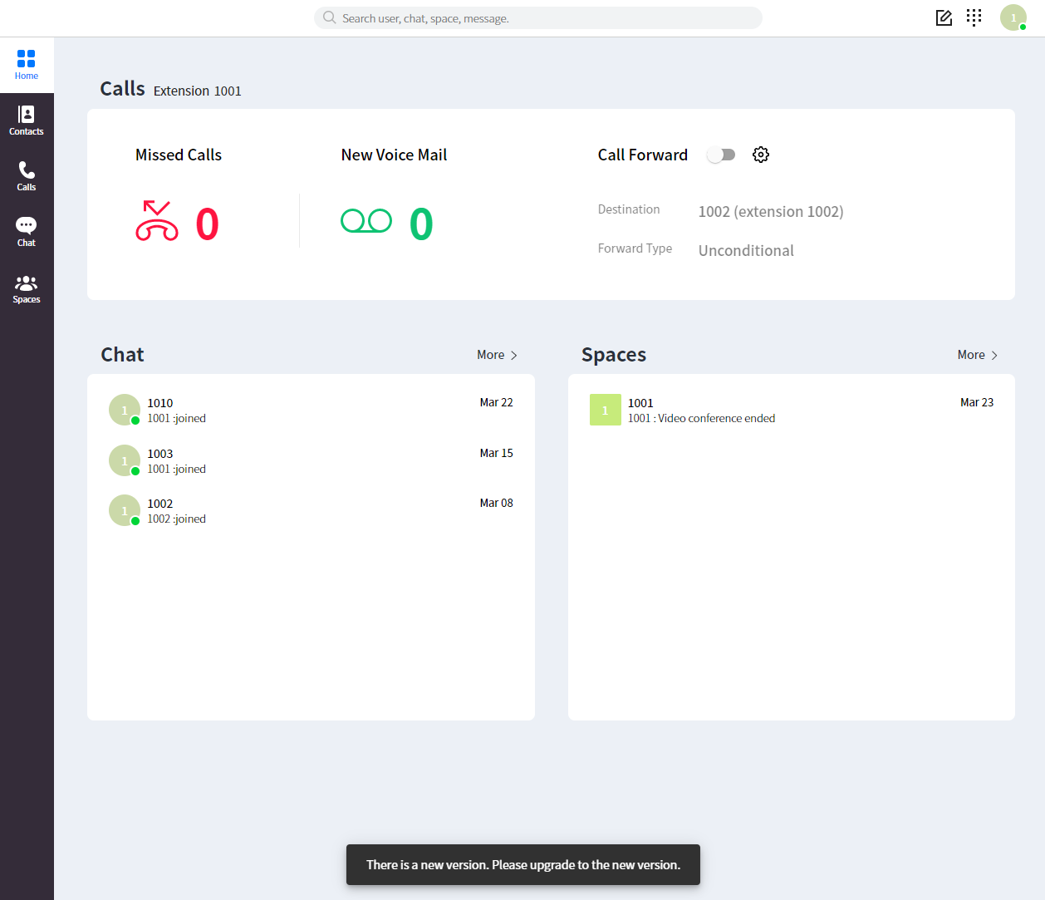
New Version Notification
When a new version of the iPECS One web client is available a notification will be displayed to users on login prompting them to upgrade their client.
There is a new version. Please upgrade to the new version.

Slide 20
iPECS Analytics V3.0

Slide 21
IPECS Analytics
iPECS Analytics provides powerful call analytics and reporting information for customers across key areas, including:
  Real-time reporting
  Historical reporting
  Custom Wallboards
  ACD/Hunt Group call stats
  Scheduled email reports

Slide 22
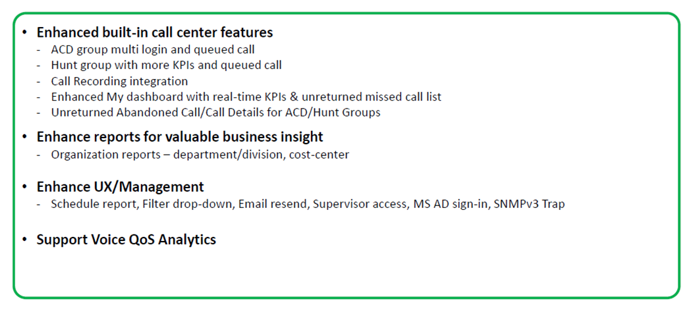
Summary of Changes

Slide 23
Microsoft Azure Active Directory Sign-In
What is this?
  Where customers utilise Azure Active Directory within their business, Supervisors can use their Microsoft Sign-In to access the Analytics Manager portal.
Benefit: Less passwords for customers to manage means easier access to the Analytics Manager portal saving time and hassle.

Slide 24
ACD Multi-Login: Agent Status
What is this?
  Ability to monitor the status of ACD agents/users across multiple groups.
Benefit: Supervisors get instant views of Agent availability and status across multiple teams allowing them to quickly and easily re-assign resource where needed.

Slide 25
ACD Multi-Login: Group Wallboard
What is this?
  Supervisor view of All Agents available and logged in across all ACD groups
Benefit: Instantly view all key stats for across the business. Spot potential issues and drill down to specific groups.

Slide 26
ACD Multi-Login: Agent Call Summary
What is this?
  At-a-glance stats for all agents across all groups.
Benefit: Align resource where it is most needed and quickly adapt to change call volumes and demands.

Slide 27
ACD Multi-Login: Group Summary
What is this?
  At-a-glance stats for all groups with a line-by-line view of each Group.
Benefit: Monitor overall business performance and simultaneously understand how each individual group is handling calls. This has the potential to help supervisor react quickly to potential issues by re-assigning resource.

Slide 28
Live Calls: Queued Call Information
What is this?
  Live queued call data presented to ACD and Hunt Group wallboards.
Benefit: Instantly view and react to calls that have exceeded business KPIs. Customers have more insight to regular Hunt Groups as well as ACD offering more flexibility around customer deployment options.

Slide 29
Hunt Group KPIs
What is this?
  More KPIs have been made visible within Analytics 3.0:
    Calls In Queue
    Longest Wait Time Today
    Average Abandoned Time
    Bounced Call Count
Benefit: More data means businesses are better placed to react to call volumes and improve customer service.

Slide 30
Custom Wallboard KPIs
What is this?
  Live KPIs can be added to custom-created wallboards:
    Live Calls
    Queue Count
    Unreturned Missed
    Unreturned Abandoned
Benefit: With more stats available to custom wallboards Customers have even greater control over the type of data available to them for monitoring and manager their call traffic.

Slide 31
Group Unreturned Abandoned Report
What is this?
  KPIs and a detailed list of Unreturned Abandoned calls presented to supervisors.
Benefit: A clear view of the most important call stats for any business allows teams to react quickly and respond to customers whilst allowing businesses to understand where resource issue may exist. It might be that one last chance to retain an unhappy customer!

Slide 32
Call Recording Integration
What is this?
  Where recordings exist, users can play and download the files. This applies to multiple areas within Analytics:
    Company Summary
    DDI Call Details Report
    Hunt Group Call Details Report
Benefit: Boost any compliance requirements for Customers with Call Recording information stored alongside all call data for ease of access. Supervisors can also quickly search within call records on the back of customer complaints.

Slide 33
QoS Monitoring for 1000i IP Phones
What is this?
  Instantly monitor call quality via a pre-built QoS wallboard. Reports can be filtered by Hour/Day/Week/Month.
  Reports are available as a top-level wallboard, call summary, extension summary or call detail levels.
Benefit: Pragma and Reseller support teams can utilise this data to spot issues and assist with the triage process if Call Quality issues are reported
NOTE: 1000i IP Phones ONLY. iPECS ONE currently not supported. Thresholds and Colour Codes can be set and customised for each problem indicator.

Slide 34
Scheduled Report Enhancements
What is this?
  Improved report format and schedules for Company Summary Report.
Benefit: More flexibility for Customers with how and when reports are distributed to key staff.

Slide 35
Change KPI Colours
What is this?
  Select individual KPIs in a wallboard or change all colours via settings.
Benefit: Customers can enhance the data that is most important to them with colours that align to their requirements.

Slide 36
Cloud Portal Data Sync
What is this?
  Where Customer data already exists in the Cloud Portal it is automatically synchronised to Analytics. This includes any Alpha Tag information.
Benefit: Save time at initial setup of Analytics and ensure that correct information is displayed across Customer Summary and Customer Call Details reports.

Slide 37
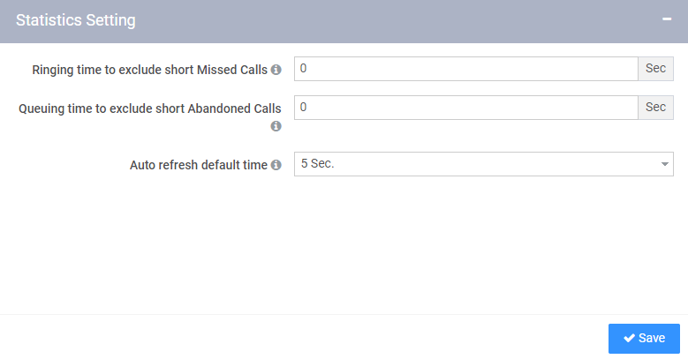
Excluding Short Calls
What is this?
  Abandoned and Missed calls can be disregarded from statistics if they do not exceed a set value.
Benefit: Prevents call statistics from being saturated with accidental or short calls.

Slide 38
Excluding Short Calls
What is this?
  Abandoned and Missed calls can be disregarded from statistics if they do not exceed a set value.
Benefit: Prevents call statistics from being saturated with accidental or short calls.

Slide 39
Default refresh timer
What is this?
  A default refresh timer can be set here that will be applied to all Wallboards. (Minimum value is 5 seconds)
Benefit: Allows a single value to be set across all Wallboards, rather than changing on a case-by-case basis.

