Slide 2
iPECS Cloud v4

Slide 3
Cloud v4 Feature Overview
Ability to use the cloud as a trunk on an on-premise PBX
Link customers on the same CM together using Customer Groups
Upgrade user licenses
Lite User License
1080i Handset
DDI Alpha Tagging and bulk change
Digit conversion / LCR
IP Dect multi-client
Shared line portal config for auto dialling voicemail
Hunt group forward via handset
Breakout from personal voicemail

Slide 4
Customer Group
Overview
Multiple customers (tenants) can be grouped together as a single customer group
This gives the ability to dial ‘internally’ between customers
BLF is supported between customers
Note: customers must be on the same CM for this to be enabled.
iPECS Cloud
Customer Group
Customer A
Customer Access Code 1*
Customer B
Customer Access Code 2*
Customer C
Customer Access Code 3*
Dial 3*1000
Toll-free internal calls
From 1*1000
Ext. 1000
Ext. 2000
Ext. 1000

Slide 5
Customer Group
There is two ways of setting up a customer group. For existing customers, you will need to check which CM the customers you would like to group are using.
This can be done in the Customer Info. Menu in the reseller portal. In the CM ID field you will see the CM number.
If the CM number is the same for the customers you would like to group then you will need to request that Pragma group these customers together.

Slide 6
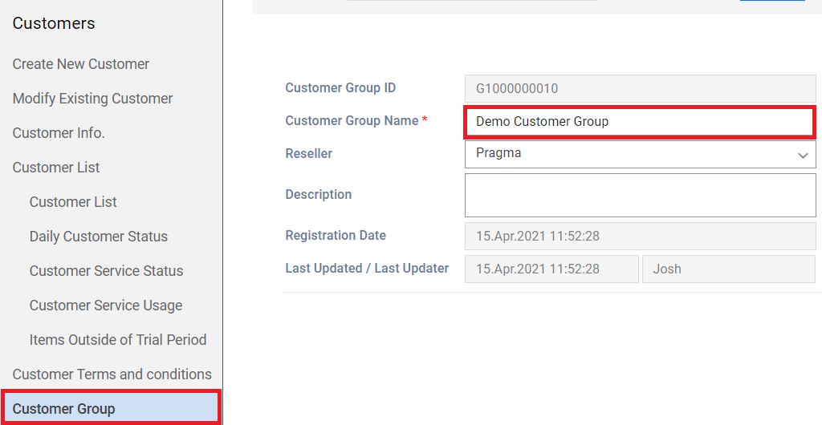
Customer Group
For new customers, in the reseller portal in the Customer dropdown go to the Customer Group menu.
Within here click add then give the Customer Group a name and save.

Slide 7
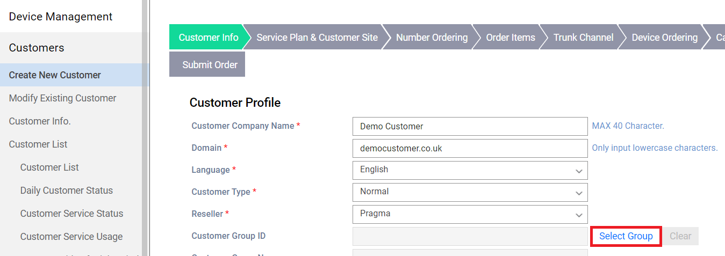
Customer Group
Then, when ordering a new customer click the ‘Select Group’ button

Slide 8
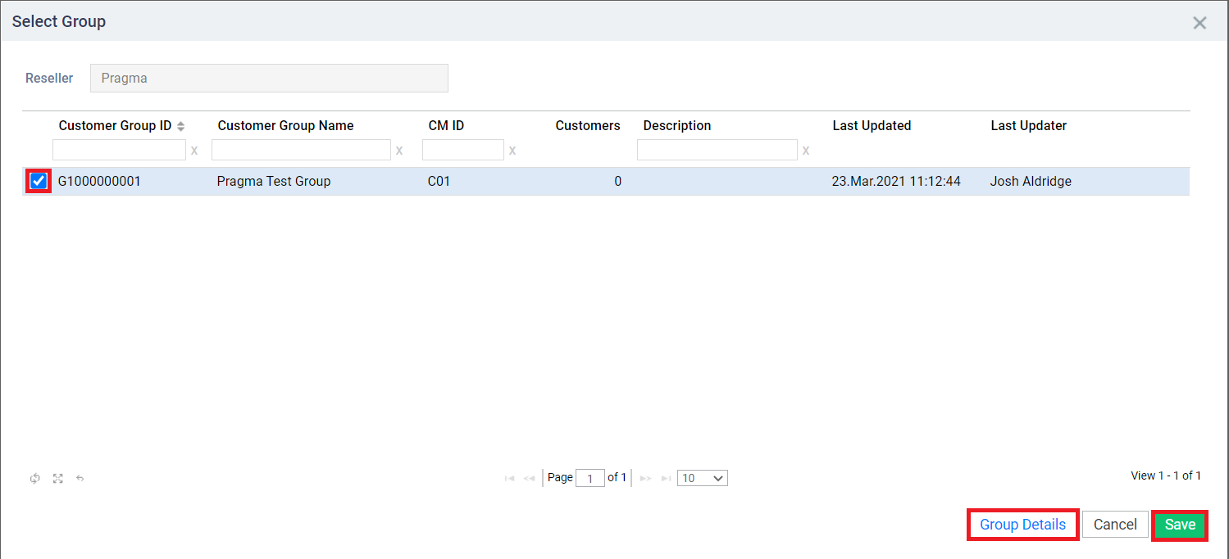
Customer Group
The customer group window is now displayed. From here you can see the customer groups you have created. To view the customers currently within a group, select the group then click the Group Details button.
To add the customer to a group, select the tick box on the left next to the group you would like to add them to and then click save.

Slide 9
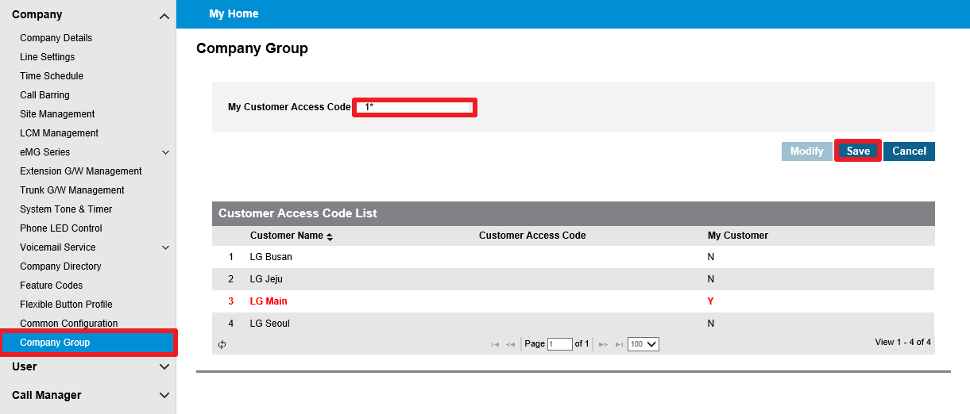
Customer Group
After the group has been setup. Within the customer manager portal go to the Company Group menu.
Within this menu you will need to configure the Customer Access Code so that other customers can be dialled – this number must be unique to this customer. Click modify and set the customer access code for the customer you are currently logged in to.

Slide 10
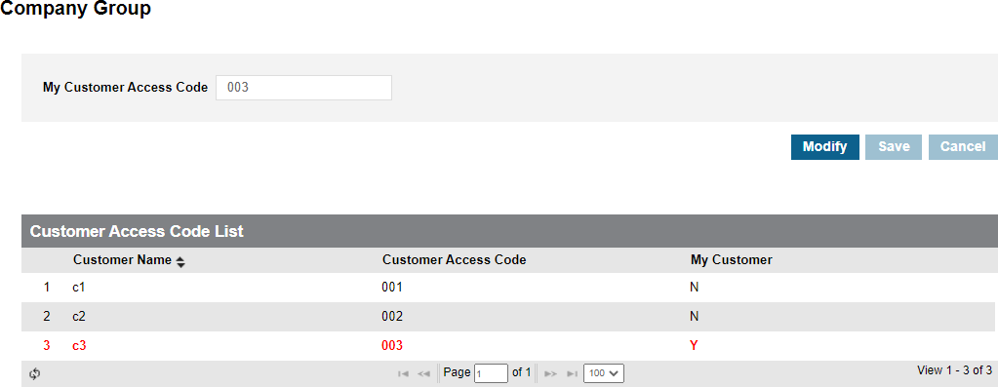
Customer Group
Operation
To call an extension on another customer within the customer group, the user needs to dial the customer access code + extension number
When dialling internal extensions on the same customer, only the extension number needs to be dialled.
Note: It is not possible to seize other customer’s trunks.
iPECS Cloud
Customer C1
Customer C2
Customer C3
Dial : 0031000
Dial : 1001
Dial : 0021000
Ext. 1000
Ext. 1001
Ext. 1000
Ext. 1000

Slide 11
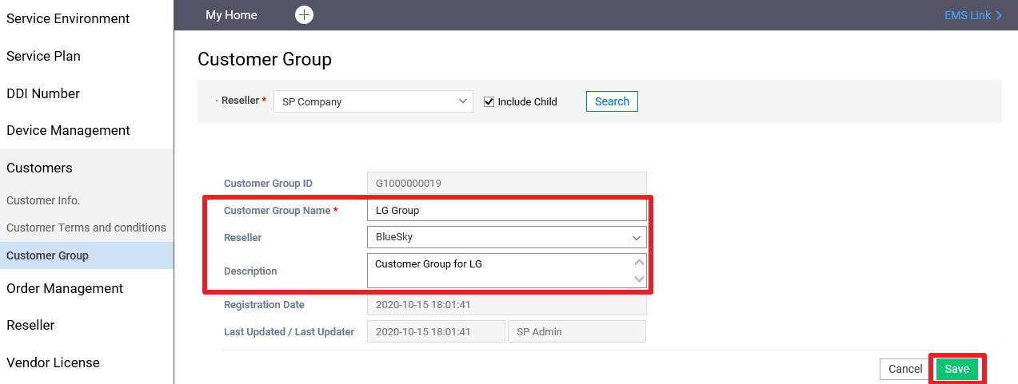
Customer Group – SP Portal
Create Customer Group for existing customers
OMS SP Portal
Customers >Customer Group
Go to the customer group menu and choose [Add] to make a new group.
Enter Customer Group Name and Description if necessary and select Reseller.

Slide 12
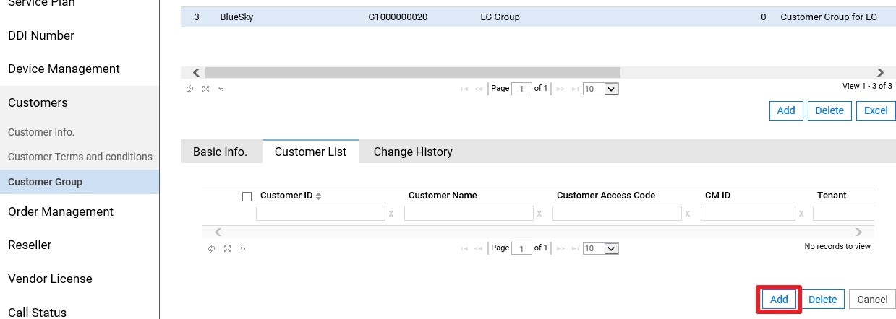
Customer Group – SP Portal
Create Customer Group for existing customers
OMS SP Portal
Customers >Customer Group
Select a group and then choose the Customer List tab.
Press [Add] to insert members to the customer group.

Slide 13
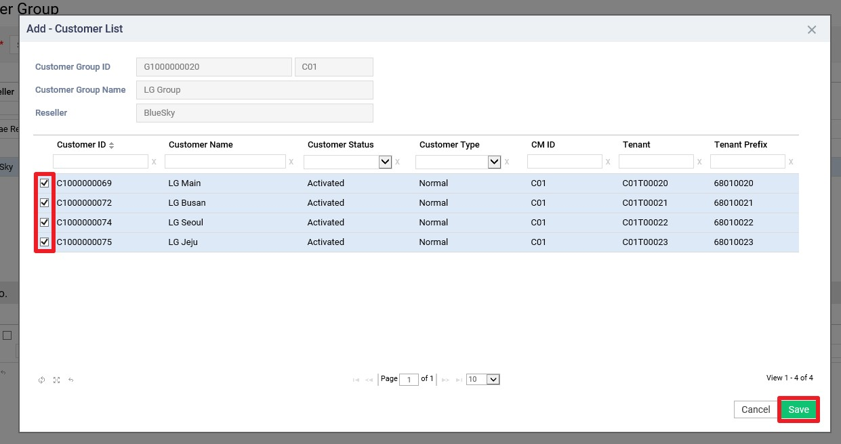
Customer Group – SP Portal
Create Customer Group for existing customers
OMS SP Portal
Customers >Customer Group
Select a customer ID by clicking the checkbox and press [Save].
For customers to be in a group they must be on the same CM.

Slide 14
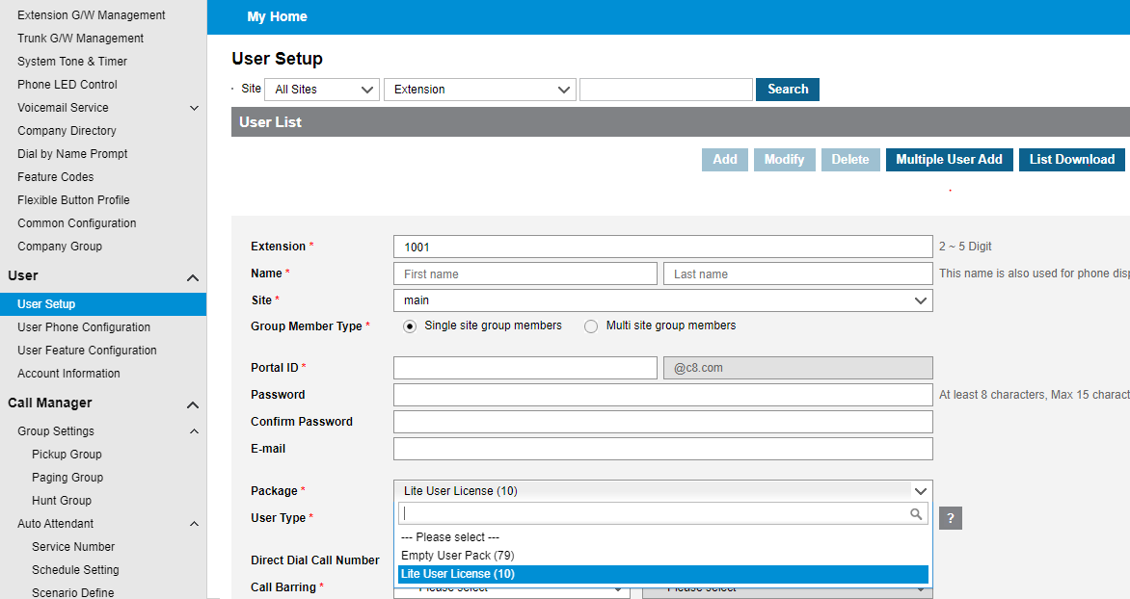
Lite User License
Overview
Lite User license is a new user license type with reduced functionality and a lower price.
Any ordered feature items will be blocked for Lite user’s so that they can not be assigned to a Lite user in the customer manager portal.
Blocked features;
Voice Mail
Call Recording
Multi Client (UCE, iPECS One, iPECS2Teams, iPECS Cloud Mobile)
Soft Client (UCE, iPECS One, iPECS2Teams, iPECS Attendant)
ACD Agent / Supervisor
Web Fax
UCE Call Control / One Entry
Lite User license can co-exist in the same cloud company as normal user license.
This is ordered and setup on the user the same way a normal license is.

Slide 15
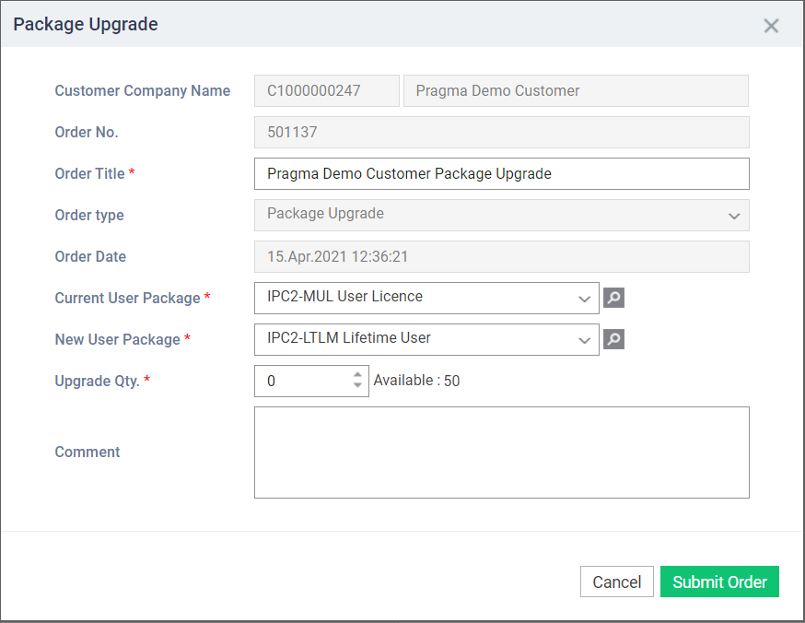
User Package Upgrade
Until Cloud V4 changing the license type on a user was not possible, the user would need to be deleted and re-added with the new license type.
In Cloud V4 you are able to upgrade the user license type. The license being added to the user must include all features that the current user license has - a downgrade is not possible. For example, a Monthly user license cannot be changed to a Lite User License.
To upgrade the license type in the reseller portal go to Modify Existing Customer and select the customer then choose the Package upgrade button
The Package Upgrade window will now be shown.
In the Current User Package dropdown select the license you want to upgrade.
In the New User Package dropdown select the license type you want to upgrade to then enter the amount of license you wanted to upgrade and then click submit order.
This will then come to Pragma for approval then you will need to final confirm like a normal order.

Slide 16
User Package Upgrade
Now, in the customer manager portal within User Setup click change next to the package type on the user.
Now you can change the package type on the user. Select the relevant option then the new license type from the dropdown and save.

Slide 17
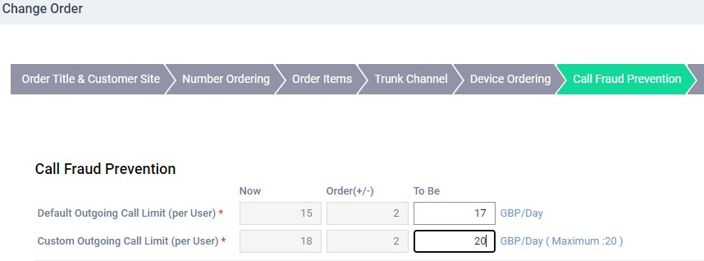
Changing Call Fraud limit
OMS Reseller Portal
Customers > Modify Existing Customer > Change Order > Call Fraud Prevention tab
Order process remains the same as other orders
Call fraud limit can be seen from > Customers > Customer Info > Basic Info tab > Fraud Prevention
OMS Reseller Portal

Slide 18
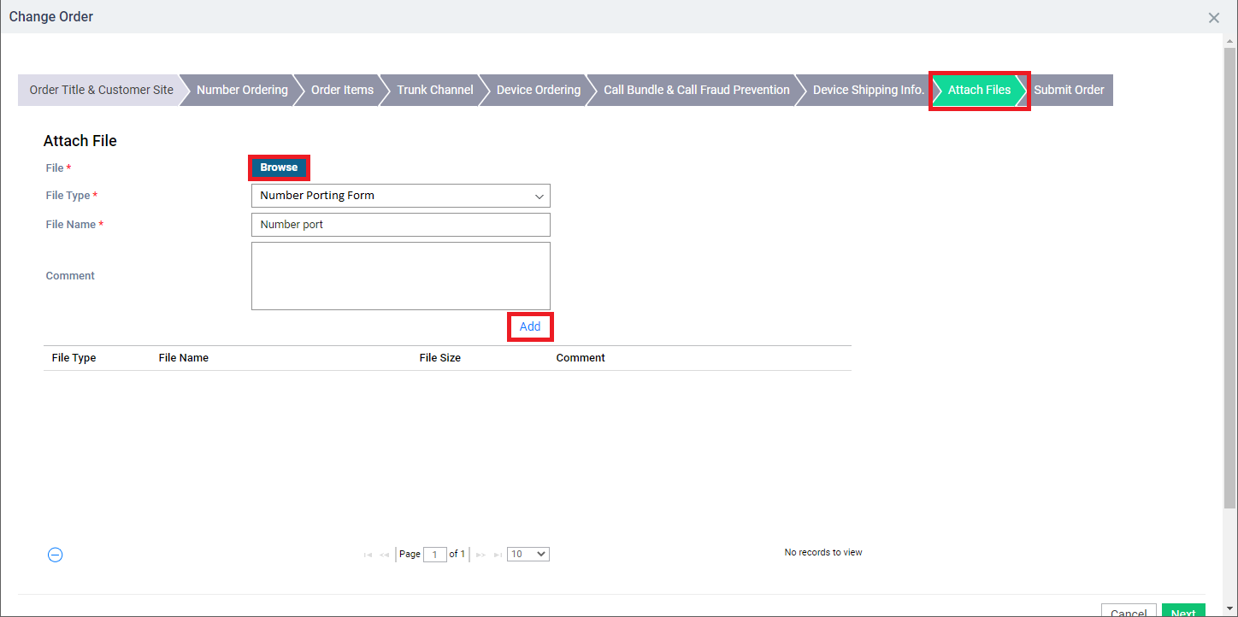
Attaching files to order form
In Version 4 you are able to attached files to an order e.g. a number porting form.
On the order form go to the Attach Files tab when you can upload and add and file.

Slide 19
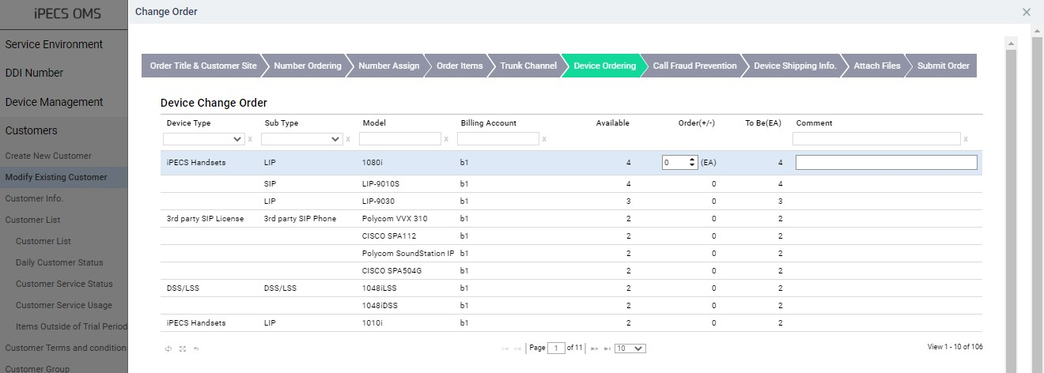
1080i /1048iDSS / 1048iLSS
Overview
1080i / 1048iDSS / 1048iLSS is added as a new device in Cloud P4.0
It can be ordered in the reseller portal and added manually in Un-shipped device allocate
User creation is the same as other 1000i handsets in the customer manager portal.
OMS Reseller Portal
Customers > Create New Customer or Modify Existing Customer > Device Ordering tab

Slide 20
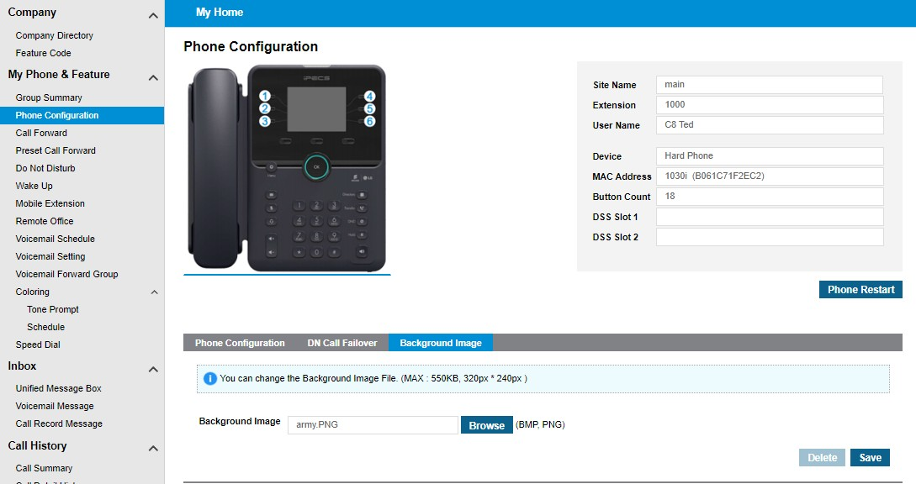
1000i Background Image Provisioning
You are now able to change the background image on a 1000i handset via the portal. To do this go to;
Customer User Portal
My Phone & Feature > Phone Configuration > Background Image tab
Within this menu click browse and upload the image, then click save.

Slide 21
DDI Alpha tagging
You can now alpha tag DDIs within the DDI summary menu. There is an alpha tag field for each DDI. The text entered here will display on LIP handset screens when this DDI is called.
Note: the max character length is 24

Slide 22
DDI Summary Bulk Change
It is now possible to do a bulk change on the DDI summary page. Click Bulk Edit and a spreadsheet style form will show where you can change multiple DDI configurations at once.

Slide 23
Digit Conversion
Overview
The digit conversion feature was previously configured on the CM (backend), but configuration via the portal was not available before Cloud 4.0.
In Cloud 4.0, it can be configured on the Customer Manager Portal.
The digit conversion feature converts dialed digits to pre-defined numbers.
On the cloud platform it is possible to dial out without need to dial a 9, below is an example of how this is achieved.

Slide 24
Digit Conversion
Configuration
Example
. Adding trunk access code(9) for external number(10 digit starting with 0) in case of call log dialing 0XXXXXXXXX > 90XXXXXXXXX
‘X’ means all digits(0~9)
If a user dials 0105553939, it will be converted to 90105553939.
If 9 is set as the trunk access code, the call will seize the trunk and dial out to 0105553939.

Slide 25
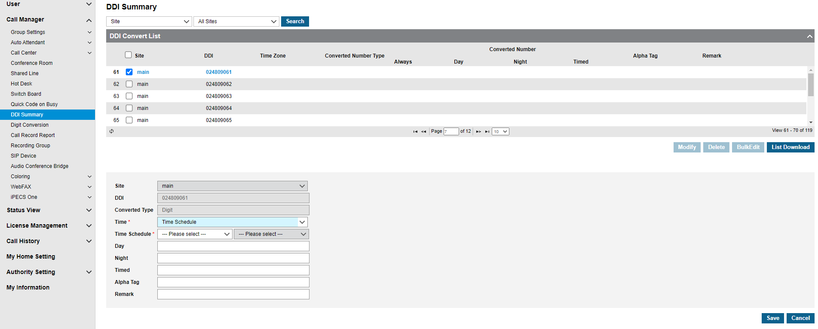
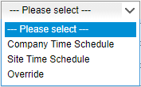
Time Schedule per DDI
Different time schedule for each DDI number
Customer Manager Portal
Call Manager > DDI Summary
Time schedule can be configured for each DDI number
Select [Time Schedule] from ‘Time’
Company Time Schedule : Company's Time Schedule is automatically selected
Site Time Schedule : Site Time Schedule is automatically selected
Override : Select from the Time Schedule list

Slide 26
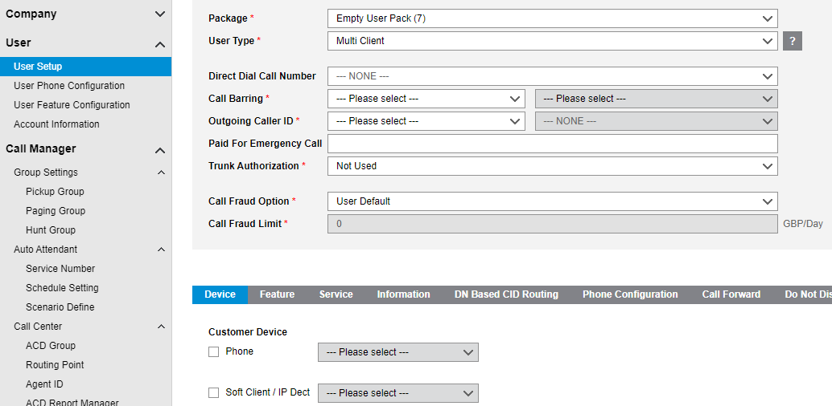
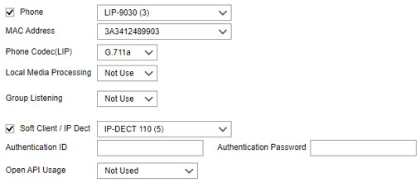
IP Dect Multi Client
It is now possible to pair a hard phone with an IP Dect handset using a multi client setup.
Customer Manager Portal
User > User Setup

Slide 27
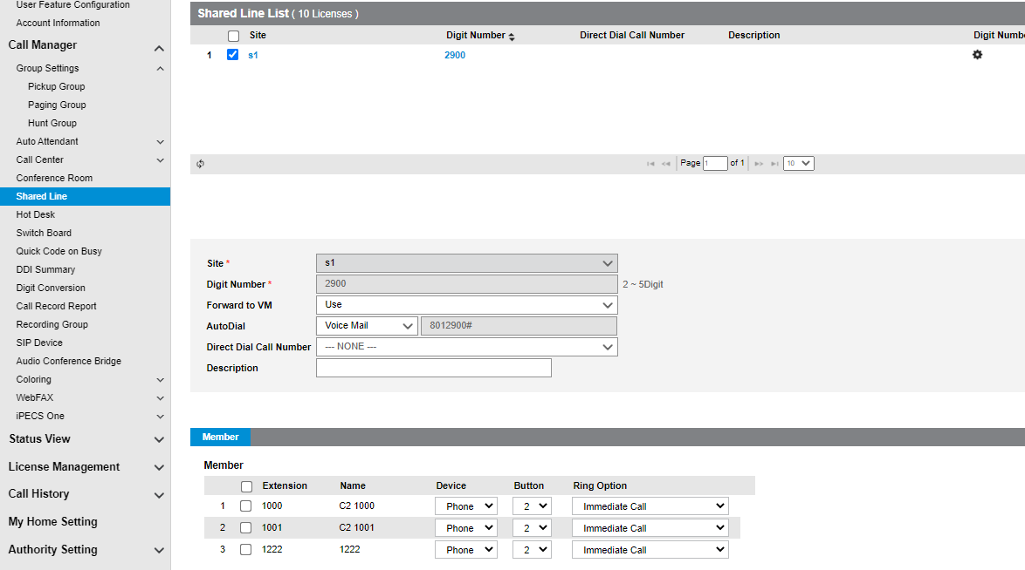
Shared line auto dial voicemail
Up until Cloud V4 to enable the shared line to dial voicemail Pragma would need to make a change on the backend. Thankfully this has been added to the Customer Manager in cloud V4
In the Shared Line menu, select the shared line and modify. You can then set the Forward to VM to Use and AutoDial to Voicemail.
Now when the shared line button is pressed it will dial voicemail and the user will just need to enter the password.

Slide 28
Hunt group forward via handset
Overview
Hunt Group Forward (Register), Hunt Group Forward (Cancel) feature code added have been added to the portal in cloud V4
If a hunt group member enters this feature code, a forward is registered on the hunt group.
Operation
If a hunt group member dials Hunt Group Forward (Register) feature code + hunt group number # + call forward type (1 Uncond, 2 Busy, 3 No ans, 4 Busy/no Ans) + call forward destination, a forward is registered to the hunt group.
When a call is placed to the hunt group, the call will be routed to the defined destination.
If the destination is a shared line number which is forwarded to voice mail, the call will be routed to the voice mail box.
If a hunt group member dials Hunt Group Forward (Cancel) feature code + hunt group number #, the forward setting is
cleared.

Slide 29
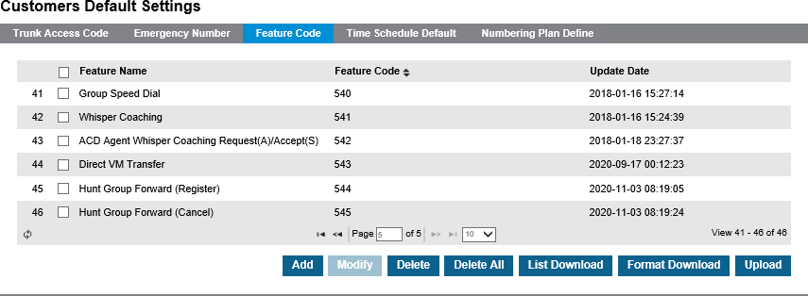
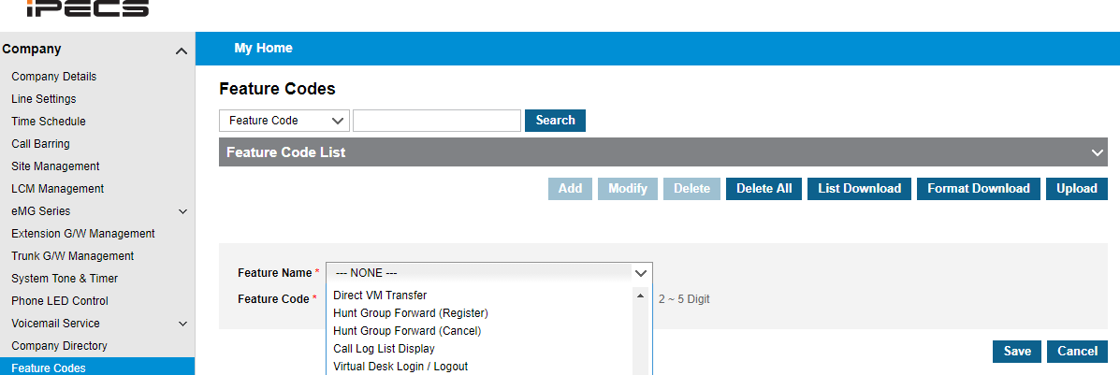
Hunt group forward via handset
Configuration
For new customers, the feature code is added automatically in Cloud v4
For existing customers, a new feature code needs to be added. In the customer manager portal, go to Feature Codes in the Company dropdown. Then go to add and find Hunt Group Forward in the list and add a feature code for both of the options.

Slide 30
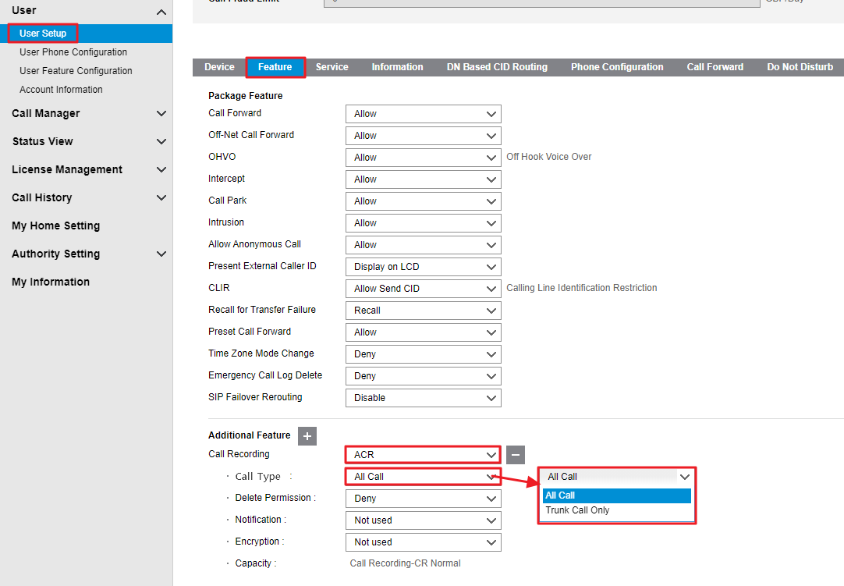
Call recording on internal calls
It is possible to select the type of calls that are recorded on an extension whether this is all calls or trunk calls only
Customer Manager Portal
> User > User Setup > Feature tab > Call Recording > ACR > Call Type
When the call recording type is ACR, There is now an option for All Call or Trunk Calls Only.
Option 1 (Default) : All Call Recording - Both internal calls and trunk calls are recorded.
Option 2: Trunk Call Only – Recording disabled for internal calls.

Slide 31
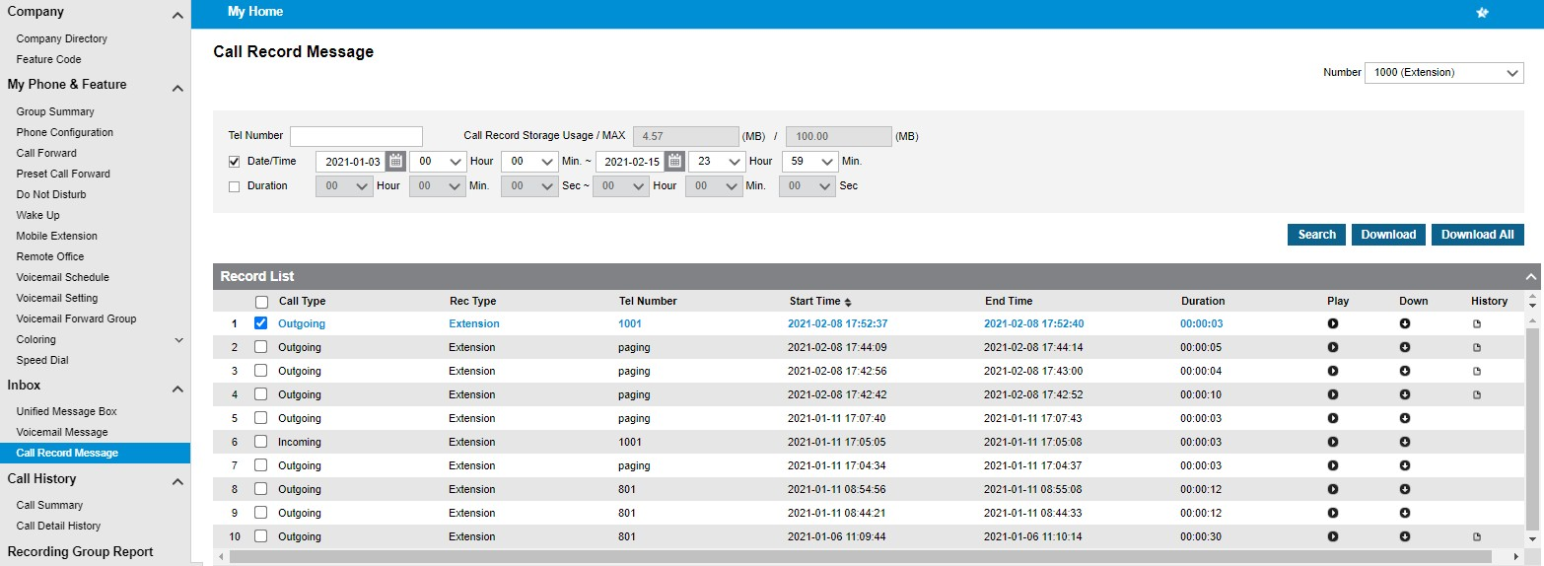
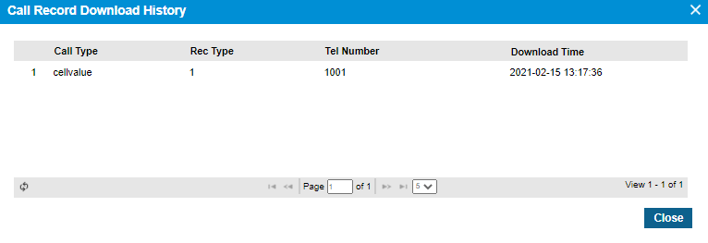
Download history for call recordings
Overview
Customer manager can check download history for call recordings in the customer user portal.
Customer User Portal
Inbox > Call Record Message

Slide 32
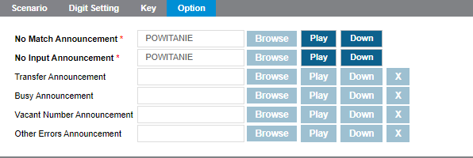
Download option for uploaded prompts
Overview
Within the customer manager portal, you can download previously uploaded prompts for Auto Attendant and ACD groups
Customer Manager Portal
Call Manager > Auto Attendant > Scenario Define

Slide 33
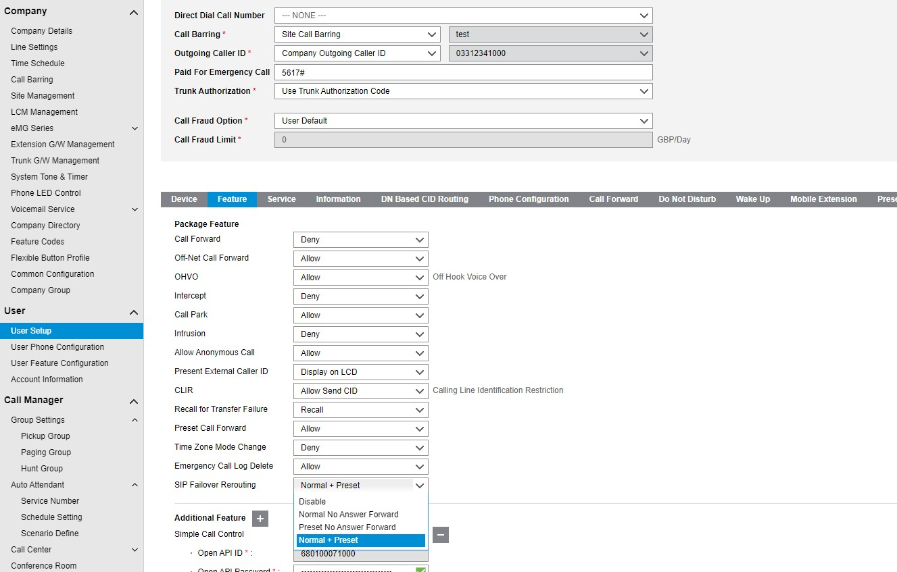
SIP device failover rerouting
Overview
If a SIP phone does not respond to an Invite message, incoming calls can be rerouted to specific number (No answer call forward / Preset no answer call forward number).
Customer Manager Portal
> User > User Setup > Feature tab > SIP Failover Rerouting
Within the dropdown you can select what you would like the extension to do in this scenario.
It will follow the selected forward which is configured in the User Feature Configuration menu.

Slide 34
Group listening
Overview
Description
Every iPECS Multi-button phone has a built-in Speakerphone. The user can activate the speaker after placing a call in the handset mode without activating the microphone. This feature allows other people to hear the conversation through the speaker without being heard over the microphone.
Operation
While on a call using the handset:
Press the [Speaker] button. The speaker is activated. The microphone is muted while the handset is off-hook.
Conditions
While using the Speakerphone, lifting the handset will turn off the Speakerphone. To activate Group Listening, the [Speaker] button must be pressed while the handset is off-hook.
While in Group Listening Mode, pressing the [Mute] button will cause the outbound speech from the handset to be muted. However, the voice is still heard over both the handset receiver and the speaker.
If full Speakerphone operation is desired, place the handset on-hook to cancel Group Listening Mode.

Slide 35
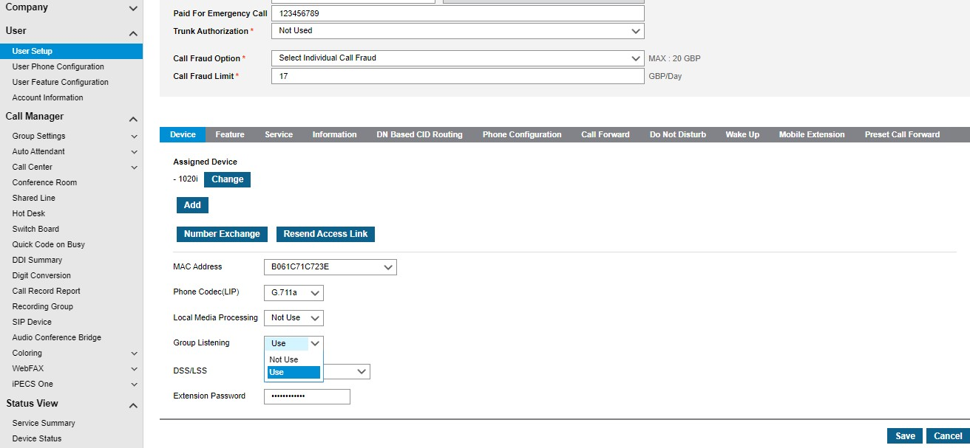
Group listening
Configuration
Enable the group listening option in Customer Manager Portal.
Customer Manager Portal
User > User Setup

Slide 36
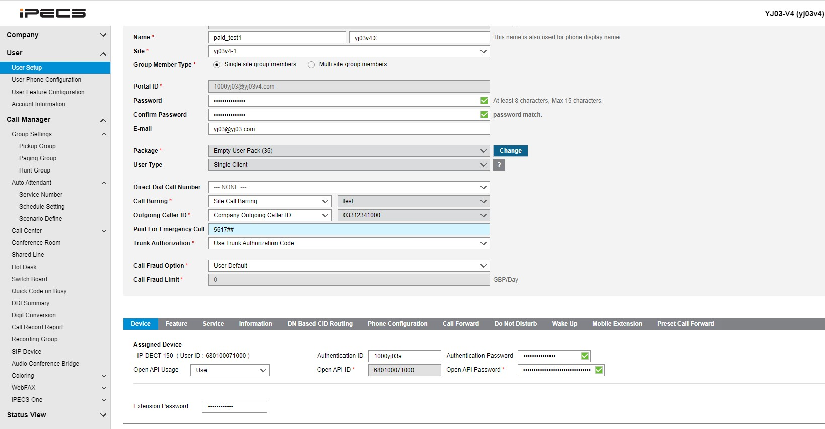
PAID For emergency call
Overview
If the CLI was to fail when dialling emergency services then the trunk bearer CLI would present. The E911 address for the caller would then be incorrect as the CLI is incorrect.
The ‘Paid for Emergency Call’ field ensures that the P-assert ID in the SIP invite is correct for this user.
Customer Manager Portal
User> User Setup > PAID for Emergency Call

Slide 37
View handset IP address and software version
Overview
You can view the software version, internal and public IP addresses of LIP handsets from the Device Status menu
Customer Manager Portal
Status View > Device Status

Slide 38
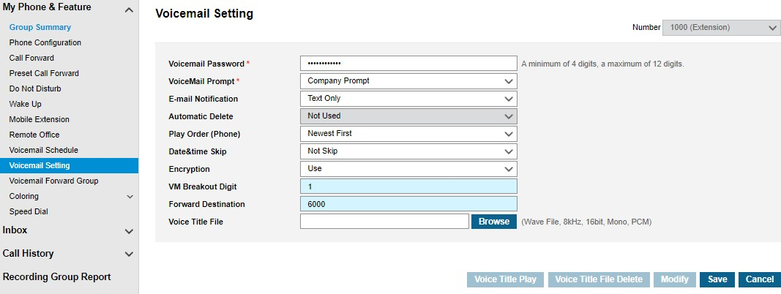
Breakout from personal voicemail
Configuration
Customer User Portal
My Phone & Feature > Voicemail Setting
Operation
A call is placed to Ext. 1000 when ext 1000 has set a call forward to voice mail.
The user greeting has been uploaded to explain the break out option in advance.
The caller listens to the user greeting (I am sorry, I’m not available now. If you want to speak to my colleague Press 1)
If the caller dials ‘1’, call will be routed to 6000.
If the caller doesn’t dial for 2 seconds, the normal voice mail announcement will be played.

Slide 39
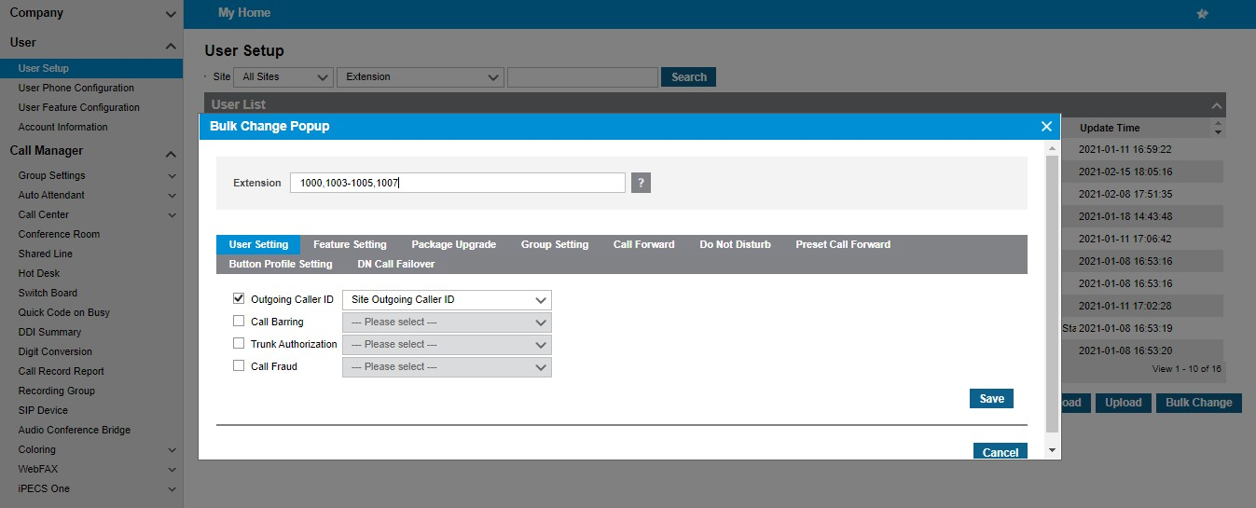
Mixed extension range for bulk change
Overview
In previous versions only 1 range of extensions could be modified on the bulk change feature on User Setup. ex) 1000-1007
In version 4 mixed ranges of extensions can be modified on the bulk change feature on User Setup. ex) 1000, 1003-1005, 1007
Customer Manager Portal
User > User Setup

