Slide 1

wqh

Slide 2

iPECS Cloud 3.5 Features

Slide 3
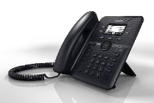
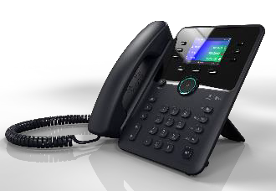
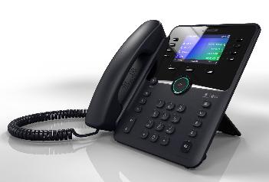
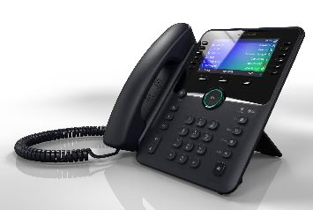
New Handset Range
With the launch of 3.5 this will enable support for the new 1000i handset range, this is due to be launched later this coming year.
1010i
1030i
1040i
1050i

Slide 4
Voicemail Enhancements
There is now the ability to mark voicemails as urgent when leaving a message.
This will show in the portal with the priority set to urgent instead of normal which is the system default.
You will also be notified that you have an urgent voicemail when logging in to listen through the handset.
When leaving a message, press the # key at the end of recording to get an additional menu, if you select option 3 your message will be left with urgency.

Slide 5
Voicemail Enhancements – Personal Voicemail Title
In 3.5 you are now able to have a personal Voice Title File, this will be automatically inserted when replying to voice mail messages or sending a new voicemail message for internal destination.
This can be configured from the Customer User Portal, under Voicemail Setting > Voice Title File
This must be in the same format as other system greetings Wav, 8kHz, 16 Bit, Mono, PCM

Slide 6
Voicemail Enhancements – Reply / Forward / Call Back
There is now 3 new voicemail features: Reply, Forward and Call back, this provides you with more options on how to utilize voicemail within the system.
Reply Voicemail
Only available between internal users
Personal voice title is added before the reply message.
Forward Voicemail
Only available between internal users
User can record their own message to play before the forwarded voicemail.
Call Back Voicemail
User can phone back to a number that has left them a voicemail
To utilise these features when listening to a message there are several options, to reply, forward or call back select option 5
You will then need to select the feature you would like to use as shown below.
Reply – When selected it will ask you to record the message you would like to reply with.
Forward - When selected it will ask you to record the forwarding greeting that will play before the voicemail that you are forwarding to complete press #. Once this has been set it will then ask you to enter the station number you will be forwarding the message to then confirm with #. You will then be asked to confirm that the station number you have entered press 1 if correct and 2 to enter a different station.
Call back – The system will list the extension number and you can select option 1 to confirm and call back.

Slide 7
Voicemail Enhancements – Creating and Sending VM
Within Cloud 3.5 there is a new feature that allows you to create voicemail and send this to another user when you are within your voicemail box.
If you use this feature and have a personal voice title already set this will be entered automatically.
To use this feature follow the steps below:
Dial voicemail
Enter your Password
Enter the digit 3 to create a new voicemail
You will be asked to record your message
You can then confirm you are happy with the message recorded with the option 1,option 2 allows you to review your message and option 3 will allow you to rerecord your message.
If you have confirmed you would like to proceed, you can then chose how you would like to send your message. Option 1 will send to an extension directly, option 2 will send to a distribution group and option 3 will use dial by name to find your message recipient.

Slide 8
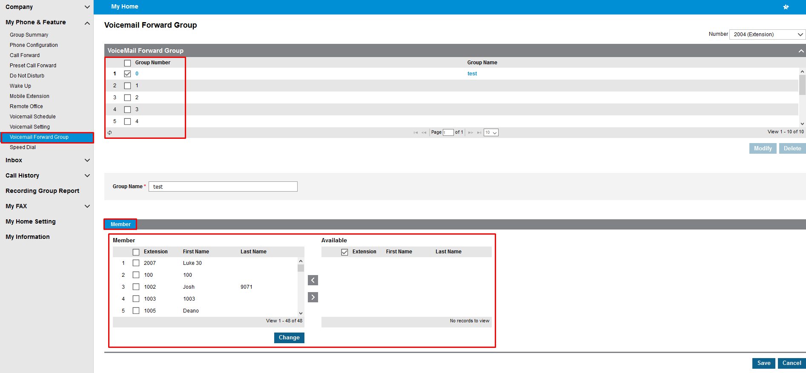
Voicemail Enhancements – Distribution Group
Within cloud 3.5 you now have the ability to route or reroute voicemail messages to a distribution group, this will enable multiple people to receive your message without having to repeat the process.
Distribution Groups need to be configured within the Customer User Portal within My Phone & Features > Voicemail Forward Group.
Each extension can have up to 10 groups configured.
Each Group can only have a maximum of 30 users in at a time.

Slide 9
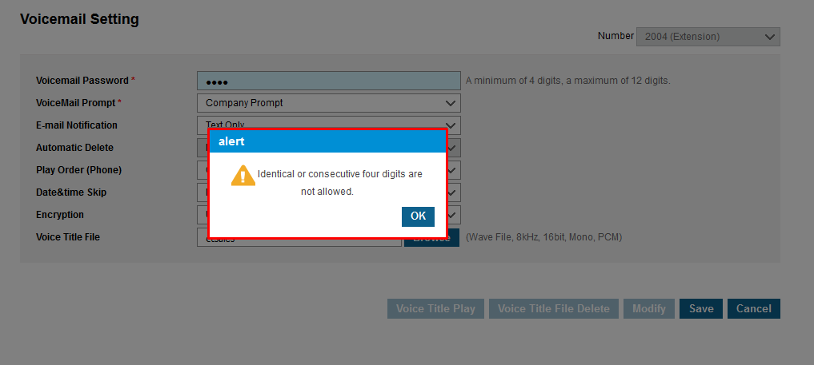
Voicemail Enhancements – Voicemail Password
Within the 3.5 upgrade we have added an increased security change for voicemail passwords.
Passwords have a length of 4 to 12 digits
You will no longer be able to set passwords with consecutive digits or multiples of only 1 digit.

Slide 10
Dial by Name - Overview
Dial by Name allows external callers and users the search for an extension if they do not know the station number but are aware of the users name. This feature is available on both voicemail and auto attendants.
On the cloud portal users are converted from text to audio files to enable them to be played when using the Dial by Name feature .
When using an Auto Attendant, the external caller can enter part of name on dial pad to find user/group name.
The auto attendant then searches on database and will play all matched user(s)/group(s) names listed within the selected range. External callers will then be able to select user(s) or group(s) by pressing short dial digit.
On voicemail when a user is sending a message they are able to enter part of name on dial pad to find user record to send to. The voicemail user can then select the recipient by selecting a listed digit.

Slide 11
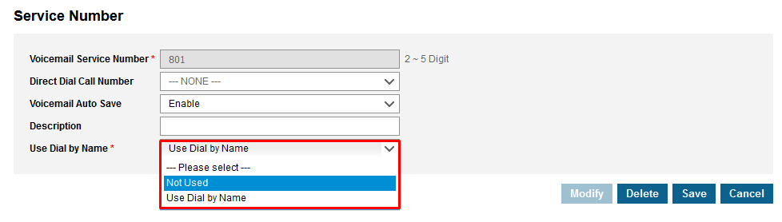
Dial by Name – Voicemail Configuration
For auto attendants you will need to enable Dial By Name to be used, this is set within;
Customer Manager Portal > Voicemail Service > Service Number > Use Dial by Name
There are two options you can select from for dial by name usage as shown below:
Use Dial by Name Usage
You have two options Use Dial by Name which is enabled
The other option Not Used which is disabled
Dial by Name Play Type
There are two options: Extension Play - which will list the user name and extensions number e.g. 1003 John Davis , 1008 Jimmy Smith, you will have to then enter the extension number to select the user you would like to dial.
The second option is Short Dial - this will list the users and then ask you to select a user listed with the number provided e.g. 1# 1003 John Davis , 2# 1008 Jimmy Smith

Slide 12
Dial by Name – Voicemail Configuration
To create a voicemail using Dial by Name you will need to follow the steps shown below:
Creating a new voice message (access to voicemail main menu and dial 3 to send a message)
After recording a voice mail message, select ‘search by name’ option.
Select name search method (Partial or Full)
Dial first name and last name separated by ‘0’ and ‘#’ to end
VM will play index and name of each extension searched by input
Dial the index to select the extension
VM message will be left to the extension
When sending a voicemail using Dial by Name, the options are available as below:
Dial by Partial Name Search
Will allow you to use the keypad to dial the user/group name but you do not have to put a correct match it will then list all users found on the system with these letters. The input method is first name + 0 + last name #
0 is separator, # is end digit
Example for ‘James Kim’ Partial name Search : ‘526054#’ or ‘526370#’ or ‘546#’
Dial by Full Name Search
Will allow you to use the keypad to dial the user/group name you must complete a exact match for it to provide you with the user details.
Example for ‘James Kim’ Full name Search : ‘526370546#’

Slide 13
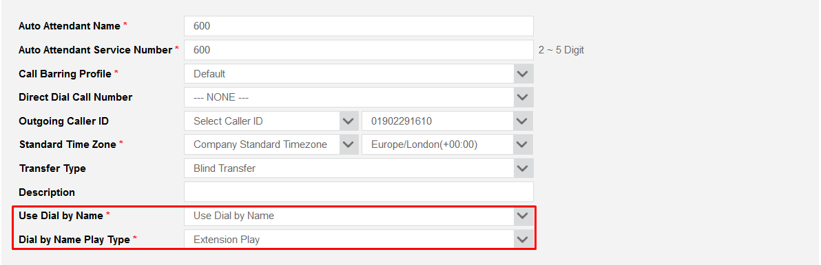
Dial by Name – Auto Attendant Configuration
For auto attendants you will need to enable Dial By Name to be used, this is set within;
Customer Manager Portal > Auto Attendant > Service Number > Use Dial By Name
There are two options you can select from for dial by name usage as shown below:
Use Dial by Name Usage
You have two options Use Dial by Name which is enabled
The other option Not Used which is disabled
Dial by Name Play Type - There are two options;
Extension Play which will list the user name and extensions number IE 1003 John Davis , 1008 Jimmy Smith, you will have to then enter the extension number to select the user you would like to dial.
The second option is Short Dial this will list the users and then ask you to select a user listed with the number provided IE 1# 1003 John Davis , 2# 1008 Jimmy Smith

Slide 14
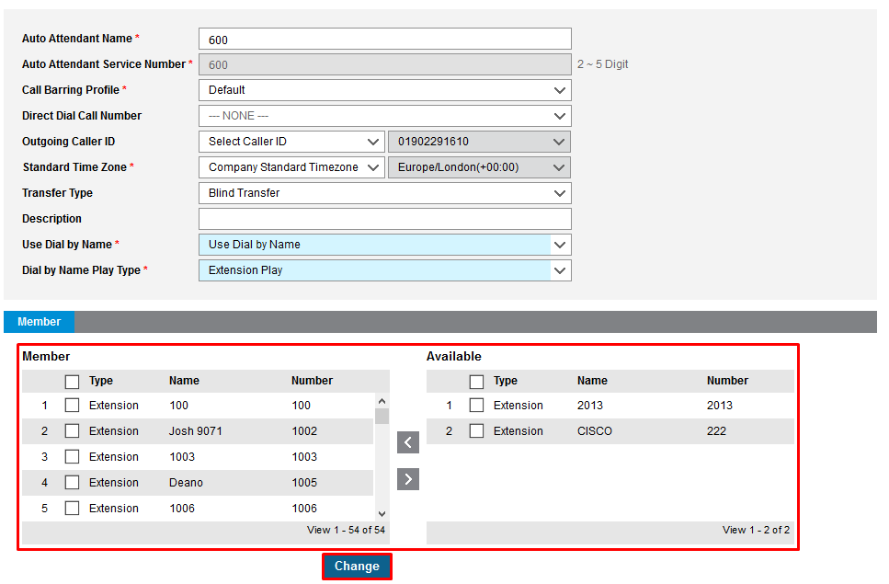
Dial by Name – Auto Attendant Configuration
Once you have made your service selections you will also need to enter the extensions and hunt groups that you would like to be searchable from the Dial by Name service .
These users can be added in the members sections below the original options.

Slide 15
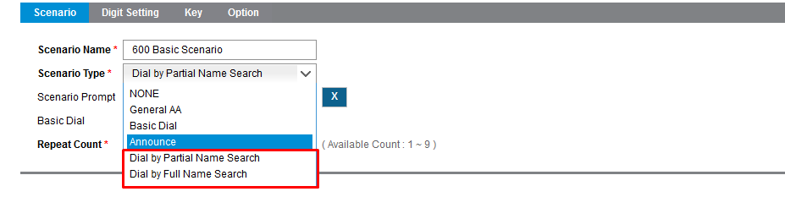
Dial by Name – Auto Attendant Configuration
You will then be able to amend the search type for Dial by Name, the options are available as below:
Dial by Partial Name Search
Will allow you to use the keypad to dial the user/group name but you do not have to put a correct match it will then list all users found on the system with these letters. The input method is first name + 0 + last name #
0 is separator, # is end digit
Example for ‘James Kim’ Partial name Search : ‘526054#’ or ‘526370#’ or ‘546#’
Dial by Full Name Search
Will allow you to use the keypad to dial the user/group name you must complete a exact match for it to provide you with the user details.
Example for ‘James Kim’ Full name Search : ‘526370546#’

Slide 16
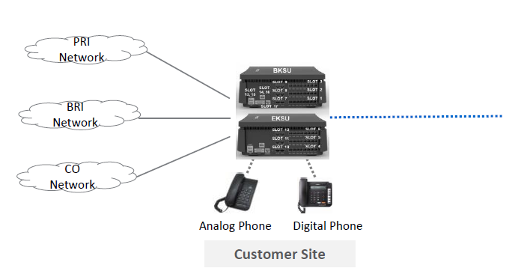
eMG80 LCM - Overview
With the launch of 3.5 you will now be able to use a eMG80 as an LCM (Local Call Manager) for redundancy.
In a normal working state all phones will be connected to the cloud, if there was any failure that meant that the eMG80 and Cloud could not communicate then you can fall back to using ISDN or Analogue lines on the local system.
Things to note:
Conference features cannot be used on an eMG80 in LCM mode.
You need either a VOIU or VOIB to establish a voice call between TDM and IP devices.
The following is not supported by the eMG80 in LCM mode:R2 in E1IB, T1IB, VMIU/VMIB, WTIB/SOIB/MCIB/MISU.
iPECS Cloud
NOTE: You are unable to use the 1000i handsets on an eMG80 system until unified version 4.

Slide 17
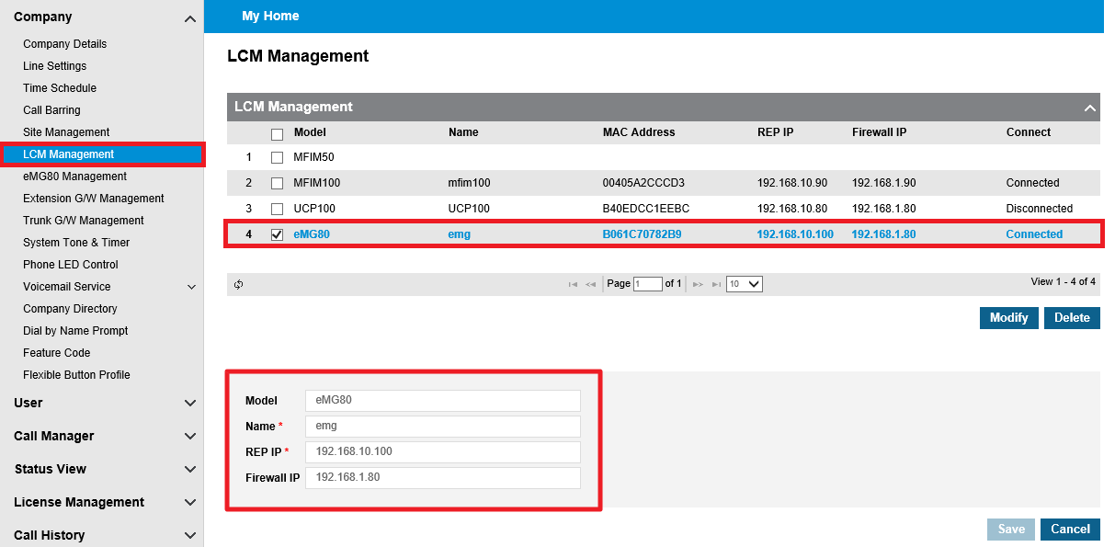
eMG80 LCM – LCM Management
To utilize an eMG80 as an LCM device you will first need to make sure that you have a licence applied to the system.
This should then show in LCM Management ready for you to configure.
If you are to select the LCM that you would like to use you will then be able to enter the:
Name – This will be what you use to select the LCM when assigning a user or site.
REP IP – This is the internal IP of the unit
Firewall IP – This is the external WAN IP for the site.
When all of the correct information has been entered then you should see the device as Connected.

Slide 18
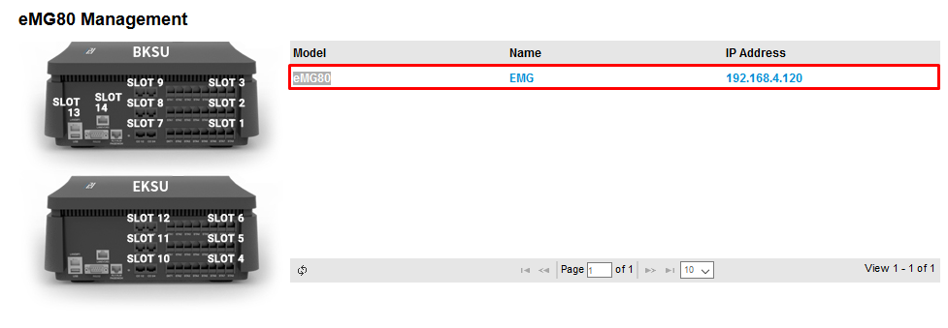
eMG80 LCM – Board Management
Configuration on the eMG80 slots can be done through the eMG80 section of the portal.
From here you are able to see the slot numbers that you will need to match with the boards installed in the eMG80 unit.
You are also able to configure the expansion EMG from the same screen.

Slide 19
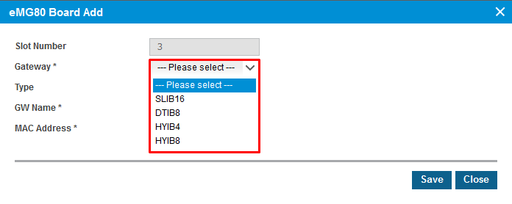
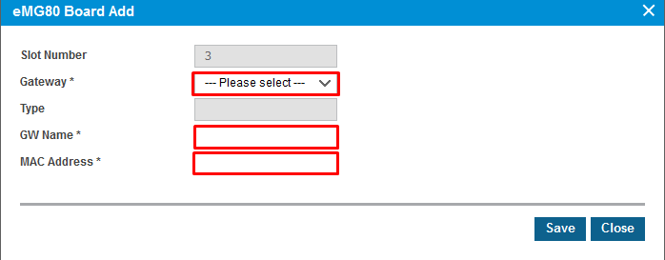
eMG80 LCM – Board Management
To configure first select the slot number you would like to identify.
Once selected you will be able to choose the module that you have installed in that position on the eMG80.
Once you have chosen your module from the list, you will be able to choose the Gateway Name and MAC Address
NOTE: Depending on the slot you select you will have different modules available.

Slide 20
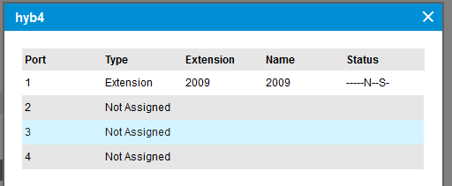
eMG80 LCM – Board Management
You will then be able to see if the gateway is registered or not in the Connected field.
If you would like to see what is allocated to the board select the magnified glass icon
This will then provide the information in a new popup window.
Notes:
Screenshot once connect changed to Status

Slide 21
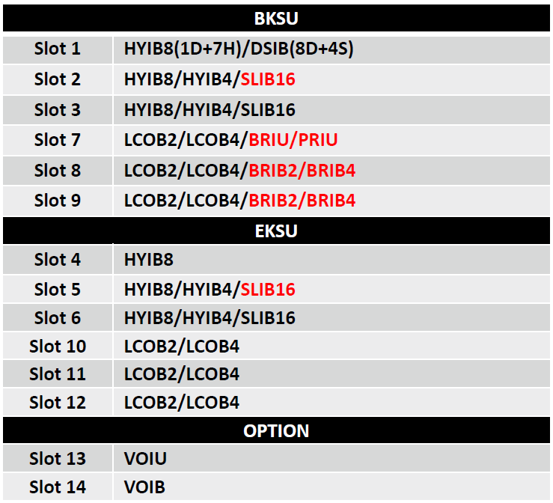
eMG80 LCM – Board Management
eMG80 in an LCM supports the bellow slot configuration.
Notes:
Screenshot once connect changed to Status

Slide 22
eMG80 LCM – Board Management
When setting a BRIB2 you will need to configure some additional options when setting up
You will additionally need to configure the trunk channels used by the board and TEI Type.
Notes:
Screenshot once connect changed to Status

Slide 23








PRS ( Phone Redirection Service) Provisioning
Until Cloud P3.1, the public IP address of Cloud must be manually entered in to any LIP terminal
for registration. With PRS this step is removed for a simple provisioning process.
PRS is synchronized with the cloud so no extra steps are needed to use the service.
PRS is only available on bellow phone models:
1010i
1030i
1040i
1050i
iPECS PRS
Receive Order
iPECS Cloud Portal
End Users
iPECS Cloud Call Manager
Notes:
Screenshot once connect changed to Status

Slide 24
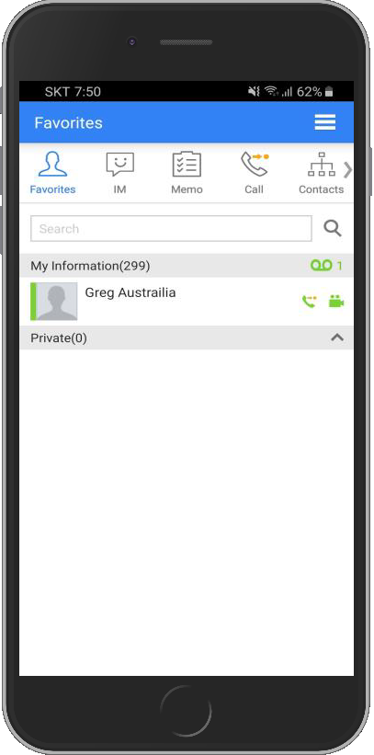
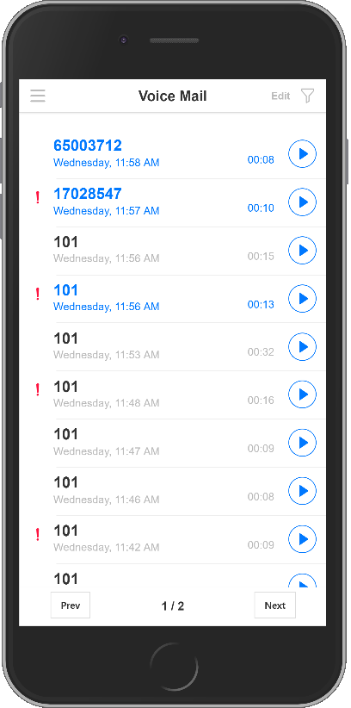
UCE Mobile Visual Voicemail – Overview
In Cloud 3.1 when a user clicked the voicemail indication icon the phone would dial voicemail for you and you would have retrieve the voicemail message through accessing your mail box in the same way you would with a LIP phone.
In 3.5 you will have a new visual voicemail mobile portal, this allows the user to interface with their voicemails in an easy to use manner.
Notes:
Screenshot once connect changed to Status

Slide 25
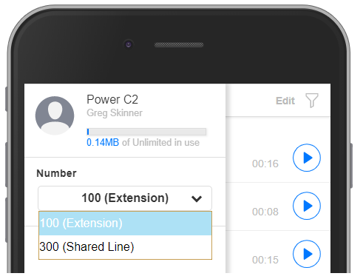
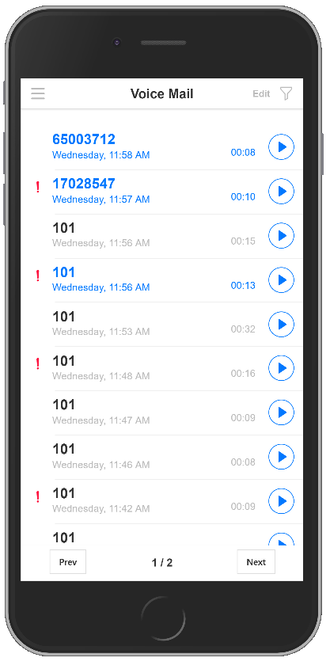
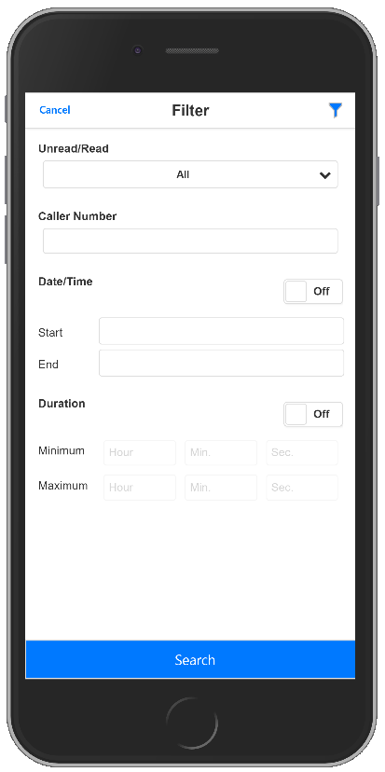
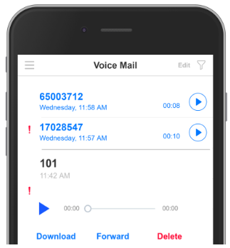
UCE Mobile Visual Voicemail - Portal Layout
Within the mobile voicemail portal you are able to see the below information:
User / Usage information
Play / Download / Forward / Delete voicemail message
Apply filter for searching.
Unread messages are shown in blue, and read messages are shown in black.
1
3
2
Notes:
Screenshot once connect changed to Status

Slide 26
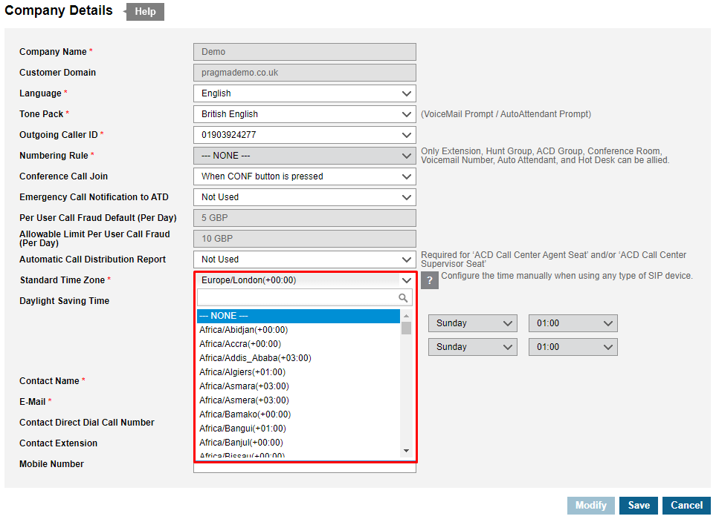
Site Based Time Zones - Standard Time Zone
Another feature coming with the Cloud 3.5 update is site based time zones, this allows customers to have a different time set per customer and will affect the day night routing, as well as the time displayed on the users phone if they are linked with a site that has a different time zone.
Due to this change you can now set this in two areas, the first location that this can be set is in Company > Company Details > Standard Time Zone
Notes:
Screenshot once connect changed to Status

Slide 27
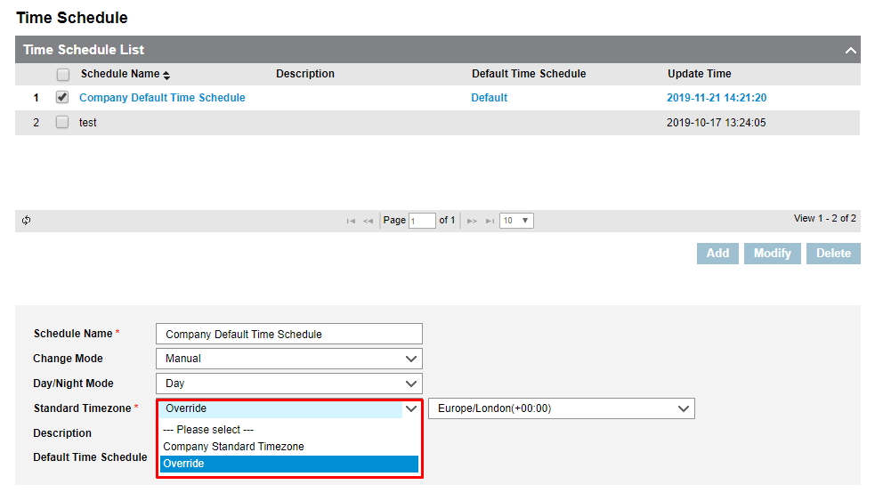
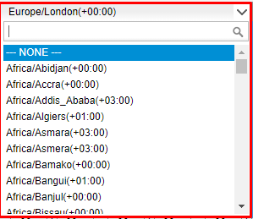
Site Based Time Zones – Time Schedule
Once you have configured this setting at a company level, you will be able to choose if you follow the same time zone or select your own time specifically for a Time Schedule.
This can be set in Company > Time Schedule > Standard Time zone
From this section you will be able to select either the Company Standard Time Zone previously set.
Alternatively you can choose to override and select your own time zone for the specific Time Schedule you are configuring.
Notes:
Screenshot once connect changed to Status

Slide 28
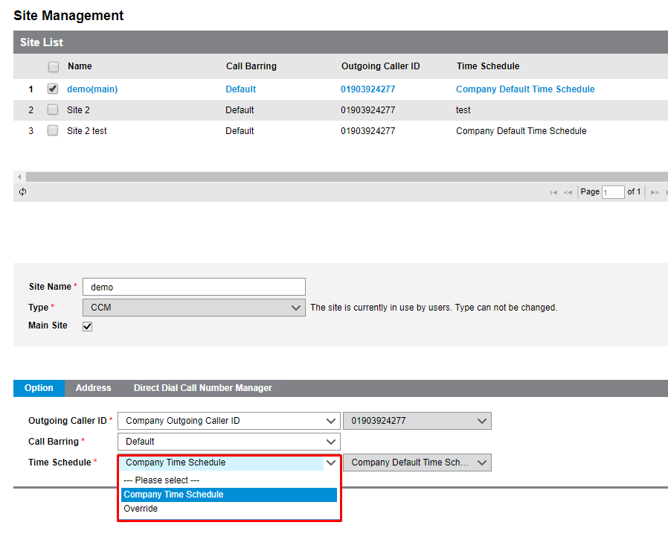

Site Based Time Zones – Site Management
You are then able to link the Time schedule to the site as currently available in version 3.1
Navigate to in Company > Site Management > Select a Site > Time Schedule
From here you are able to select to use either the company defined Time Schedule or override with your own custom defined time schedule that could have another time zone attached to it.
Notes:
Screenshot once connect changed to Status

Slide 29
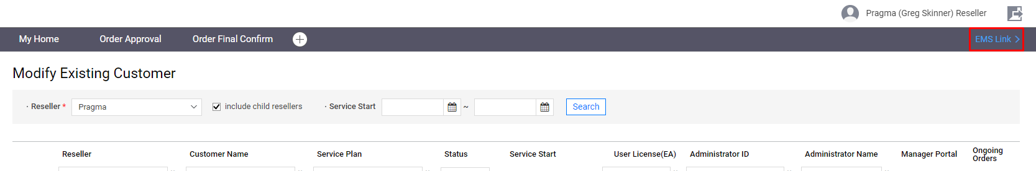
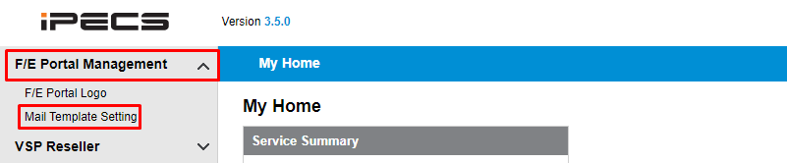
Email User Templates – Password Reset / Welcome Email
Within 3.5 you will be able to define your own password reset and welcome email, this setting is not yet available on the new management portal so the first step you will need to take is to use the EMS link button on the top of the reseller login portal.
This will take us to a view similar to the previous reseller portal and you can see there is only a small number of options in this portal which will be migrated at a later date.
Within F/E Portal Management you will find a new option Mail Template Settings.
Notes:
Screenshot once connect changed to Status

Slide 30
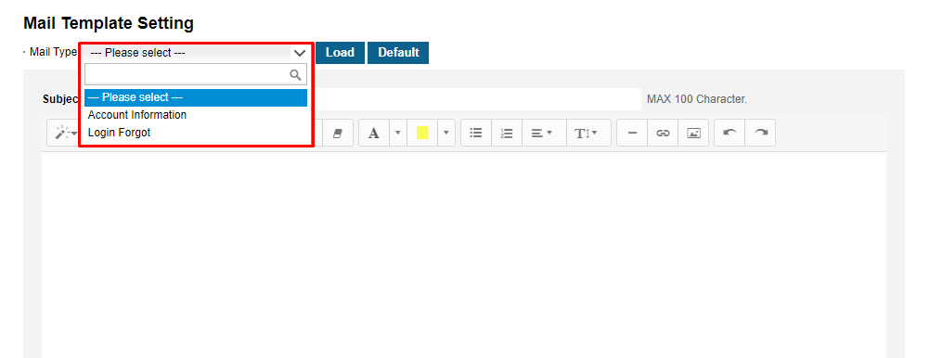
Email User Templates – Password Reset / Welcome Email
Within the Mail Template Setting you will be able to first select the mail type you wish to create a new layout for, the options available are Account Information which can be used to send a welcome email, the other option is Login Forgot this will be used if you instigate a password reset.
Notes:
Screenshot once connect changed to Status

Slide 31
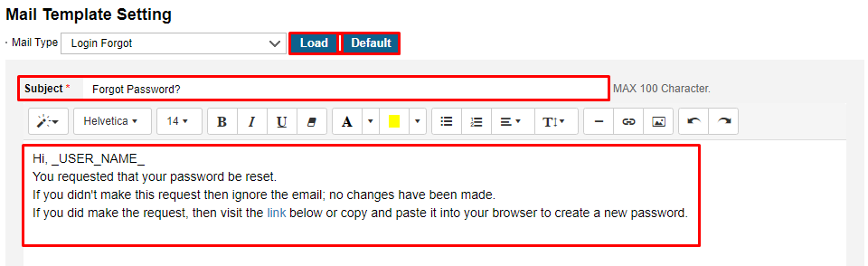
Email User Templates – Layout
Once you have selected the profile you are going to amend from the drop down list you can select load if you have already created a template to load your information in the text field below.
If you select Default then the system will populate with the below area with the system default subject and text.
Notes:
Screenshot once connect changed to Status

Slide 32
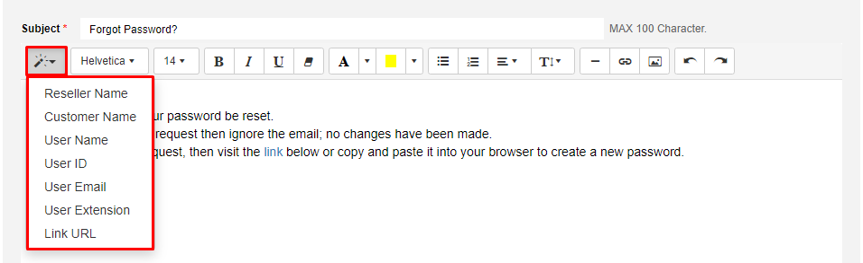
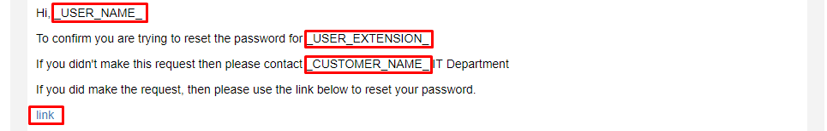
Email User Templates – Variables
You will now be able to personalise the subject and text that will display for your customers.
When creating text you will also be able to enter wildcards using the wand icon dropdown, this will allow you to enter variables shown below.
This will then pull the correct value when sending the email, this allows for more personalisation in the email.
Notes:
Screenshot once connect changed to Status

Slide 33
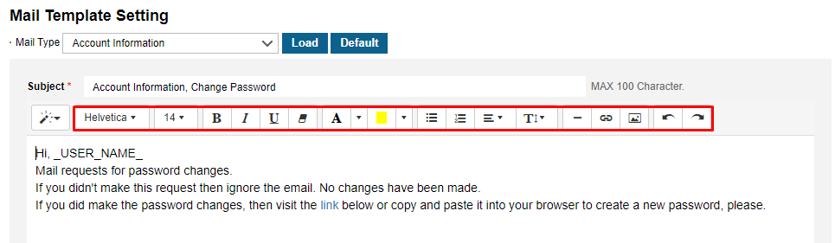
Email User Templates – Email Options
You also have the ability to amend the below:
Font Type
Font Size
Typography
Text Colour
Background Colour
Text Layout Format
URL Link
Text
Image File
Notes:
Screenshot once connect changed to Status

Slide 34
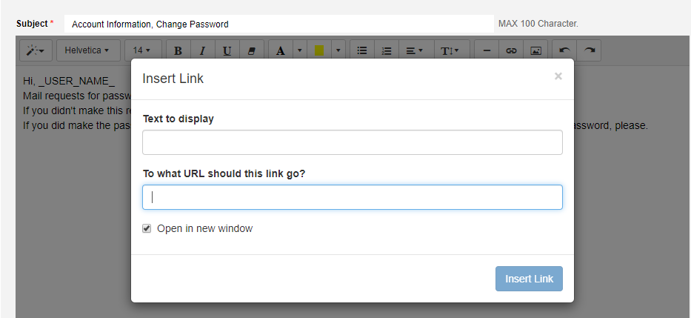
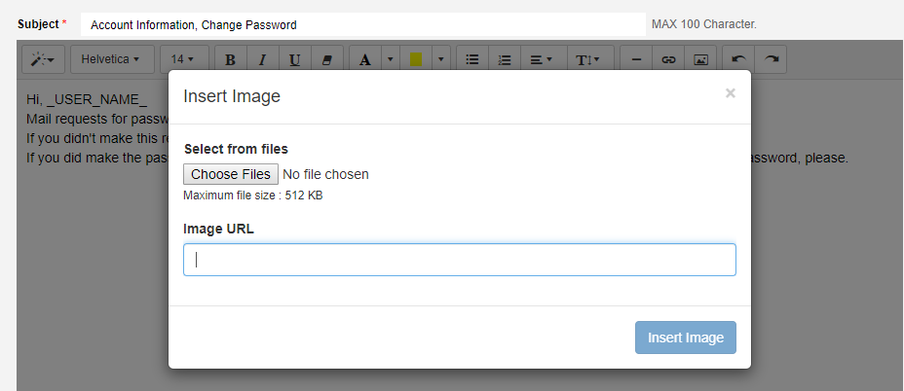
Email User Templates – Inserting Images and Links
Once you have selected insert link you will get a popup, this will allow you to enter what text will display and also the destination when clicked.
Once you have selected insert image you will get a popup, this will allow you to either select your image file locally.
Alternatively you are able enter a Web URL to import the image.
Notes:
Screenshot once connect changed to Status

Slide 35
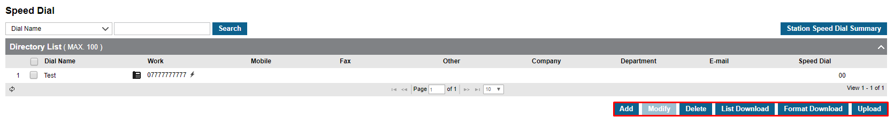
Station Speed Dial Setup on User Portal
With version 3.5 you are now able to set Station speed dials from the Customer User Portal > Speed Dial menu.
Each user can have a maximum of 100 station speed dials.
Each record can only have 1 number linked with the handset directory, like the company directory.
To search for station speed dials use the Speed Dial button or directory then option 1
This can created individually or uploaded through an Excel file in bulk.
You can also use click to dial in the same way that is available from the company directory.
Notes:
Screenshot once connect changed to Status

Slide 36
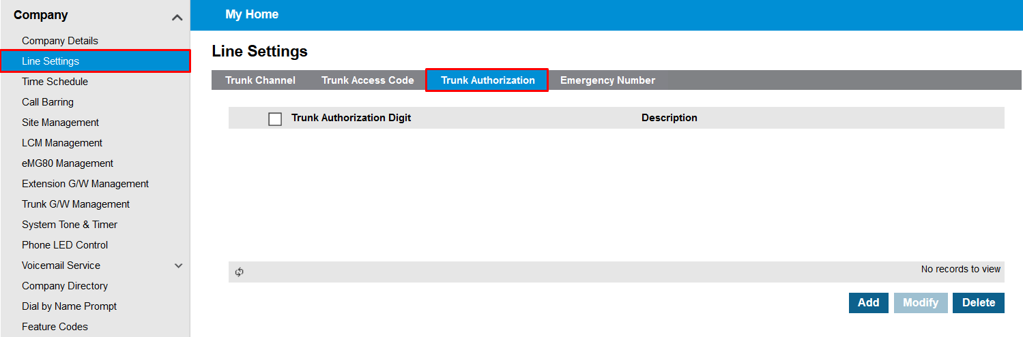
Trunk Authorization - Setup
Trunk Authorization allows you to restrict an individuals ability to make an outgoing call without entering a password to validate the user.
This setting is configured within Customer Manager > Company > Line Settings > Trunk Authorization
Notes:
Screenshot once connect changed to Status

Slide 37
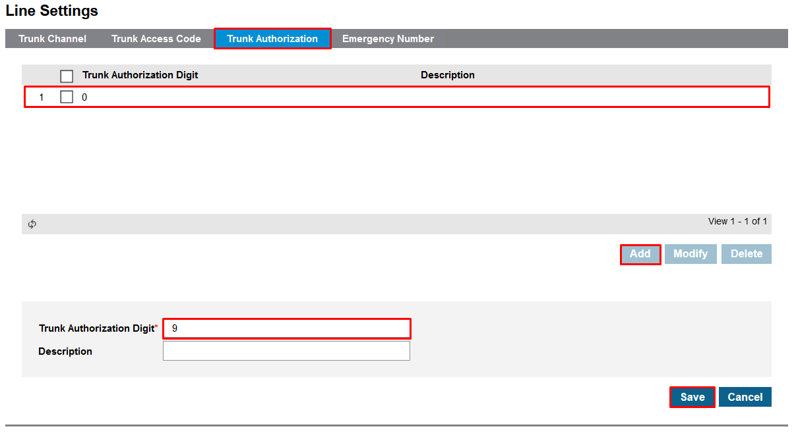
Trunk Authorization - Setup
To use this first you will need to define the digits that will trigger a user to authenticate when dialling.
To create a new Trunk Authorization Digit click Add. You will then be able to enter the digit you would like to create a rule for, at this point you also have the ability to set a description.
Once done select save to create the rule.
Example : If you set digit to 1 when trying to dial any number starting with 1, you would then have to enter the Extension Password when it shows Enter Auth Code on the screen.
(NOTE : To restrict outbound calls you will need to have a rule created for 9 and 0)
Notes:
Screenshot once connect changed to Status

Slide 38
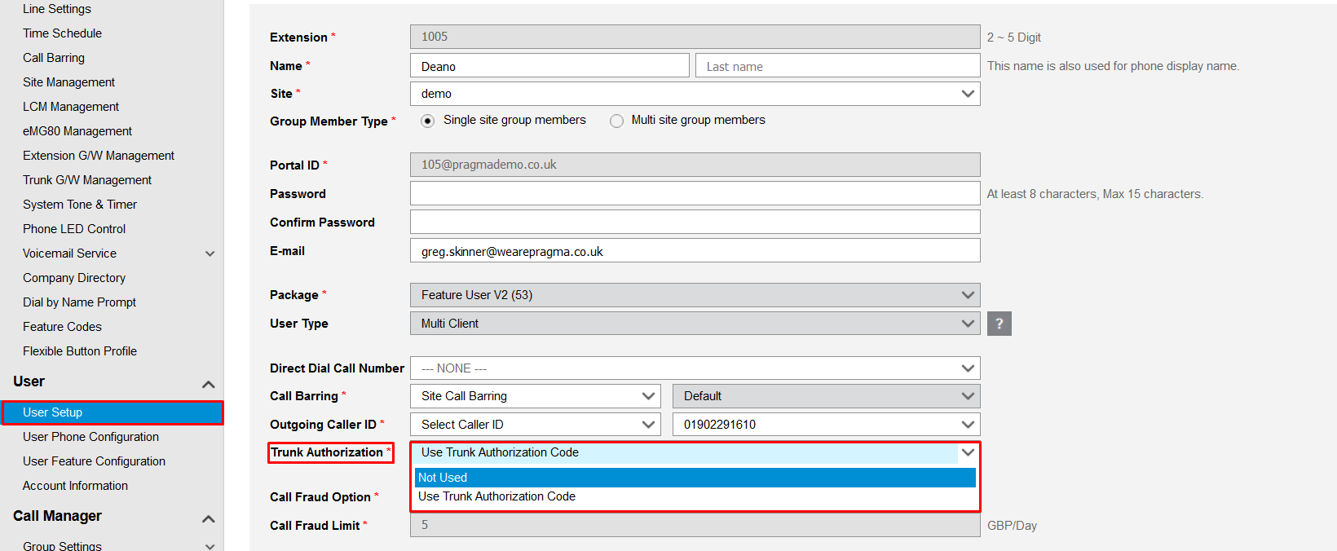
Trunk Authorization - Setup
Once you have created the digits that you would like to instigate Trunk Authorization, you will then need to set the user to use this feature.
This is done within Customer Manager > User > User Setup > Select the User > Trunk Authorization
This is configured when creating the user but you can also go back and amend this at any time.
The options are either Not Used or Use Trunk Authorization Code.
Notes:
Screenshot once connect changed to Status

Slide 39
Trunk Authorization - Example
LIP Phone using Trunk Authorization
Trunk Authorization Digits : 9012
Call to 901234567890
Dial 9012
The system displays “ENTER AUTHORIZATION CODE” on the terminal LCD and responds with a voice prompt “Enter Your Password”.
Dial Password, press ‘*’.
Dial the remaining digits(34567890)
The outgoing call will be allowed.
Sip Phone using Trunk Authorization
Trunk Authorization Digits : 9012
Call To 901234567890
Dial 9012 3456 7890
The system responds with a voice prompt, “Enter Your Password”.
Dial Password, press ‘*’.
If password is correct, the outgoing call will be allowed.
If the password is mismatched, the outgoing call will be blocked.
Notes:
Screenshot once connect changed to Status

Slide 40
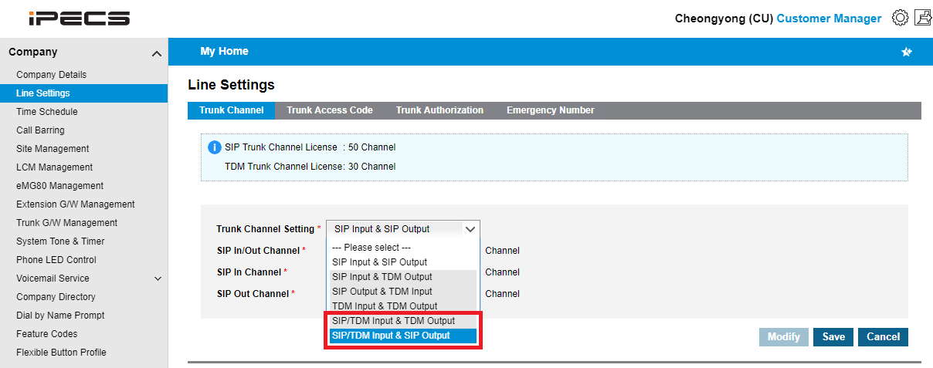
Trunk Channel - SIP & TDM Trunk Simultaneous Configuration
Within the iPECS Cloud version 3.0 the ability to select your Trunk Channel Settings was added.
This allowed TDM trunk modules to be installed ahead of the numbers porting to provide an inbound calls thought the platform without a forwarding charge.
When your numbers ported you would have to go back in on the day of porting and swap back to using SIP In/Out to enable the inbound calls to work once ported. There is now an additional two options that can be used to keep SIP inbound enabled at all times.
This means that you no longer have to make changes on the day of porting and this an be scheduled in at a later time.
This can be amended within Customer Manager > Company > Line Setting > Trunk Channel > Trunk Channel Setting
Notes:
Screenshot once connect changed to Status

Slide 41
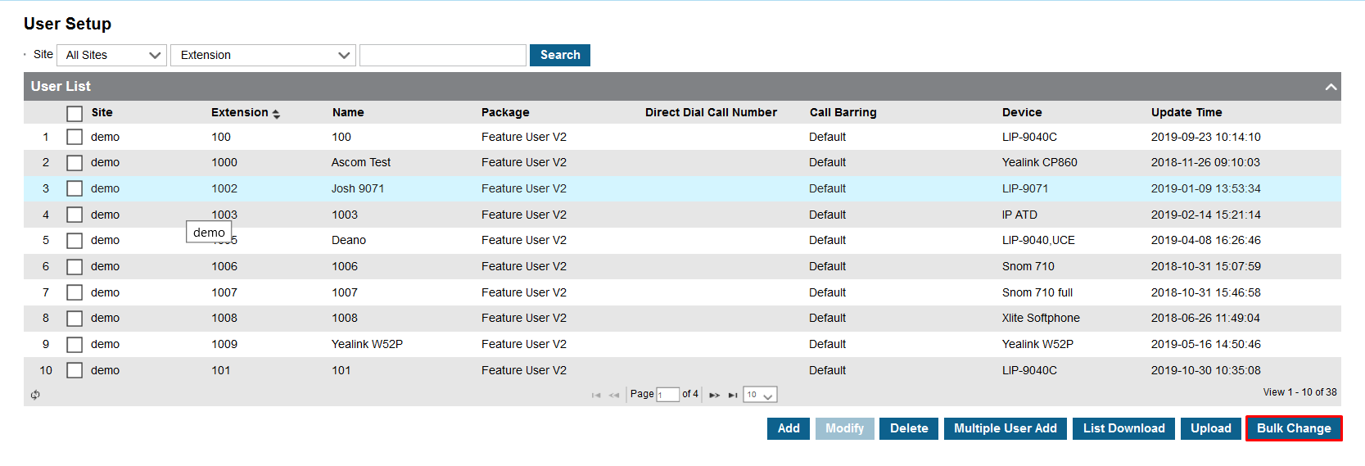
Bulk Feature Change
Within 3.5 there is a now the ability to make changes for multiple extensions at the same time, this feature is called Bulk Change.
Bulk Change is available to be selected within Customer Manager > User > User Setup > Bulk Change
NOTE : This is only available for sequential extension numbers
Notes:
Screenshot once connect changed to Status

Slide 42
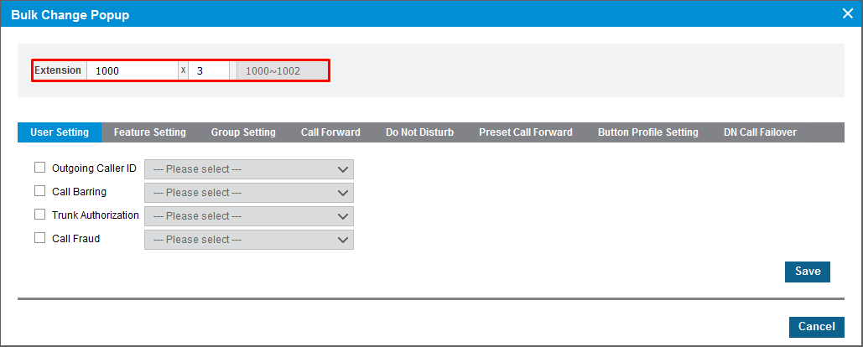
Bulk Feature Change
Once you have selected Bulk Change you will get a popup that allows you to choose what will be configured.
First you need to select the extension number and the amount of extensions after the chosen extension that you would like to make the change on.
This will then show you the stations that will be amended on the right hand side .
Notes:
Screenshot once connect changed to Status

Slide 43
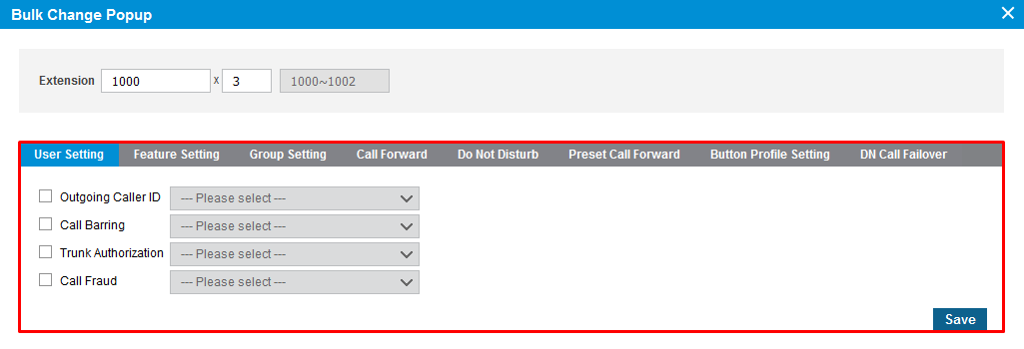
Bulk Feature Change
Below you will then be able to see the changes that can be made as below:
User Settings – ALL options can be amended at once then saved.
Feature Setting – Only ONE change can be made at a time, regardless of if this setting is within Configuration Change, Feature Add or Feature Delete.
Group Setting – Only ONE group type can be amended at any time.
Call Forward – Only ONE feature displayed on the menu option.
Do Not Disturb – Only ONE feature displayed on the menu option.
Preset Call Forward – Only ONE feature displayed on the menu option.
Button Profile Setting – Only ONE feature displayed on the menu option.
DN Call Failover - Only ONE feature displayed on the menu option.
Notes:
Screenshot once connect changed to Status

Slide 44
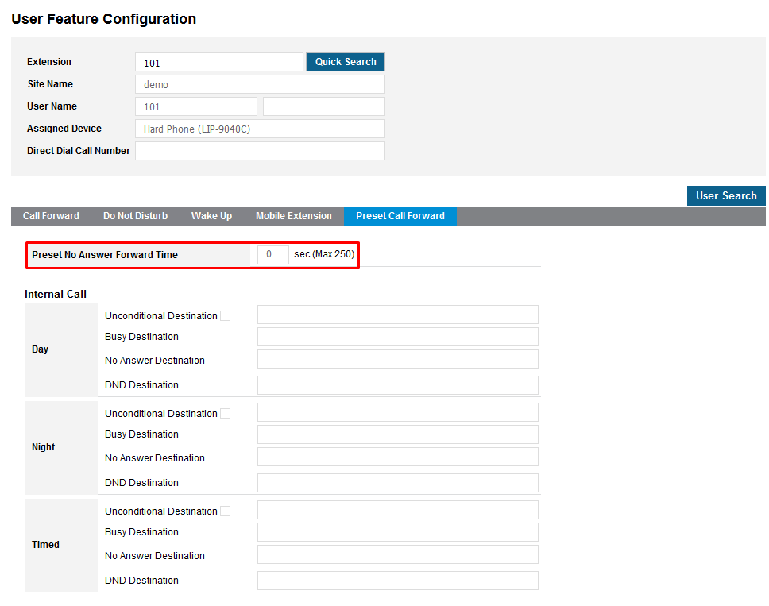
Preset Call Forward Timer
Previously you have been unable to amend the time it takes for a station to failover to its preset forward destination.
If a user wanted to amend this timer from its 15 second default value, then a support ticket would need to be raised and backend work done by the pragma technical support team.
From version 3.5 this is now available within Customer Manager Portal > User > Feature Configuration > Preset Call Forward > Preset No Answer Forward Timer
Notes:
Screenshot once connect changed to Status

Slide 45
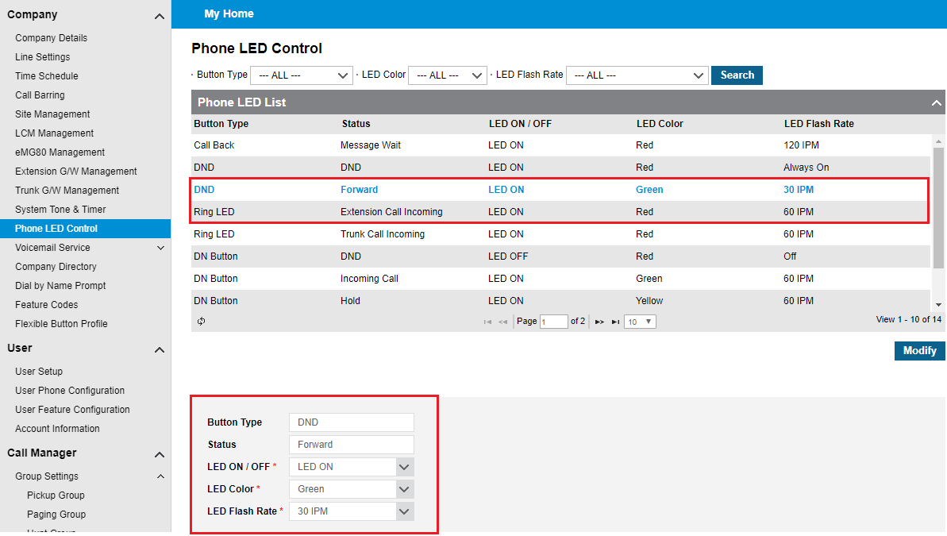
Phone LED Control – DND Control
Within Customer Manager > Company > Phone LED Control you are now able to set what happens when the phone is forwarded and in DND.
This will now allow you to distinguish the difference between DND and a temporary call forward.
Notes:
Screenshot once connect changed to Status

Slide 46
User Functionality – Transfer Directly to Voicemail
Also add slide for other undocumented features and things to note.
Notes:
Screenshot once connect changed to Status

Slide 47
Q&A

Slide 48
Go to www.wearepragma.co.uk for more information

