Slide 2
2.4 Update
iPECs Cloud

Slide 3
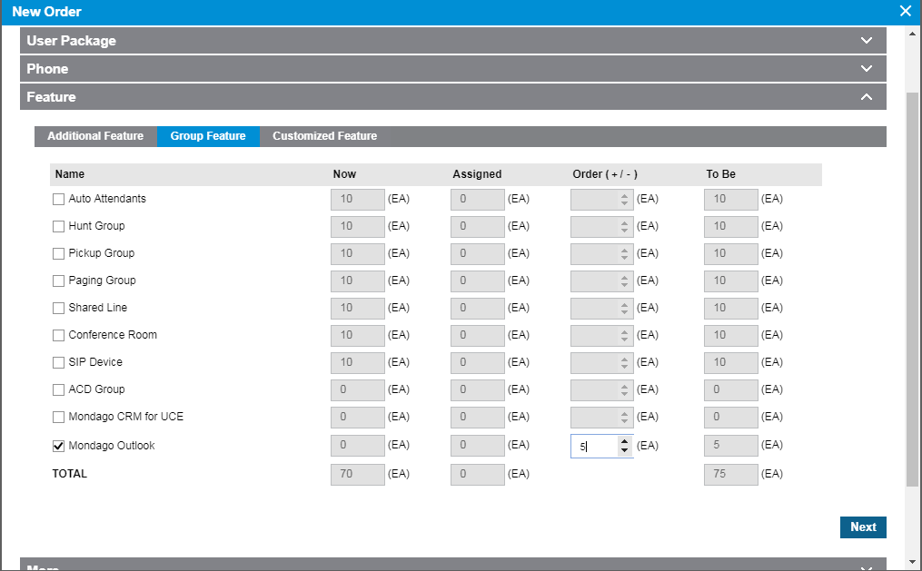
Mondago Outlook License
Reseller can order Mondago Outlook license in when creating an order

Slide 4
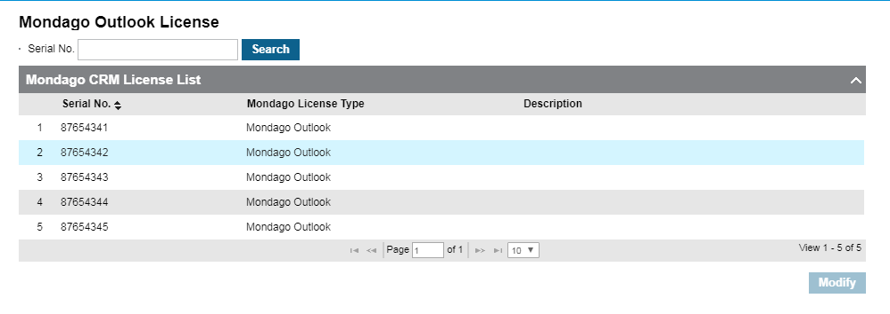
Mondago Outlook License
Customer manager portal will display the assigned license’s serial number after order completion.
Licenses can be viewed within License Management > Mondago Outlook License menu.
To assist managing the license assignment for individual user, description field can be used as bellow.

Slide 5
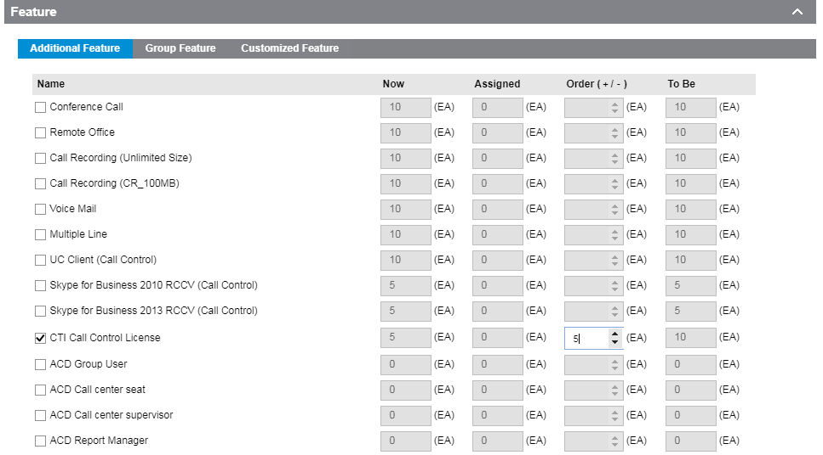
CTI Call Controller License
This license is used for Mondago Phonelink server
It can be ordered as same as other features or packages within the order menu.

Slide 6
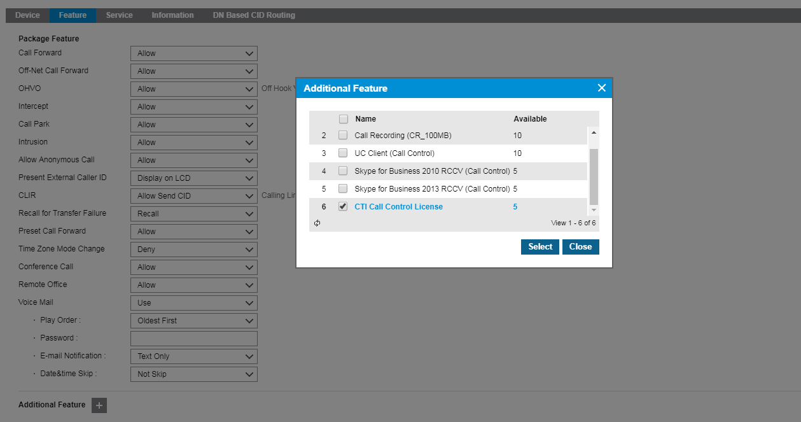
CTI Call Controller License
After ordering the licence, you can see the CTI Call Control License when adding or modifying Additional Features
Multi client can’t use CTI call control license
Other CTI licenses (UCE Call Control, RCC Call Control, ACD Call Center seat supervisor) can’t be used with CTI call control license at the same time.

Slide 7
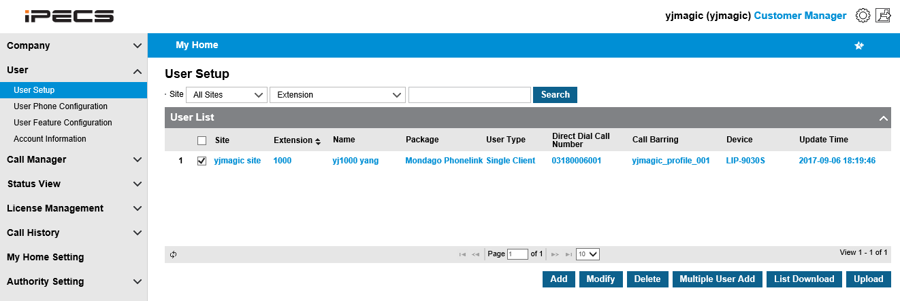
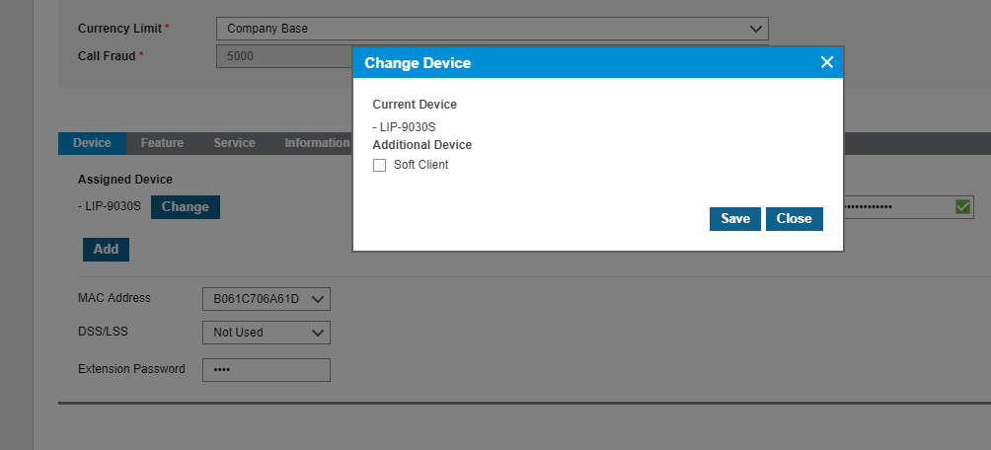
Changing User type from single client to multi client
Navigate to User, User Setup, Select user to change
Scroll down Click Add button, and select Soft Client, you will then need to select the softclient and number of licensees to assign to the multi client.

Slide 8
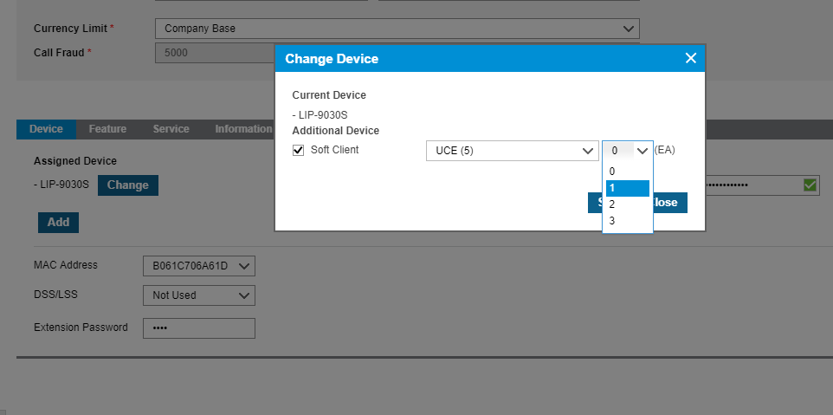
Changing User type from single client to multi client
If UCE is selected you will need to assign required number of clients.

Slide 9
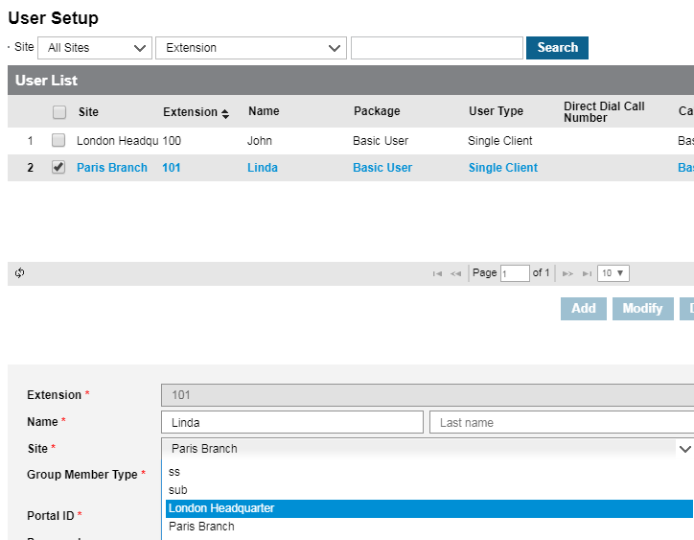
Moving Users from one site to another
User can be moved to another site without removal and recreation.
To do this select the user in User Setup select the user then modify, once in this menu you will be able to select the site you would like to move the user to and save to move the user.
When user’s site changed, bellow information will be removed.
DDI information (user, multiple line)
Shared line member
Group information for single site group member option
In case of multi site group member option, group information will be maintained.
Multiple Line information

Slide 10
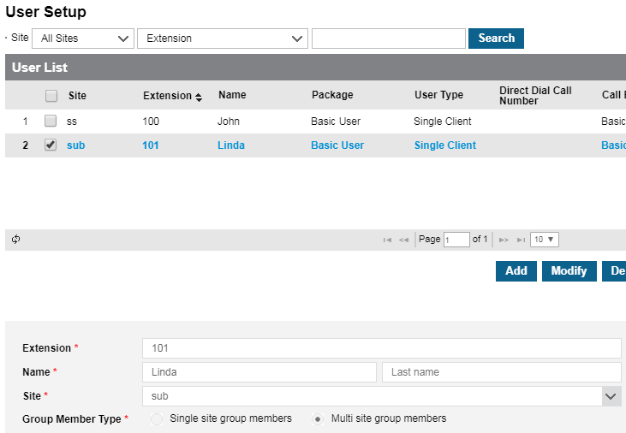
Allowing users from multiple sites to be members of same hunt group
A user can be a member of other site group member by bellow user based option.
When customer create a user, or modify user attribute, Group member type can be assigned with single site group member or multi site group members as bellow.
- Single site group members : user can be assigned as a member of same site groups.
- Multiple site group members : user can be assigned as a member of all site groups.
To set this up go to User Setup select the extension you want then choose Multi Site Group member

Slide 11
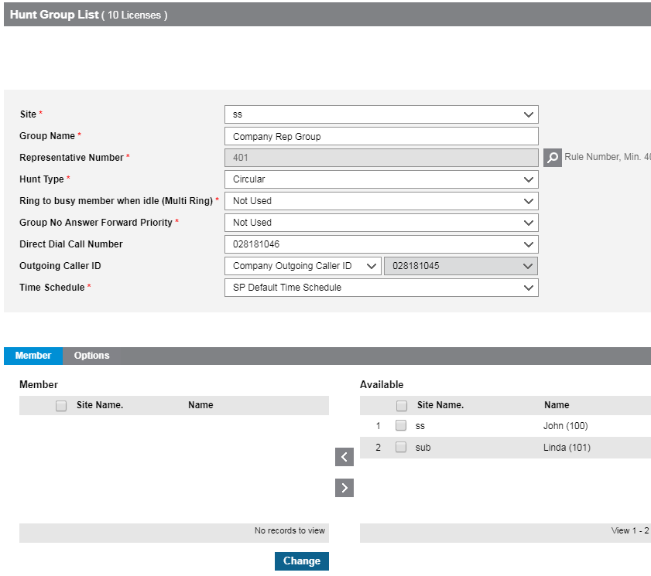
Allowing users from multiple sites to be members of same hunt group
This option is applied to Hunt group, Paging group, pickup group.
101 can be a member of other site hunt group, because of multi site group member option

Slide 12
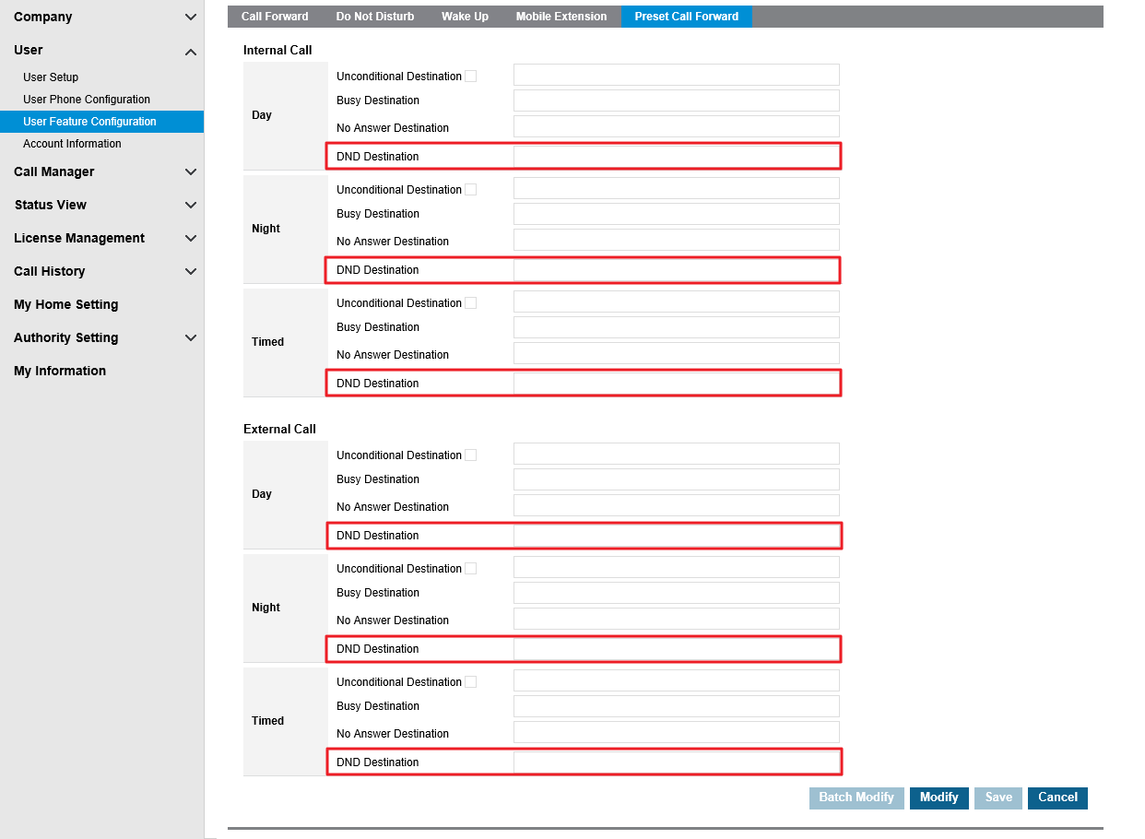
DND Preset Call Forward
Preset Call Forward Destination for DND option is added to feature configuration
If user set DND destination, and enable DND, call will be routed to the DND forward destination.
If user has DND destination, when call comes in to the phone and user presses the DND button, call will be routed to the destination.
If DND destination is set to voice mail number, call will be routed to voice mail.

Slide 13
DN number replacement with Name
‘DN’ + extension number is presented on idle screen of the phone and on the flexible button, but as this is not a familiar terminology for all customers you are now able to amend.
If customer changes flexible button label, the label will be presented instead of DN + extension number.
Changed LCD Display in OFFHOOK state for LIP
Before
IDLE State
DN 100
05 SEP 17 07:59 pm
SPEAKER button
CloudLab 100
05 SEP 17 07:59 pm
After
CloudLab 100
05 SEP 17 07:59 pm

Slide 14
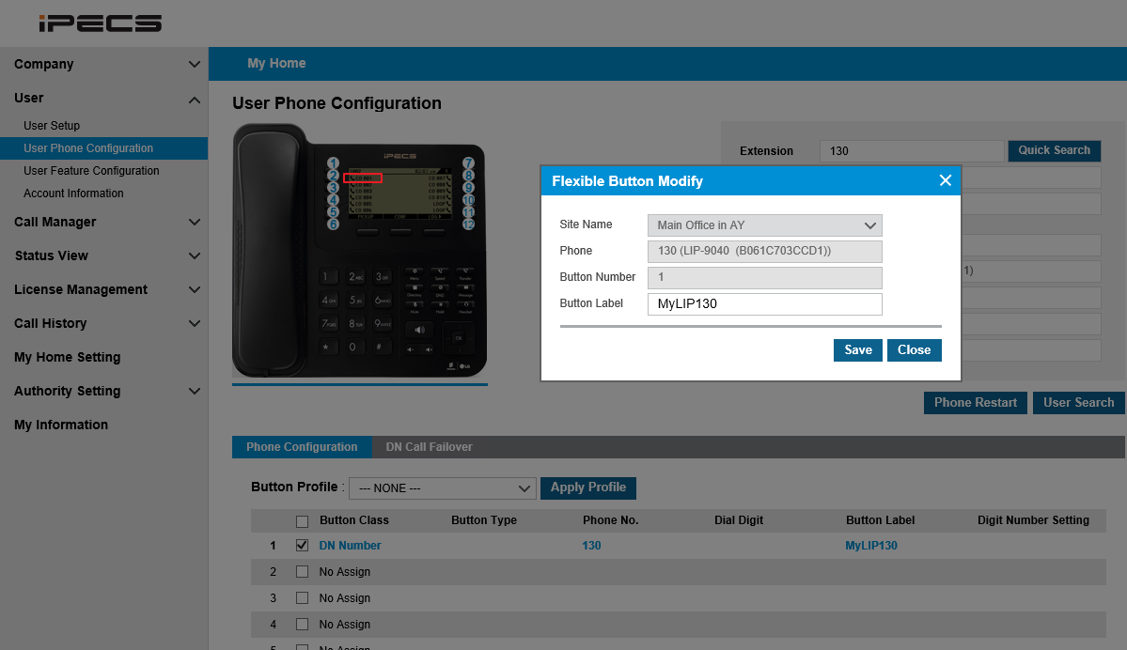
DN number replacement with Name
To Change the label go to User Phone Configuration and select the fist flexible button to add a label.

Slide 15
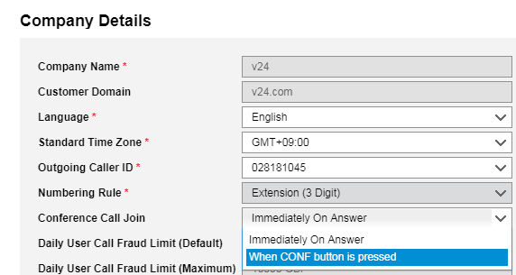
Conference Call Option
New conference option added:
Option 1 ‘Immediately On Answer’
This is unsupervised transfer
Option 2 ‘When CONF button is pressed”
This is a announced transfer allowing you to talk to the person you will conference in before joining in to a conference

Slide 16
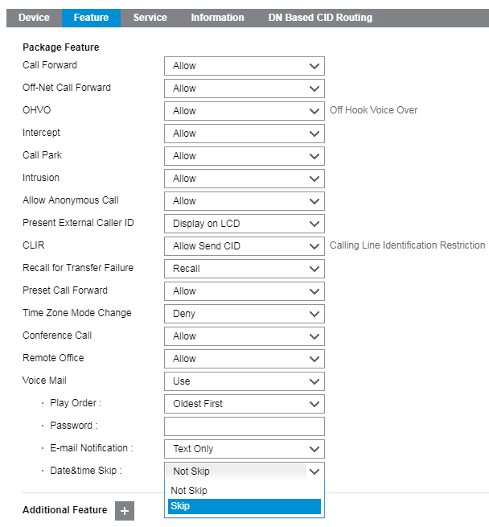
Date & time skip option for voicemail
Adds the ability to skip voice mail recorded date & time announcement when listen to recorded voice mail.
It is provided as sub option of voice mail feature in User Setup menu.

Slide 17
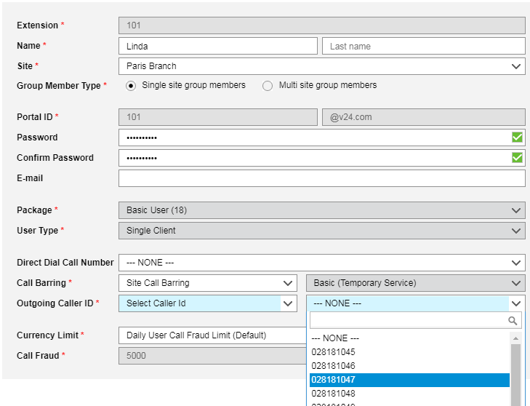
CLI Selection among all DDIs
“Select Caller ID” option is added on “Outgoing Caller ID” parameter.
This allows any DDI can be used as outgoing caller ID.

Slide 18
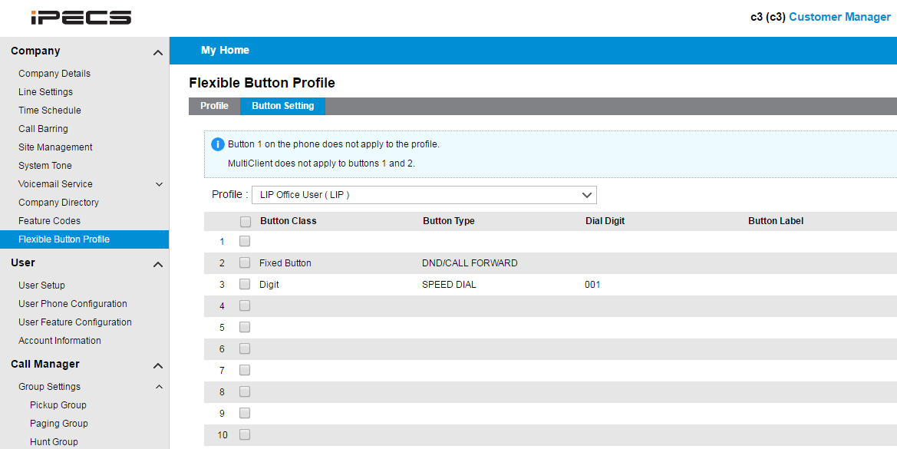
Flexible Button Profile
This is useful feature to assign same button information on multiple terminals.
Customer manager can predefine flexible button profile for LIP or SIP phone.
Assign button information on defined profile.

Slide 19
Sorting by approval date on ordering status
Order list can be sorted by approval date in “Order Status” menu of Reseller portal.

Slide 20
Thank you for watching

