Slide 1
iPECS Cloud
Tech, Ops & Provisioning

Slide 2
Training – Tech
Tech, Ops and Provisioning
The Tech, Ops and Provisioning training will take you through the full ordering and provisioning process from start to finish.
At the end of the 1 day training session you will feel comfortable with creating customers, provisioning handsets and flexible buttons and setting up all major system features.

Slide 3
Agenda
Morning Session: 10.00am – 11.30am
Architecture & Overview
Overview of the Reseller Interface
Order Process
Break: 11.30am – 11.45am
Daytime Session: 11.45am – 12.30pm
First time Customer setup
Overview of the Customer Manager Interface
Adding Users
Configuring Handsets
Configuring user features
Call Manager Features: Group Features, Auto Attendant, ACD Group etc.
Call Recording
Lunch Break: 12.30pm – 12.55pm
Afternoon Session: 12.55pm –4.00pm
Applications: Skype for Business, IP Attendant
Introduction to Call Centre Features (Advanced course available as Webinar)
QoS Setup
Trouble Shooting (Best practices)
Course Test
Tools & Further Courses

Slide 4
Architecture & Overview

Slide 5
Why iPECS Cloud?
Reseller Centric Model
True reseller proposition not SP land grab
No direct sales conflict
Ease of deployment with administrative resource
Leasing supported
IPKTS
Increased handset functionality
Highly configurable soft keys
Increased handset security
Ericsson-LG End to End
Single vendor
Cloud with telephony heritage
PBX Feature set
Hybrid Cloud
Utilise existing hardware and limit CAPEX
Acts as local redundancy
Compatible with LIK, UCP & EMG80
Inbound & Outbound Call Centre Functionality
Inbound & outbound ACD agents
Auto-dial capability
Inbound and Outbound reporting & statistics

Slide 6
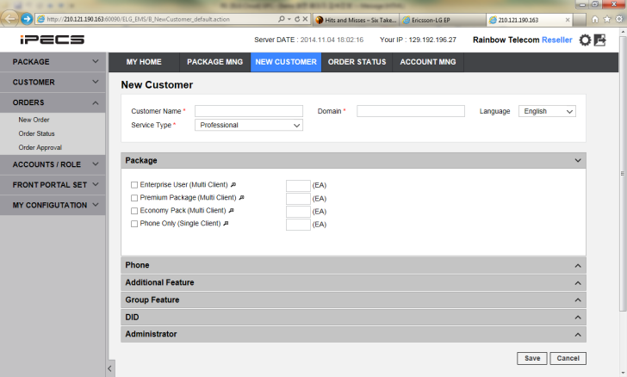
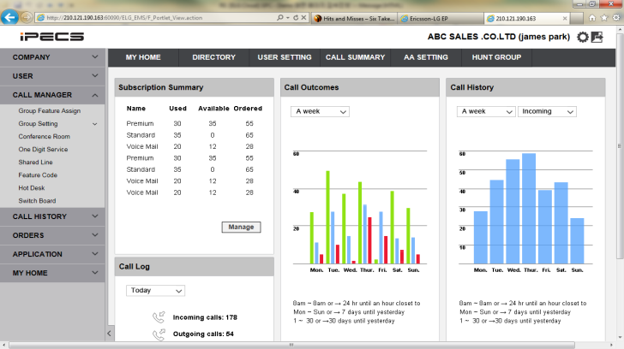
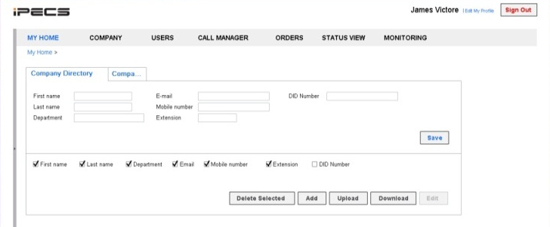
Overview
Back end portal
Service Provider, Reseller and Manager
Resource management
Order management
Basic Configuration
Service package & management
Handset and User Configuration
User feature configuration
CDR Reporting
Network I/F for voice (SIP, IPKTS)
Call Server(CM)
Service components
Voice mail
Auto Attendant
Manager portal
Unified Management Interface
Call Recording
ACD Report/Monitor
Lync RCC
UC
User portal
User
Voicemail Management
Personal feature provisioning
Own CDR reports
Billing G/W

Slide 7
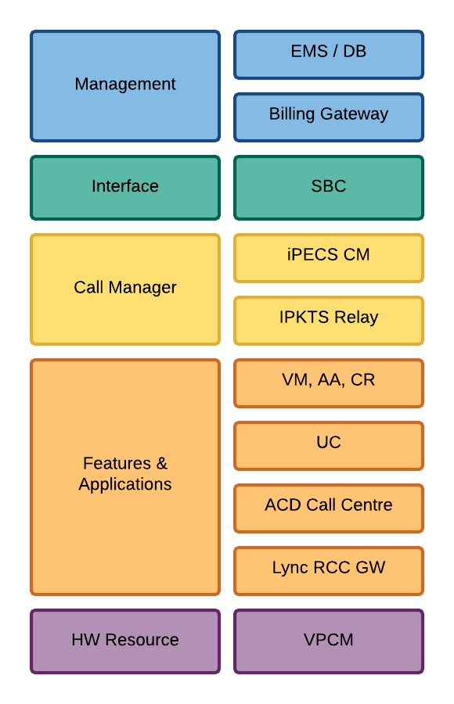
Architecture – Components
Element management for all components
Single user interface(Web portal) for both operator and user
CDR collection & Billing interface
Call rate calculation for fraud protection.
SIP Signal interface for all phones and clients.
NAT and SIP security
Tenant base call server : 250 tenants / server
iPECS protocol signal gateway
RTP redirect
Voice applications
Presence/IM, Video call, Sharing.
Conference manager.
Agent client
ACD statistics/report, monitoring & dashboard
Remote call control gateway for Lync
Windows base
Dedicated Hardware for conferencing.
256 concurrent channels per card.

Slide 8
Features
Groups
Groups and Queuing
Automatic Call Distribution Group
Call queue management with voice announcement
Skill based routing
Schedule based call routing
Agent status
Multiple group support for agents.
Hunt Group
Increase responsiveness while every individual has own number
Call queue management and distribution with various option
Paging Group
Immediate communication and command for emergency or open/wide office environment
Multiple paging group support.
Pick up Group
Multiple pick up groups available
Queuing
Local Survivability
Switchboard
Multi-number / Shared Number
Corporate Directory
Hot Desk
Mobile Extension

Slide 9
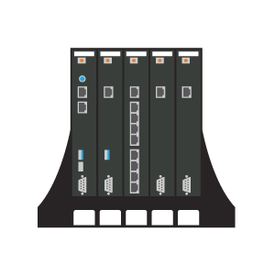
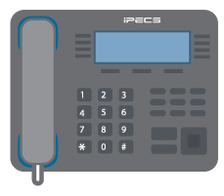
Features
Groups
iPECS Cloud
Queuing
PSTN
Local Survivability
Local Survivability – Hybrid Cloud
Connect your UCP to the cloud using t-net
Utilise the cloud with local redundancy using the UCP and PSTN
CAPEX protection by retaining existing iPECS handsets and hardware
Support iPECS LIK/UCP MFIM & PSTN/SIP gateways
Switchboard
Local Network
Multi-number / Shared Number
Router
Corporate Directory
UCP
Hot Desk
Mobile Extension

Slide 10
Features
Groups
iPECS Cloud
Queuing
PSTN
Local Survivability
X
Switchboard
Local Network
Multi-number / Shared Number
Router
Corporate Directory
UCP
Hot Desk
Mobile Extension

Slide 11
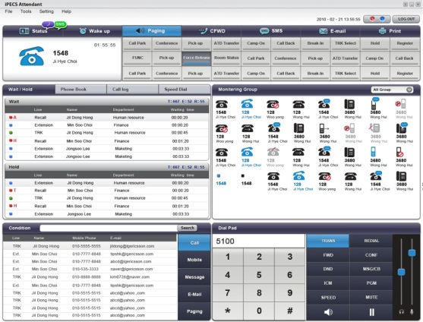
Features
Groups
Switchboard (IP Attendant)
Show member status
Simple Call Management
Simple call forwarding
Call queue management
Integrated Reports
Queuing
Local Survivability
Switchboard
Multi-number / Shared Number
Corporate Directory
Hot Desk
Mobile Extension

Slide 12
Features
Groups
Multiple Numbers
Assign multiple numbers to a single device
Shared Number
Multiple users can share a single number – Boss/Secretary
One Number Twinning
Max 4 phones can work with one business number including mobile phone, home phone etc.
Queuing
Local Survivability
Switchboard
Multi-number / Shared Number
Corporate Directory
Hot Desk
Mobile Extension

Slide 13
Features
Groups
Corporate Directory
Corporate directory can be imported via iPECS Cloud web GUI and shared amongst employees. This can be shared via the user web login and UC client.
Personal Directory
Click on personal smart phone directory and make a call through your business phone using your mobile UC client.
Hot Desk
Easily configure Hot Desk agents via the iPECS Cloud GUI. Log on and off handsets for sharing handsets and shift workers.
Mobile Extension
Use your mobile phone as an extension, calls can be routed to and from your mobile phone using your business number.
Queuing
Local Survivability
Switchboard
Multi-number / Shared Number
Corporate Directory
Hot Desk
Mobile Extension

Slide 14
Overview of Interface

Slide 15
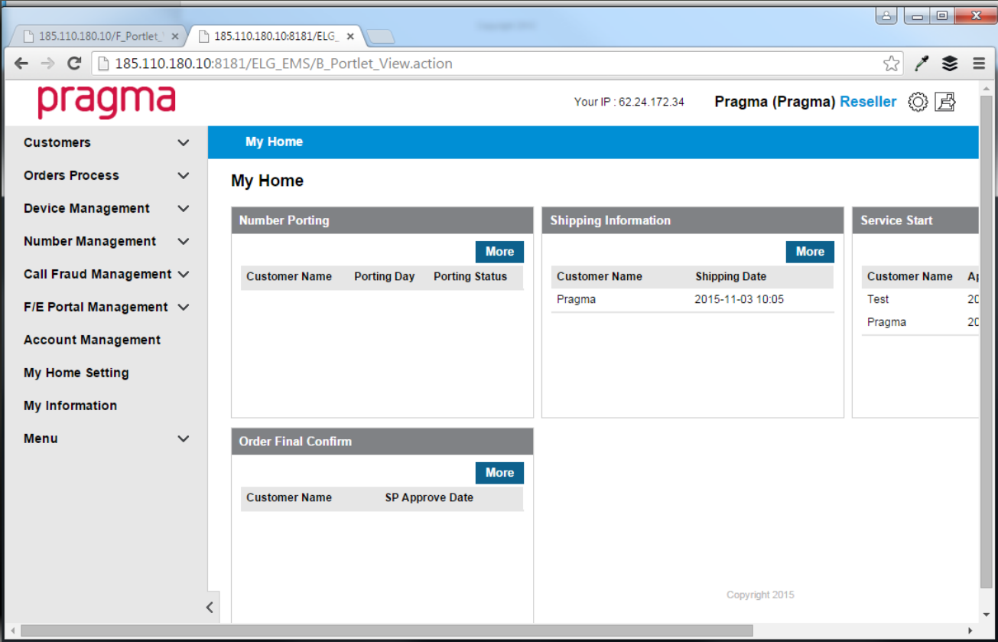
Under the Bonnet - Reseller
Full Portal Control
Same Day Provisioning
Handset Status Monitor
Simple Order Process
Call Fraud Management

Slide 16
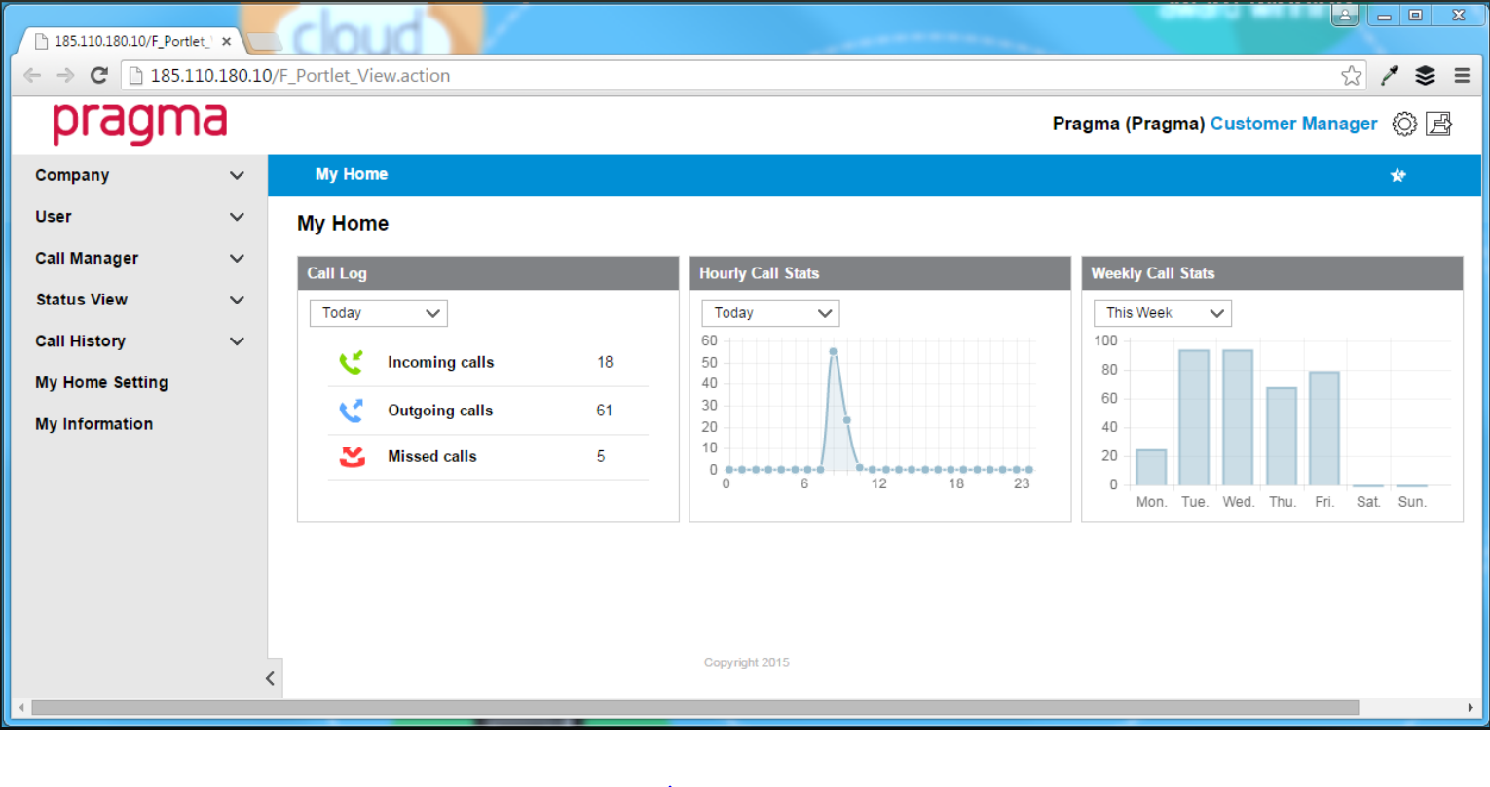
Under the Bonnet – IT Manager
Full Portal Control
Simple User Setup
Simple Ordering Process
System Monitoring & Support
IPKTS for Simple Remote Deployment
Easy configuration of:
Auto-attendant
Hunt Groups
Pickup Groups
ACD Groups
Paging Groups

Slide 17
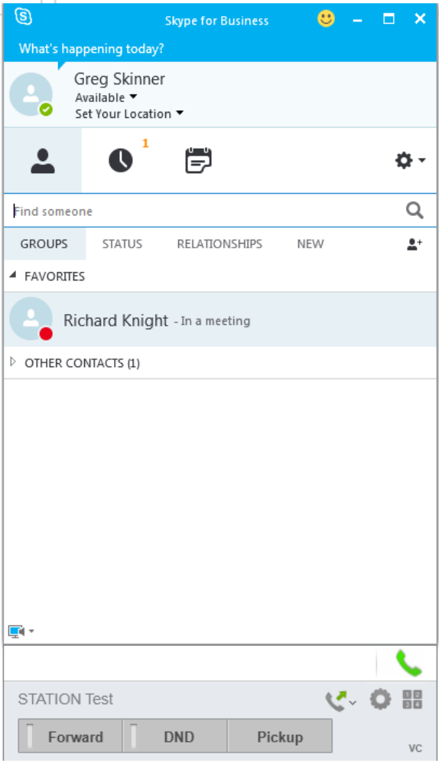
Under the Bonnet – User
User Portal Control
Click to Dial from Directory
One Number Twinning
Flexible Button Control
Mobile Extension
Skype for Business
Comprehensive Voicemail

Slide 18
Overview of Interface
Login as reseller
Add some quick links to top navigation
Edit your home screen
Run through left hand navigation menu items

Slide 19
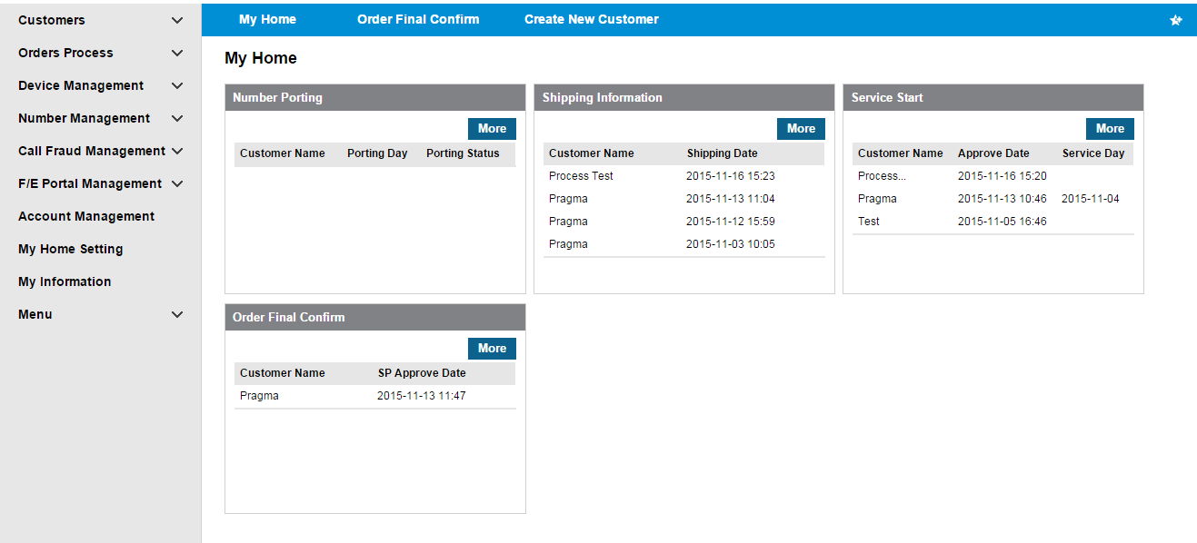
Overview of Interface
Main Navigation Menu
Adjustable quick links
Editable Home Screen
Notes:
Give overview of interface including:
Configurable Home Page
Top Menu
Navigation
Overview of menu Items

Slide 20
Order Process

Slide 21
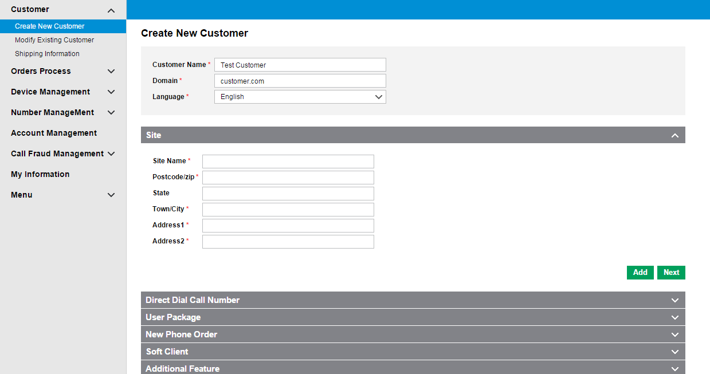
Order Process
Select “Create New Customer”
Run through full order process
Notes:
Run through order process from start to finish

Slide 22
Break

Slide 23
First time Customer setup

Slide 24
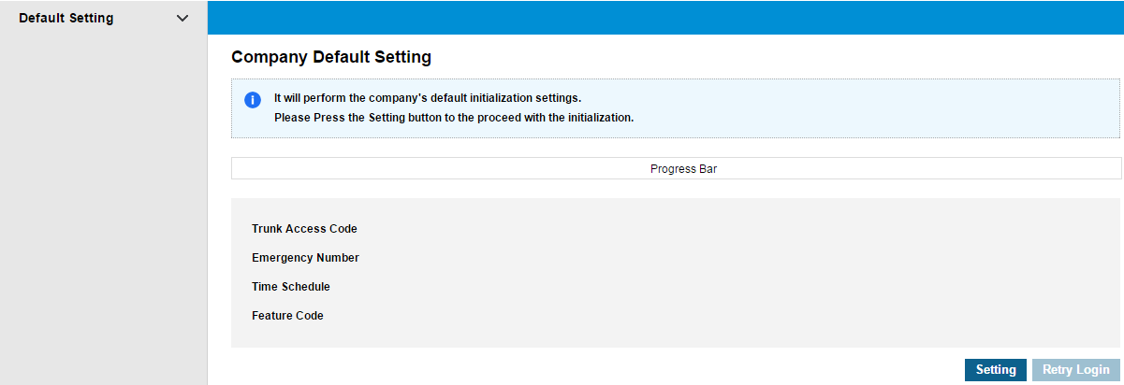
First time customer setup
On first time login you will be prompted to configure your default settings.
Click the setting button and allow the system to configure your default settings.
Notes:
Run through configuration of default settings.
Explain what this process is doing:
Setting up 9 for outside
Setting Default Feature Code
Setting Emergency Numbers

Slide 25
First time customer setup
Once completed you will prompted to log back into the system.
Notes:
Log back in to system

Slide 26
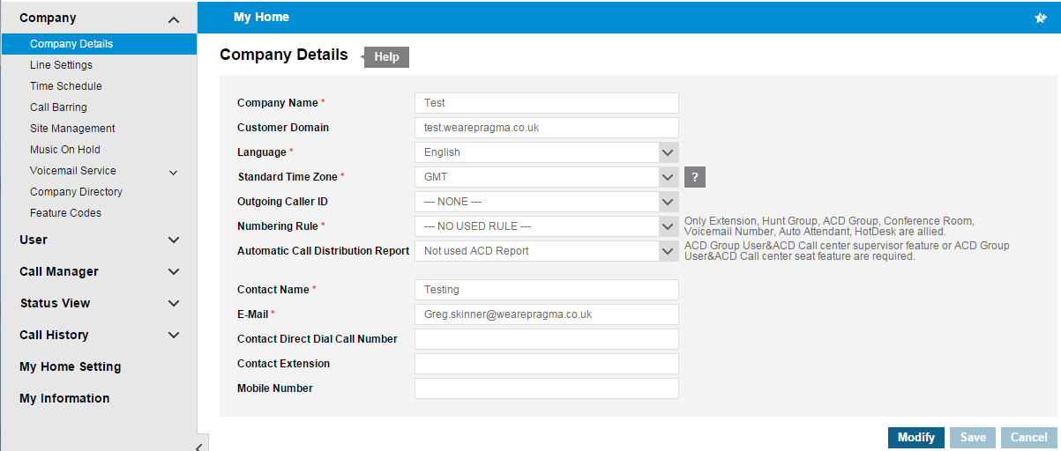
First time customer setup
Run through the left hand menu for the first time configuration.
Notes:
Configure all “Company” menu items before moving onto the user setup.

Slide 27
Adding Users

Slide 28
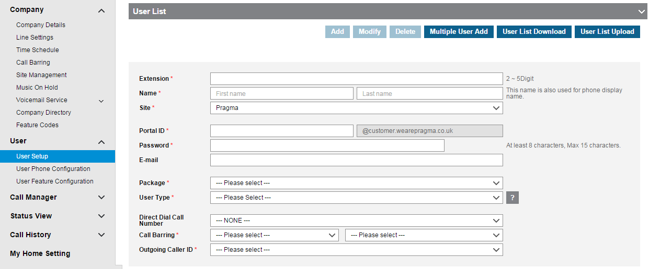
Adding Users
Select “User Setup” and add your first user.
Notes:
Configure user and assign a handsets.
Show different user types for multiple devices

Slide 29
Configuring Handsets

Slide 30
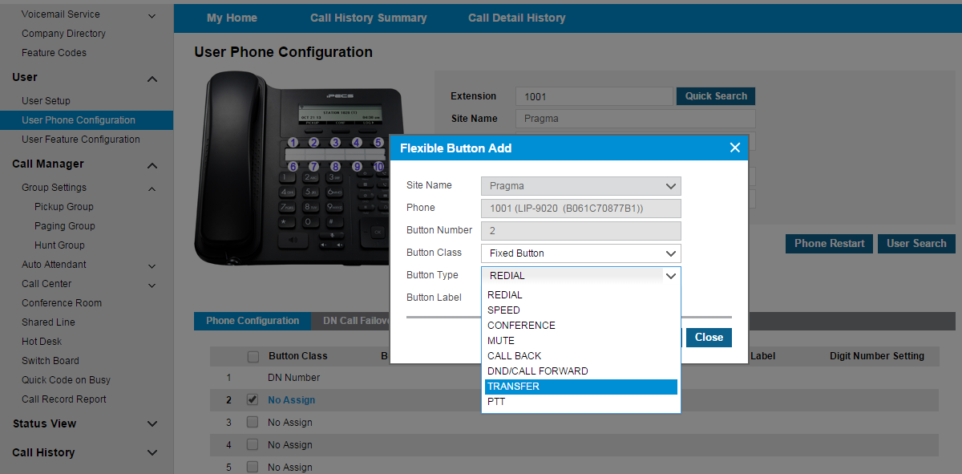
Configuring Handsets
Configure some handset buttons with various features.
Notes:
Explain button configuration.
Add fixed buttons
Add BLF lights

Slide 31
Call Manager Features

Slide 32
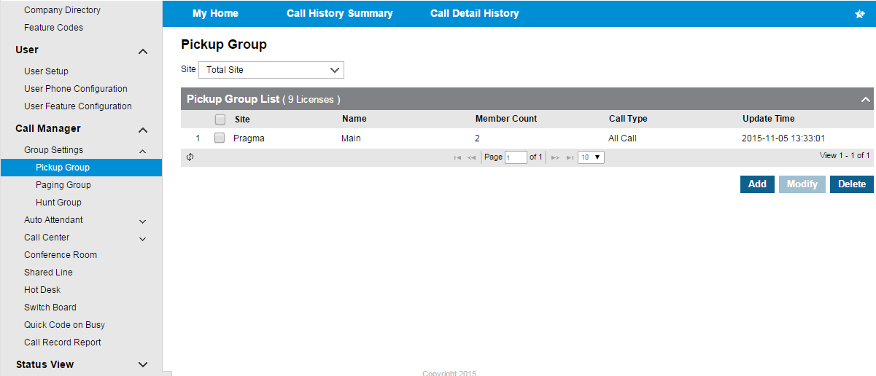
Call Manager Features
Run through and configure all “Call Manager” features.
Notes:
Configure all “Call Manager “ features.
Call Centre features covered in separate Webinar

Slide 33
ACD Call Centre Configuration

Slide 34
ACD Group and Permissions

Slide 35
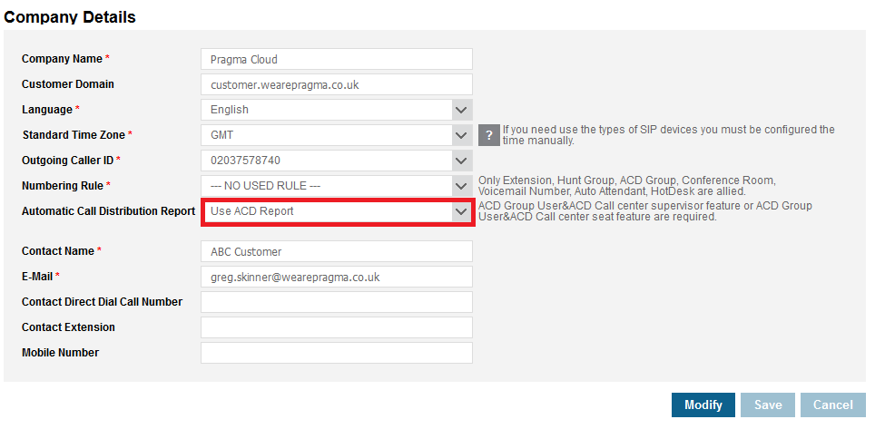
ACD Call Centre Configuration
Check Account is Set to ACD Enabled if required
Notes:
Configure all “Call Manager “ features.
Call Centre features covered in separate Webinar

Slide 36
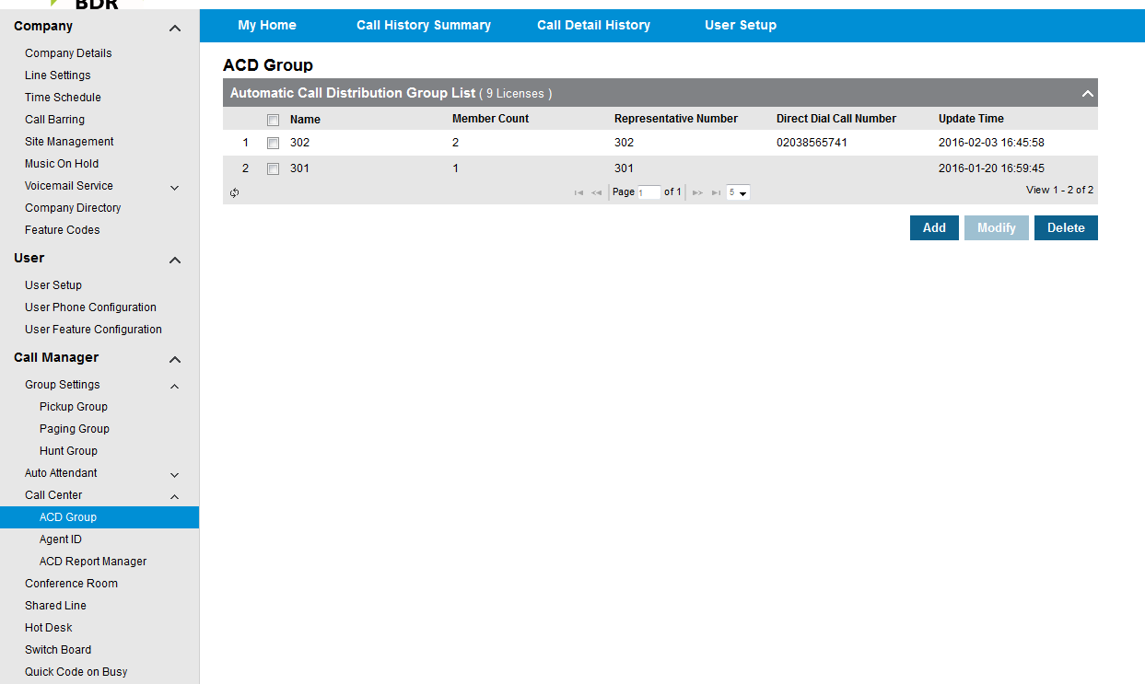
ACD Call Centre Configuration
Run through and configure all “Call Centre” features.
Notes:
Configure all “Call Manager “ features.
Call Centre features covered in separate Webinar

Slide 37
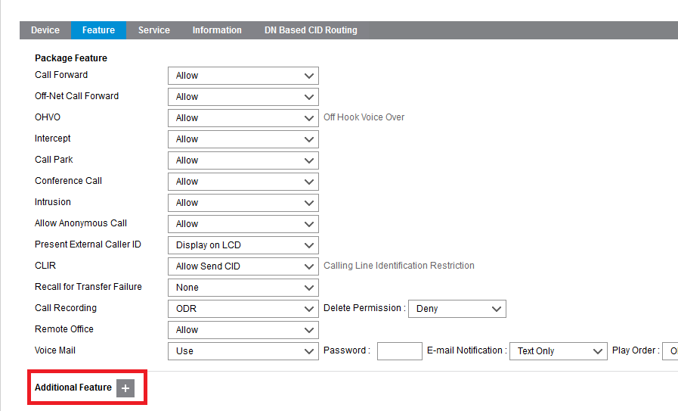
ACD Call Centre Configuration
Add ACD Properties to User
Notes:
Configure all “Call Manager “ features.
Call Centre features covered in separate Webinar

Slide 38
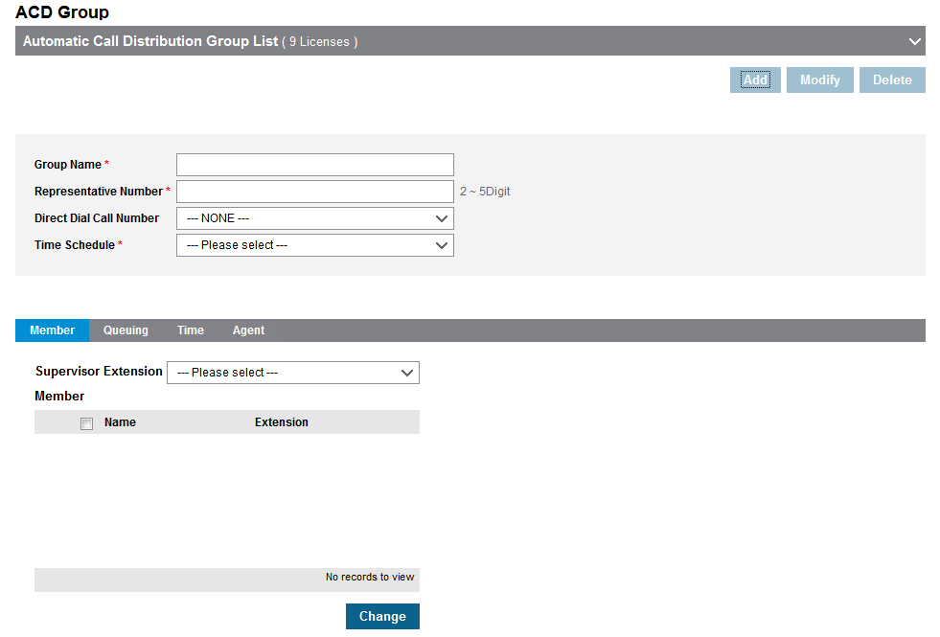
ACD Call Centre Configuration
Set up ACD Group Members
Notes:
Configure all “Call Manager “ features.
Call Centre features covered in separate Webinar

Slide 39
ACD Call Centre Configuration
Set up ACD Group Queuing
Notes:
Configure all “Call Manager “ features.
Call Centre features covered in separate Webinar

Slide 40
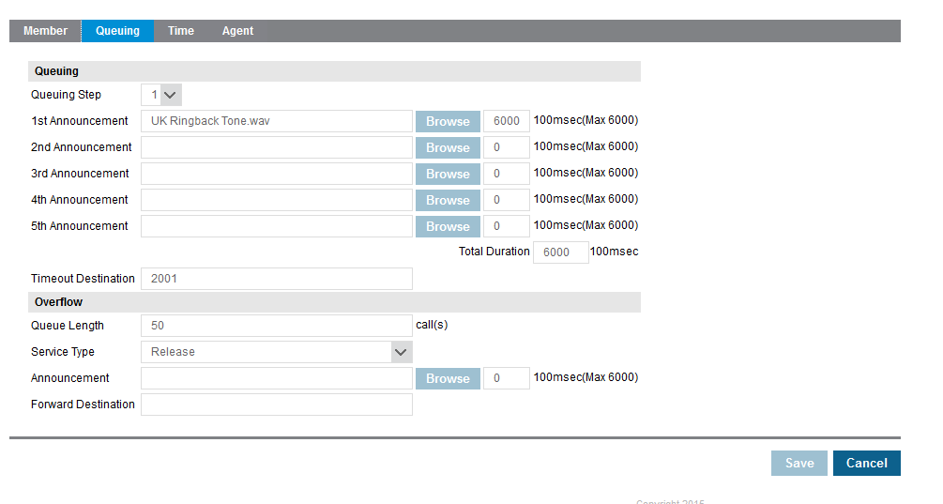
ACD Call Centre Configuration
Set up ACD Group Queuing
Notes:
Queueing step shows the amount of greetings that will be played.
Timeout destination will be sent to if this is exceeded.
Queue length = Max Callers
Service type will show the reaction given when max callers is met

Slide 41
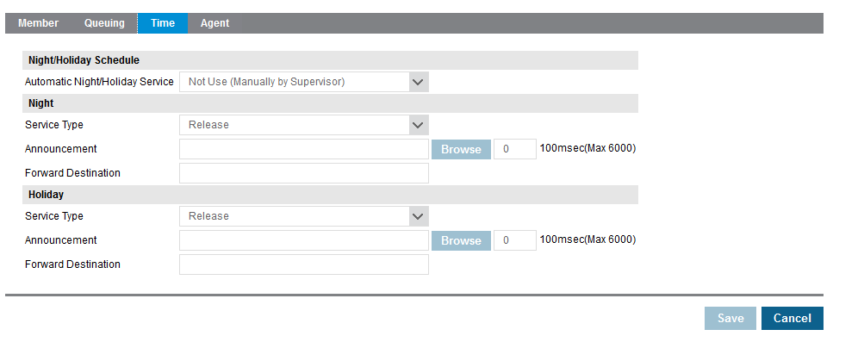
ACD Call Centre Configuration
Set up ACD Group Time
Notes:
Day/ Night mode – If this is kicked in by default or supervisor
Night/Holiday – Release, Forward, Announce

Slide 42
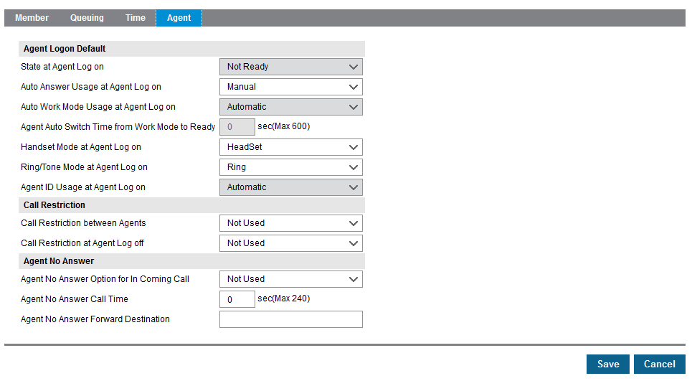
ACD Call Centre Configuration
Set up ACD Group Agent with Reporting
Notes:
Set default privileges of the ACD

Slide 43
ACD Call Centre Configuration
Set up ACD Group Agent No Reporting
Notes:
As you can see more is selectable

Slide 44
ACD Call Centre Agent

Slide 45
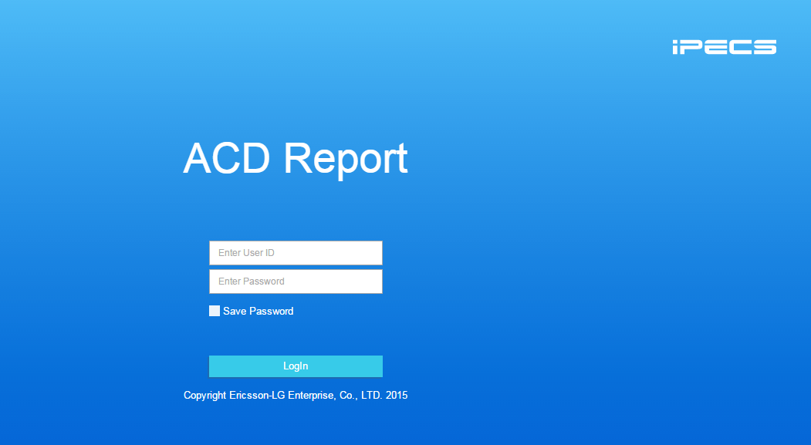
ACD Call Centre Configuration
Set up ACD Group Agent Login
Notes:
Login using User and Pass

Slide 46
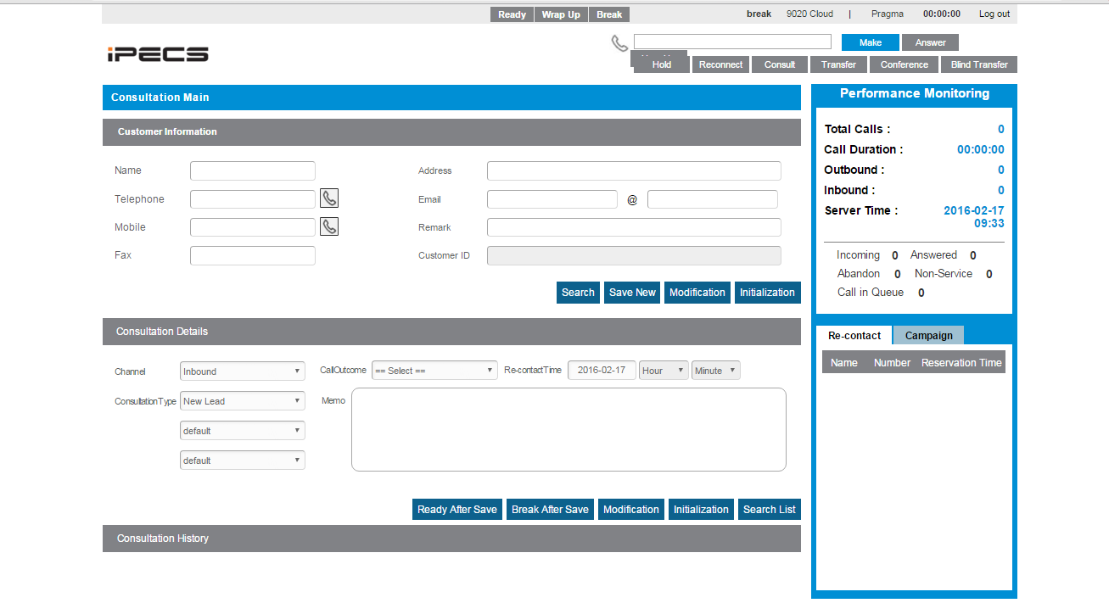
ACD Call Centre Configuration
Set up ACD Group Agent Interface
Notes:
Customer information will be populated on inbound or outbound call
You can also add status and details to the call to allow detailed information of the call.
You will then be able to see this under consultation history and reference this if needed.

Slide 47
ACD Call Centre Supervisor

Slide 48
ACD Call Centre Configuration
Set up ACD Group Supervisor Login
Notes:
Login using User and Pass

Slide 49
ACD Call Centre Configuration
ACD Management Administration Management
Notes:
Within agent management you are able to see ACD users and also the status of the user
Also able to define users menu usage for supervisor

Slide 50
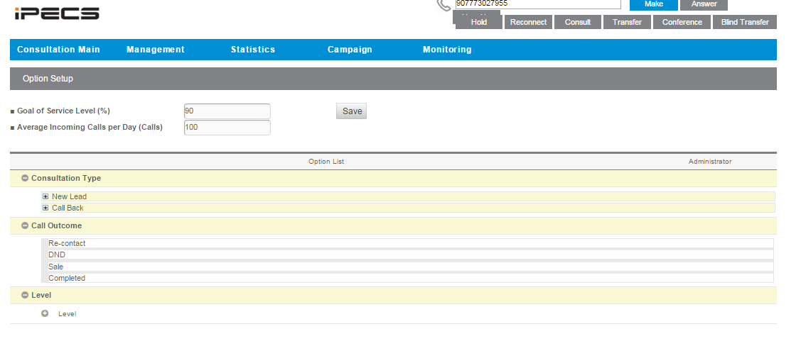
ACD Call Centre Configuration
Set up ACD Group Agent Login
Within Management Option Setup you are able to set call dispositions as well as service level.
You are then able to set these dispositions to groups so that they can be tailored to a specific group.
Notes:
Consultation type = type of call
Call outcome = disposition
Level shows if they are agent supervisor or manager.

Slide 51
ACD Call Centre Configuration
Set up ACD Group Supervisor Integration and Consolation Details
You are able to check numbers for contact records and then integrate this in to the database.

Slide 52
ACD Call Centre Configuration
ACD Statistics Agent Call Category Summary
You are able to breakdown reporting on calls to the ACD, including call outcome Group and Agent.
Notes:
You can also get graphs and excel documents if required
This can be viewed by date

Slide 53
ACD Call Centre Configuration
ACD Statistics Agent Performance in Age
Notes:
You are able to see Agent stats including Talk Time
This can be viewed by date

Slide 54
ACD Call Centre Configuration
ACD Statistics Agent Performance in Total
Notes:
You are able to see Agent totals again this can be sorted by date

Slide 55
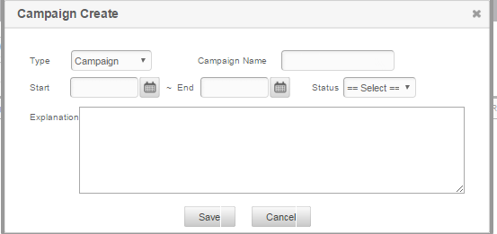
ACD Call Centre Configuration
ACD Statistics Campaign Stated and Registration
Notes:
Register Campaign

Slide 56
ACD Call Centre Configuration
You have now created a Campaign
Notes:
Campaign has been registered

Slide 57
ACD Call Centre Configuration
Download Template and then select Campaign to re-upload to.
Notes:
Create dummy data

Slide 58
ACD Call Centre Configuration
Routing DB
Notes:
You are now able to route numbers that you have uploaded to corresponding agents you are also able to retrieve this to reallocate if required.

Slide 59
ACD Call Centre Configuration
Routing DB
Notes:
You are now able to route numbers that you have uploaded to corresponding agents you are also able to retrieve this to reallocate if required.

Slide 60
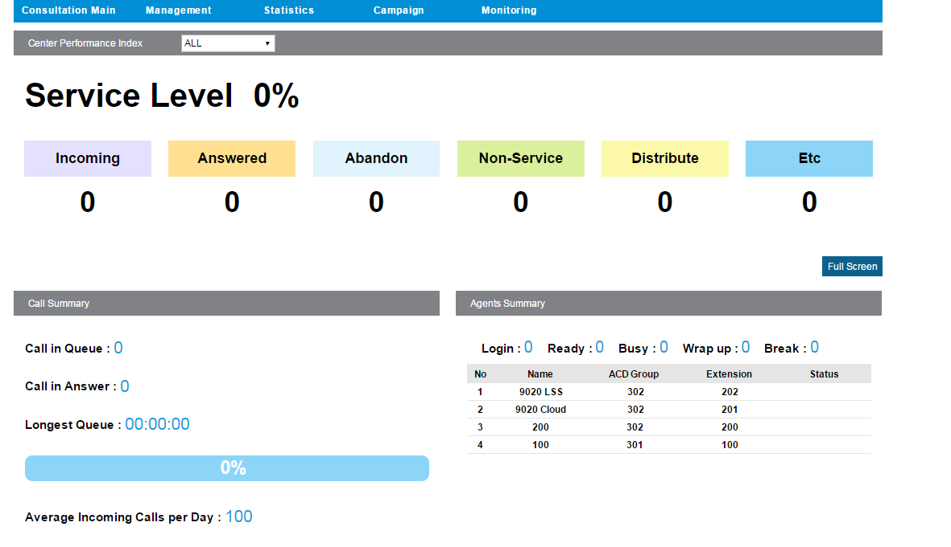
ACD Call Centre Configuration
ACD Monitoring Page
Notes:
From this screen you are able to see the daily calls within either all or a specific queue.
This also includes a breakdown of multiple statuses
You are also able to see the agents status within each ACD Group

Slide 61
ACD Report Manager

Slide 62
ACD Call Centre Configuration
Set up ACD Group Report Manager Creation
Notes:
Login using User and Pass

Slide 63
ACD Call Centre Configuration
Set up ACD Group Report Manager Login
Notes:
Login using User and Pass

Slide 64
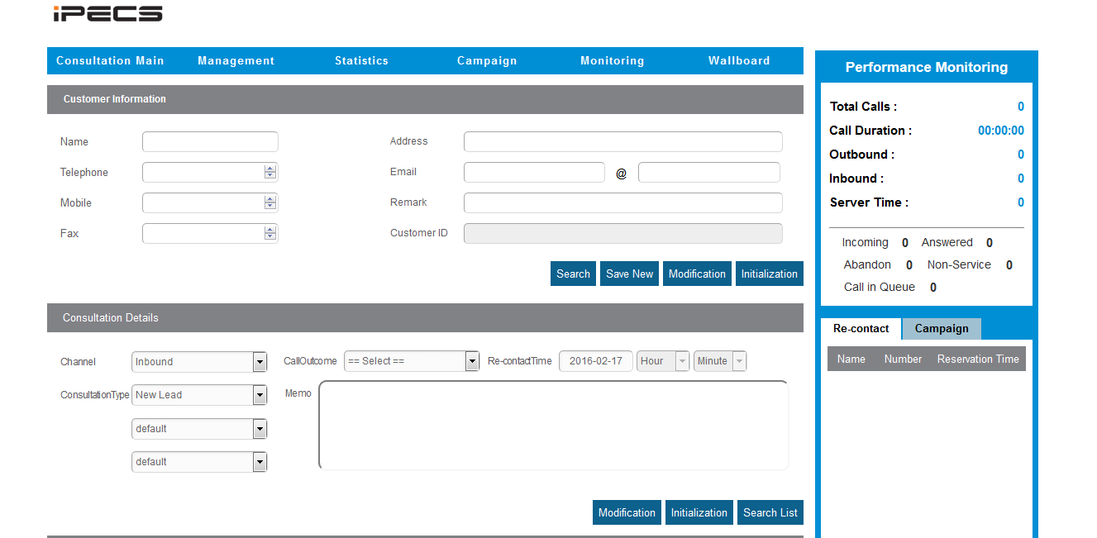
ACD Call Centre Configuration
Report manager has access to all the privileges of the supervisor except for the calling abilities, with the inclusion of the wall board.
Notes:
Login using User and Pass

Slide 65
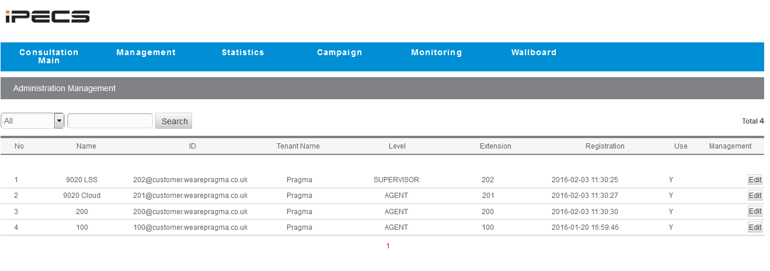
ACD Call Centre Configuration
Report manager has access to all the privileges of the supervisor except for the calling abilities, with the inclusion of the wall board.
Notes:
Login using User and Pass

Slide 66
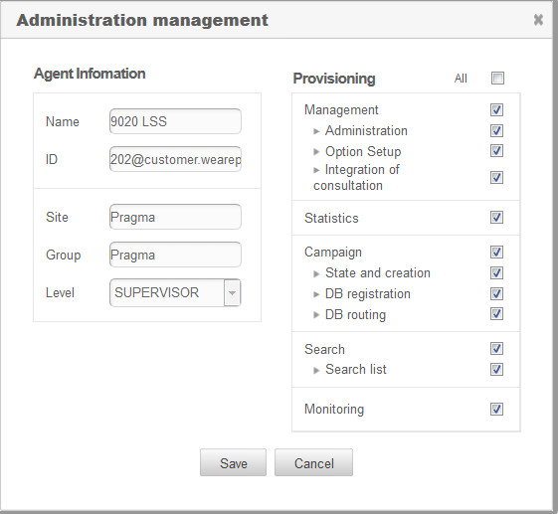
ACD Call Centre Configuration
Notes:
You are able to amend the user level and what options they have.

Slide 67
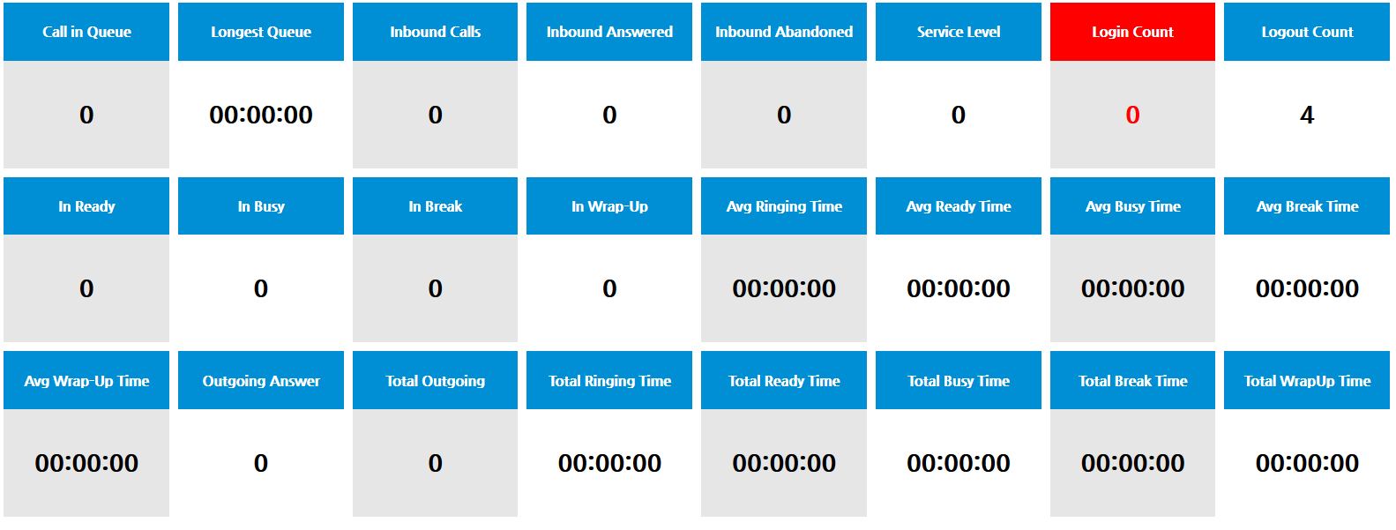
ACD Call Centre Configuration
The Wallboard has many options to report on you are also able to amend what shows as well as the threshold for this to alert.
Notes:
Login using User and Pass

Slide 68
Application Configuration

Slide 69
Skype for Business With Voice

Slide 70
Configuring Skype for Business Soft Client
Create a User as you would normally do but instead of selecting Phone, select Lync RCCV from the drop down list.
PLEASE NOTE !!!
This option will not be available unless you have purchased a licence.

Slide 71
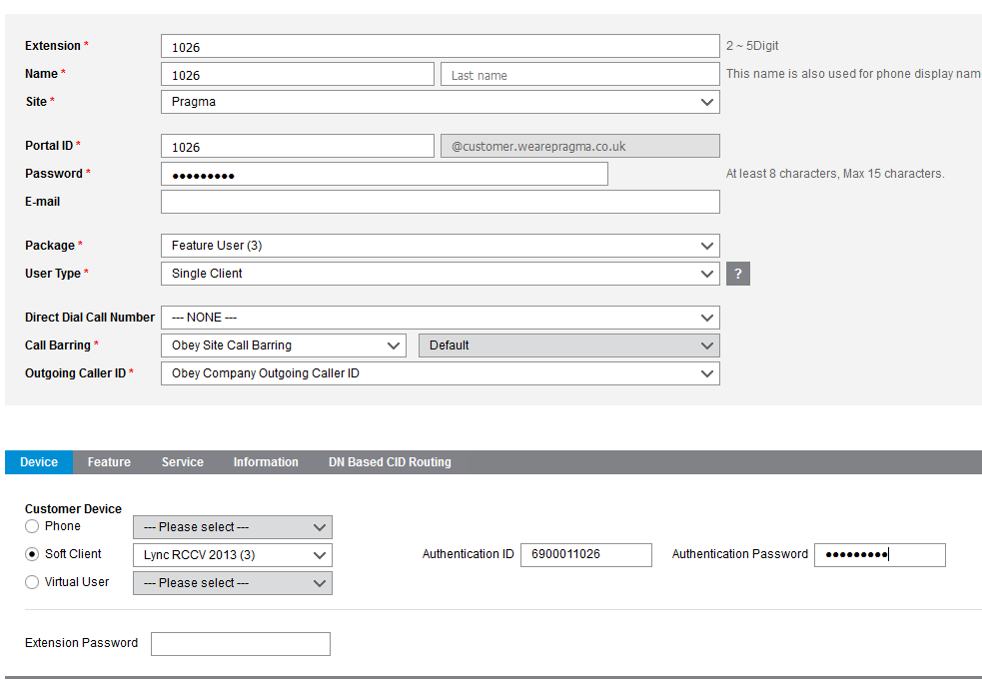
Configuring Skype for Business Soft Client
Once you have selected this option you will then need to input the username and password that will be used to register your client.
Currently you will need to contact support to get your unique identifier as this must be a prefix to the extension number as shown in the image.
As you can see we have the prefix of 69001 followed by the extension 1026.
You will also need to select a strong password as this is going to be used for your registration.

Slide 72
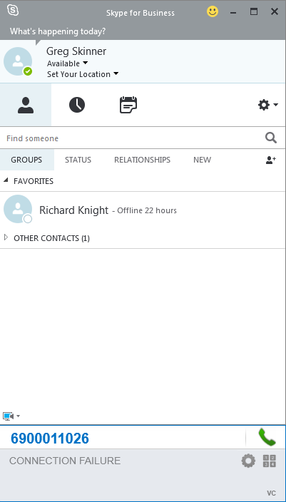
Configuring Skype for Business Soft Client
Next you will need to download and install Lync RCCV client from our website.
You will then have the below plugin once you open Skype for Business

Slide 73
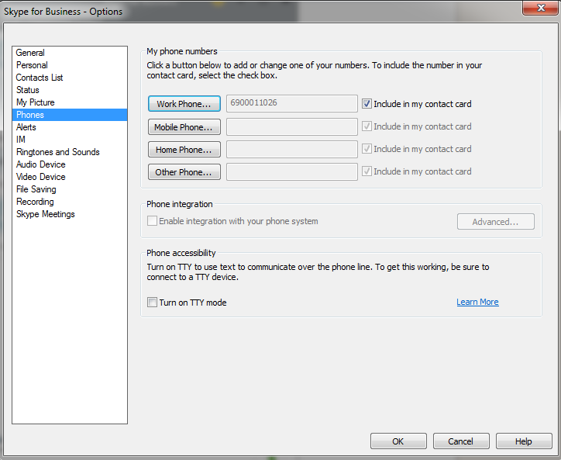
Configuring Skype for Business Soft Client
You will now need to go in to properties on Skype and then phones and amend your work phone to the registration user name as shown on the screenshot.

Slide 74
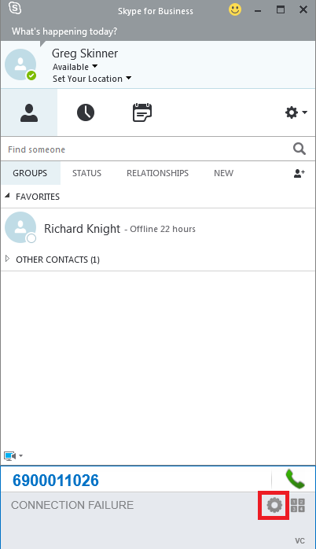
Configuring Skype for Business Soft Client
Next we will need to configure the client its self we can do this by clicking the cog found at the right of the bolt on.

Slide 75
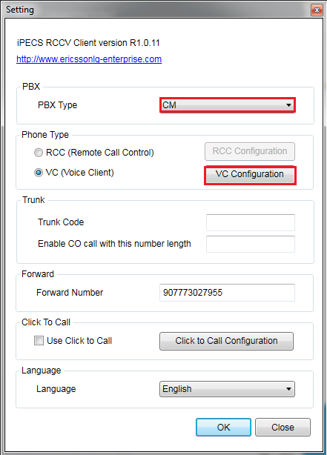
Configuring Skype for Business Soft Client
This will bring up the registration details, you will need to set the PBX type to CM
Also make sure to set Phone type to VC as this is the Softphone option, and once this is done you will need to click VC configuration to input the credentials.

Slide 76
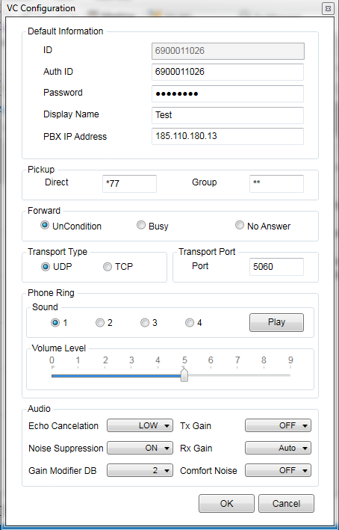
Configuring Skype for Business Soft Client
You will now need to enter your Username and Password as well as the SIP registration IP which will be 185.110.180.13.
You will need to make sure the port is set to 5060 and then click OK

Slide 77
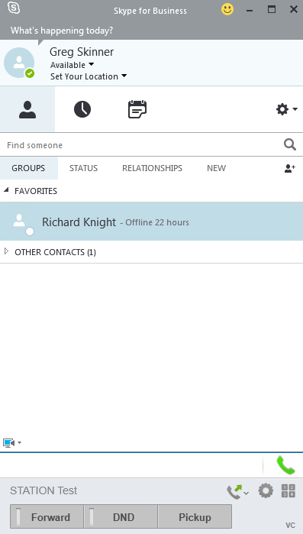
Configuring Skype for Business Soft Client
The softphone will now be registered as shown.

Slide 78
Skype for Business Non Voice

Slide 79
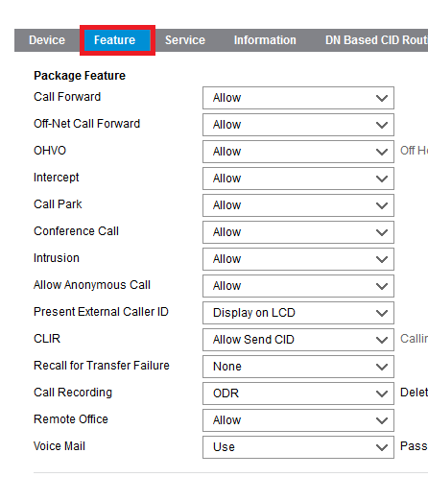
Configuring Skype for business Non Voice Client
First create an extension with a desk phone as normal, then go to features within the extension and you will see the screen shown.

Slide 80
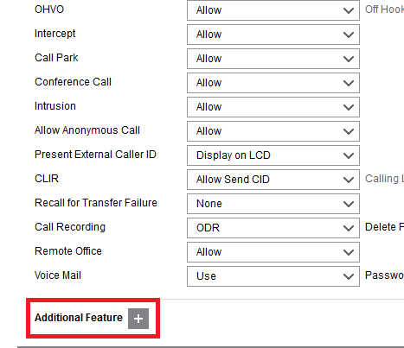
Configuring Skype for business Non Voice Client
Now if you scroll to the bottom you will see Additional features with a + button next to it. If you click then then you will get a pop up screen with further options.

Slide 81
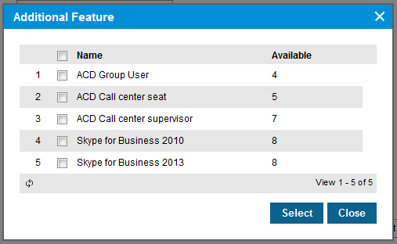
Configuring Skype for business Non Voice Client
You will now need to select the correct version of Skype normally this will be 2013. Once you have done this you can proceed and then save the extension to link this permission.

Slide 82
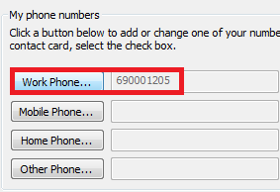
Configuring Skype for business Non Voice Client
Now we need to go to Skype and set the phone number under settings Phone

Slide 83
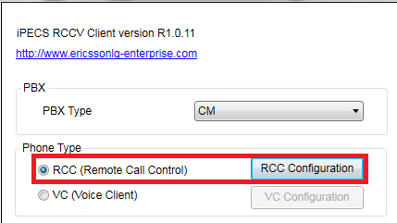
Configuring Skype for business Non Voice Client
You will then need to go under the RCCV client and select RCC .

Slide 84
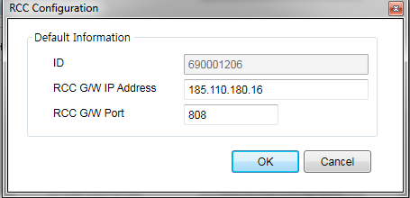
Configuring Skype for business Non Voice Client
You then need to input the information as shown in the Image.

Slide 85
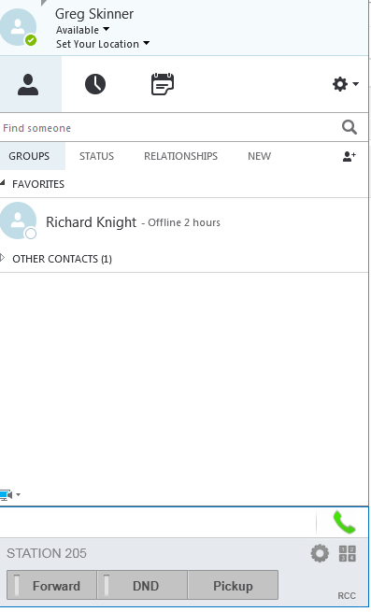
Configuring Skype for business Non Voice Client
You will then have a registered call controller.

Slide 86
IP Attendant

Slide 87
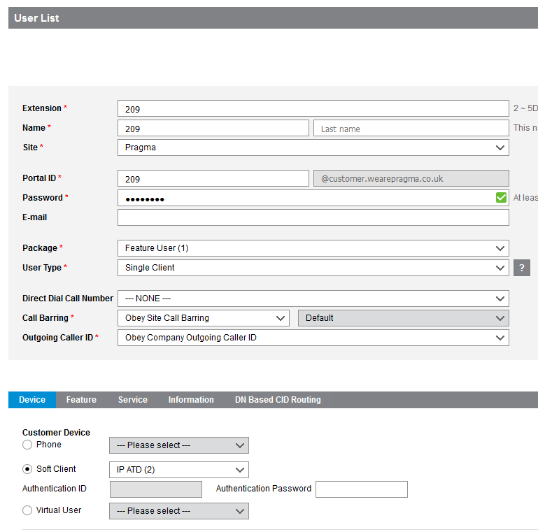
Configuring IP Attendant
Create User
Notes:
Create user

Slide 88
Configuring IP Attendant
Install IP Attendant
Notes:
Create user

Slide 89
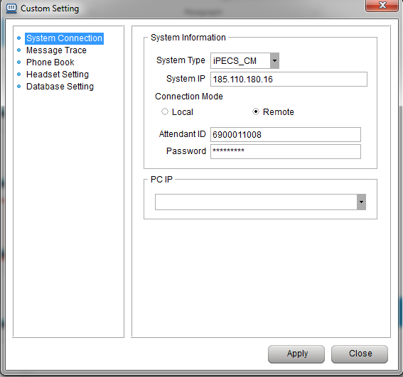
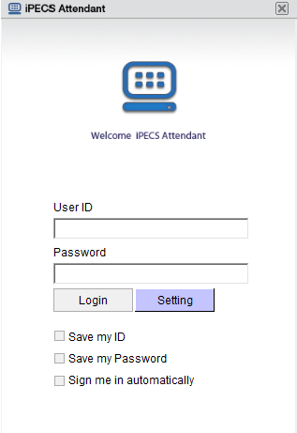
Configuring IP Attendant
Set IP Attendant Settings
Notes:
Configure settings/ System type and login credentials

Slide 90
Configuring IP Attendant
Configure Account Within Tools Account
Notes:
Create user

Slide 91
Configuring IP Attendant
Ip Attendant Online
Notes:
Create user

Slide 92
Call Recording

Slide 93
Call Recording
Configure both on-demand call recording and automatic recording features.
Notes:
Explain call recording
ODR = On Demand
ACR = Automatic

Slide 94
QoS Setup

Slide 95
QoS Setup
What is QoS?
Quality of Service is a function of a router or firewall that is used to prioritise certain network traffic. This is often used to prioritise voice traffic over data.
When setting up the iPECS Cloud system you will need to make sure to configure Quality of Service (QOS) if you do not have a separate internet connection for your phones.

Slide 96
QoS Setup – Ports to Prioritise
IPKTS
Signalling Port: 5588 UDP
Media Ports: 30000-60000 UDP
SIP
Signalling Port: 5060 UDP
Media Ports: 16384-17384 UDP

Slide 97
QoS Setup – Example

Slide 98
QoS Setup – Example

Slide 99
Troubleshooting
Best Practices

Slide 100
Troubleshooting – Best Practices
Run a Traceroute or PingPlotter
If a customer is reporting quality issues, this can often be a result of packet loss.
Run a trace route from the customers site to the IPKTS relay or SIP server and see if it is indicating packet loss. Alternatively use PingPlotter
Notes:
Show ping plotter

Slide 101
Troubleshooting – Best Practices
Run a network trace
Loss of audio or one way audio is often caused my incorrectly configured firewalls.
Use Wireshark to run a network trace, this can then be filtered to inspect call traffic. Traces can be used to diagnose a number of issues.

Slide 102
Troubleshooting – Best Practices

Slide 103
PRAGMA TECHNICAL SUPPORT TEAM
Steve Birchall
Simon Colley
Mark Jones
Greg Skinner
Josh Aldridge
Andrew Cleveland

