Slide 1

iPECS Cloud
Version 3 Update

Slide 2
New Features

Slide 3
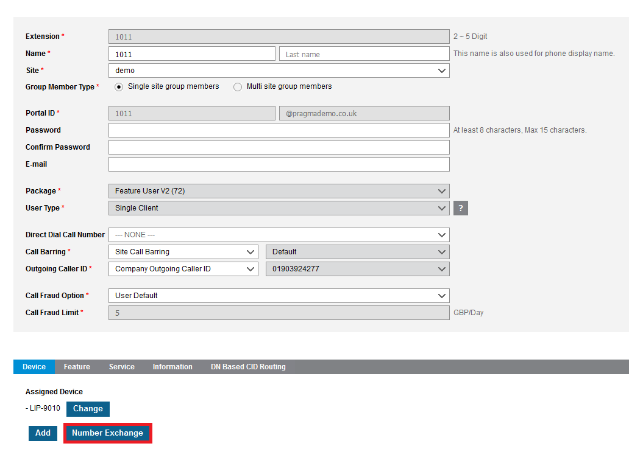
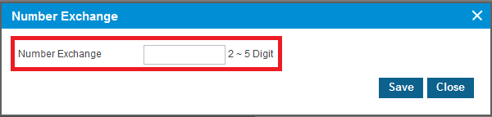
Extension Number Change
You are now able to swap extension numbers without any issues by going to User Setup and then select the extension, and scroll down to Number Exchange you will then be able to select the extension you would like to change to.

Slide 4
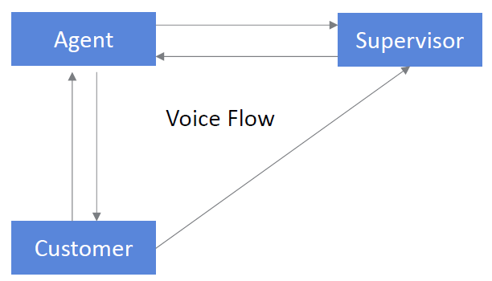
ACD Whisper Coaching
ACD Whisper Coaching is now available to be utilised while you have call recording enabled.
Agent can request Coaching by pressing ACD Agent Whisper Coaching
Request(A)/Accept(S) Feature code at Agent to use this function Feature code should be
registered on flex button

Slide 5
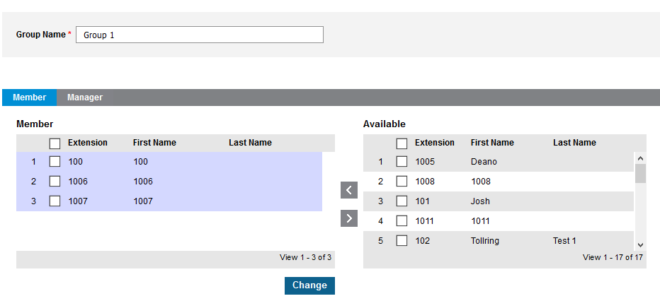
Call Recording Groups
Call Recording groups can now be configured, this will allow restricted access to multiple users call recordings from the customer manager portal this will allow team leaders or managers to have access to only certain users call recordings.
First you need to set the members that you will be able to see

Slide 6
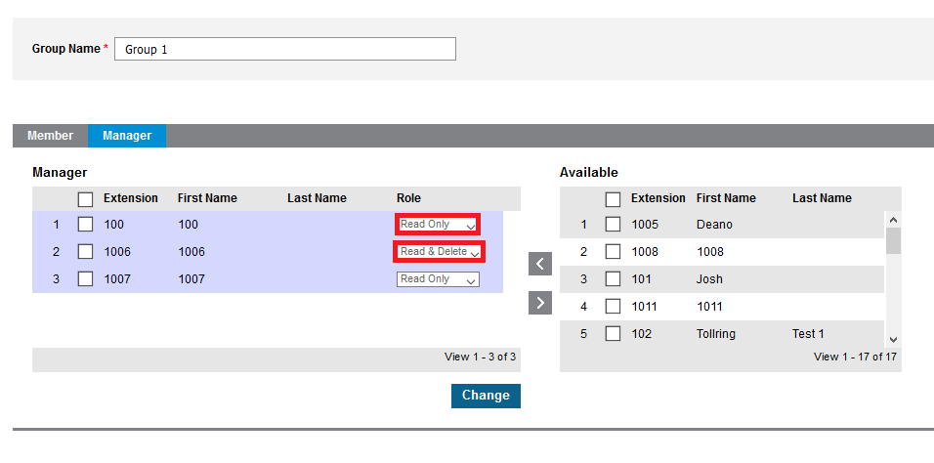
Call Recording Groups
Next you need to set the people that will be able to see this group and what access they will have either Read Only or Read and Delete

Slide 7
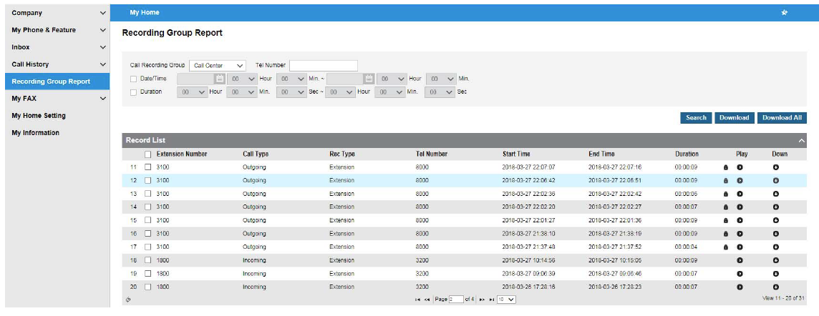
Call Recording Groups
When logged in to the user portal for the manager accounts you will then be able to see recordings for the selected users.

Slide 8
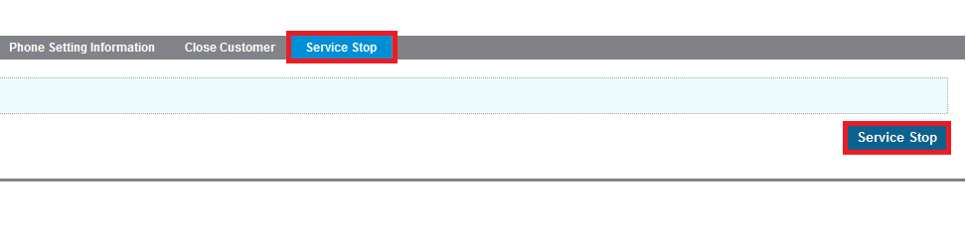
Service Stop
You now have the ability to stop a customers account should you need to restrict the account for any reason.
NOTE this is an order so will need to be confirmed by pragma and then final confirmed before this will take action.

Slide 9
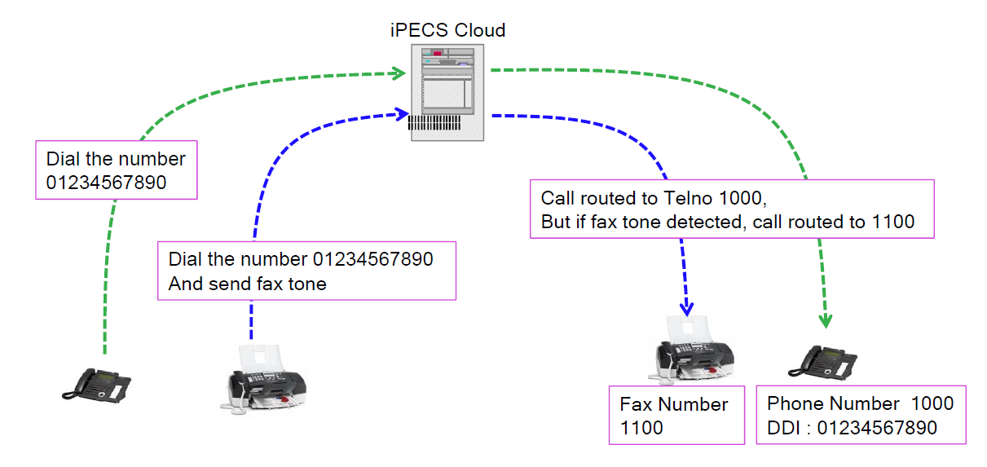
Fax Bridge
Fax Bridge allows you to set a time that the line will wait to detect fax before the call is transferred to the user.
If fax is detected then the call is rerouted to the fax destination set.

Slide 10
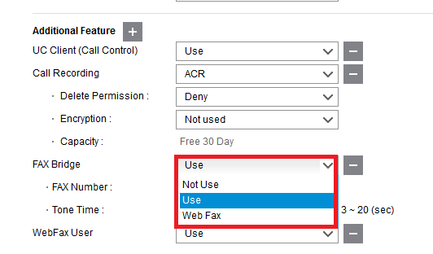

Fax Bridge
In User Setup in additional features you can add fax bridge you will then be able to select the usage if this will go to the web fax service or if this will go to a specific extension number.

Slide 11
Security – DB Encryption
DB Encryption
: All Database in EMS is encrypted AES by default
Existing data in v2.4 will be automatically encrypted during v3.0 migration.
Component | Encrypted Data | Details
EMS | DB All
SBC | All Data
AA, VM, CR | All Data
Billing G/W | All Data
UCE | All Data
uCM | Personal Information | IP address, Name, Directory, …
ACB | Personal Information | IP address, Name, Directory, …

Slide 12
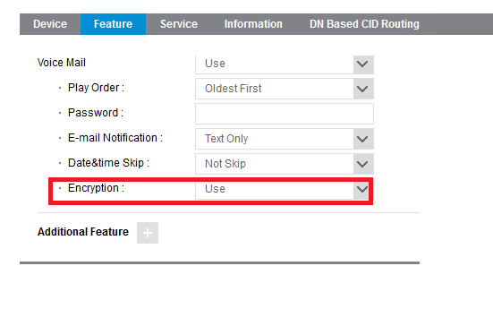
Security – Voice mail Encryption
Encryption can be enabled by going to User Setup > Features Then under voicemail you will see the option for Encryption
If encryption is enabled, recording file will not be attached in e-mail notification regardless attachment option.

Slide 13
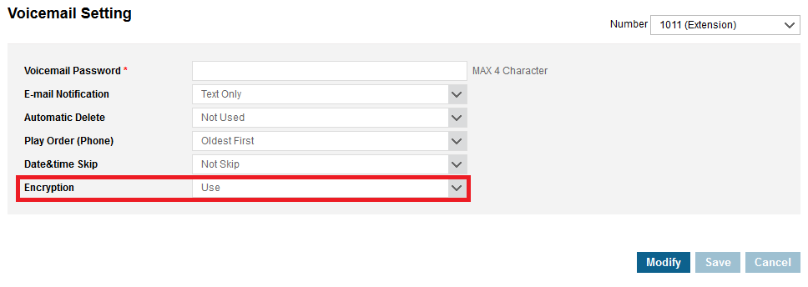
Security – Voice mail Encryption
This can also be set on the User Portal
If encryption is enabled, recording file will not be attached in e-mail notification regardless attachment option.

Slide 14
FOC Licences will not require Order
Pragma will allocate certain licenses to be free of charge. This means that you will no longer need place an order and will be able to add the license from the portal.
TO NOTE Once this license is set to FOC it will no longer show when placing orders.

Slide 15
Voicemail Auto Delete
Voicemails will automatically delete the oldest file when the storage limit is reached.

Slide 16
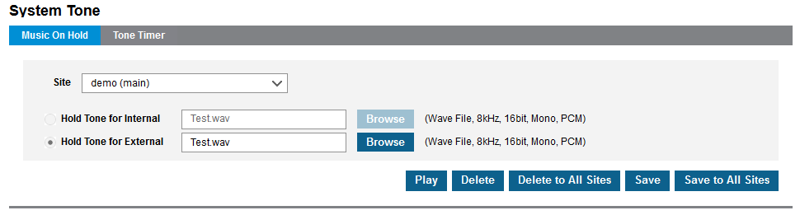
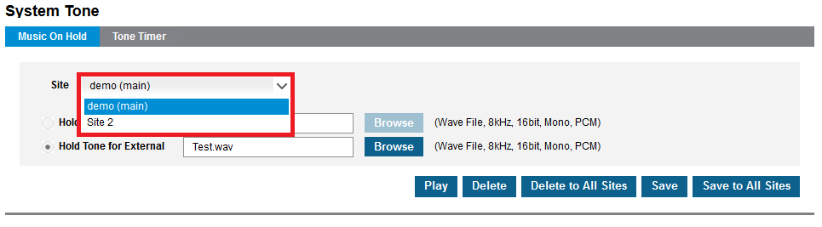
MOH Available per site
MOH is now available on a per site basis instead of one MOH for the entire company.

Slide 17
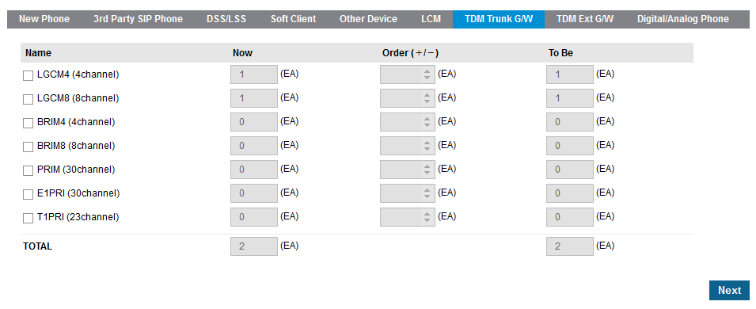
Module Support TDM Trunk G/W
TDM Trunk Gateways are now available to be used on the cloud to allow you to migrate your customers without needing to wait for porting.

Slide 18
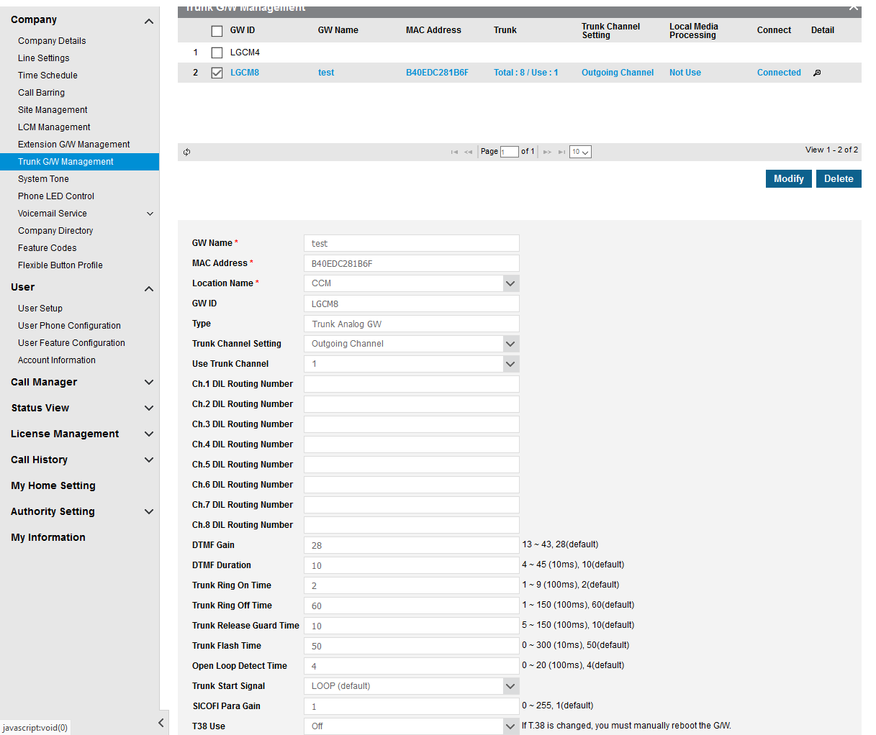
Module Support TDM Trunk G/W Setup
Once you have ordered the module you will then need to configure the module. To do this you will need to navigate Trunk G/W Management, next select your module then click modify. You will then need to enter the MAC address for the device.

Slide 19
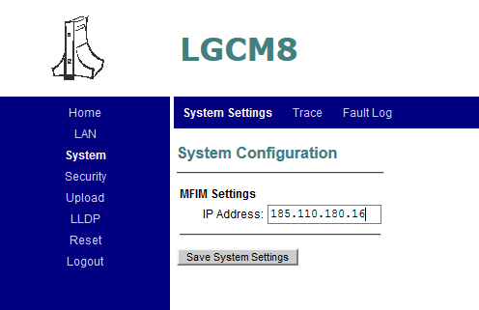
Module Support TDM Trunk G/W Setup
You will also need to set the IP that the module will connect to, this will be the IP that you phones will be registering to.

Slide 20
Module Support TDM Trunk G/W Setup
When using TDM Trunks you will need to select how this will be used, NOTE currently you cannot have sip and ISDN running at the same time for inbound

Slide 21
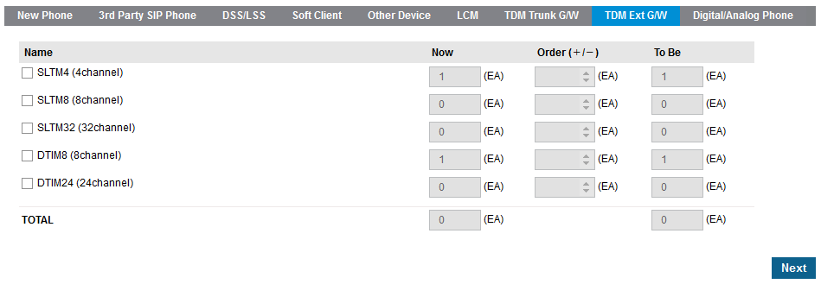
Module Support TDM Ext G/W
TDM Extension Gateways are now available to be used on the cloud to allow you to bring the cloud customers that may not want to re-cable there existing TDM infrastructure.

Slide 22
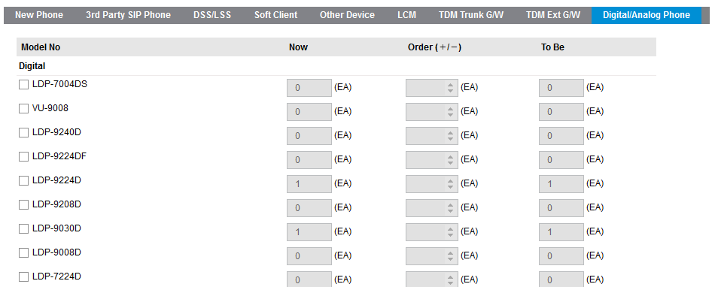
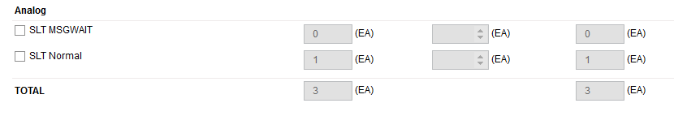
Module Support TDM Ext G/W
If you select to use a TDM Ext GW then you will also need to order the phones that will be provisioned on this module.

Slide 23
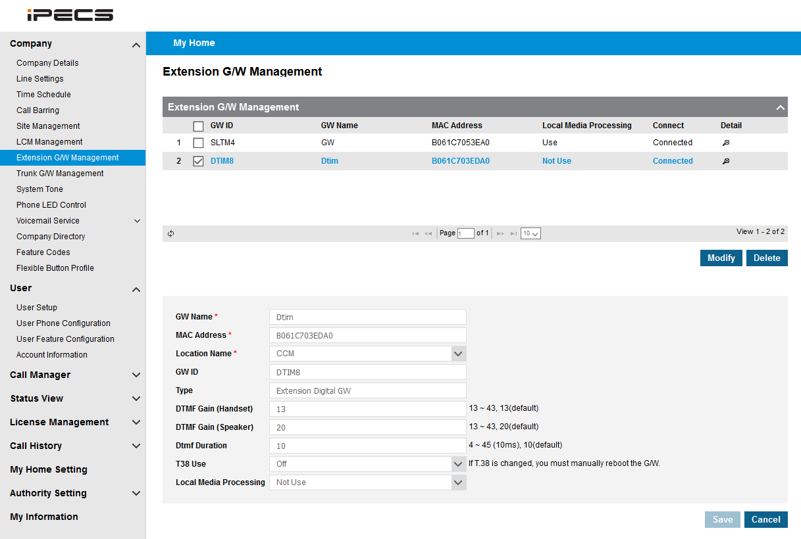
Module Support TDM Ext G/W Setup
Once you have ordered the module you will then need to configure the module. To do this you will need to navigate Extension G/W Management, next select your module then click modify. You will then need to enter the MAC address for the device.

Slide 24
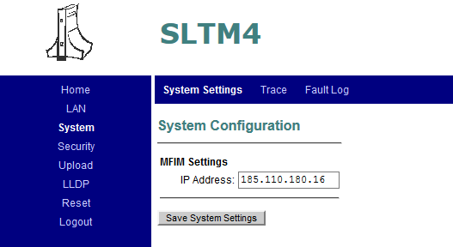
Module Support TDM Ext G/W Setup
You will also need to set the IP that the module will connect to, this will be the IP that you phones will be registering to.

Slide 25
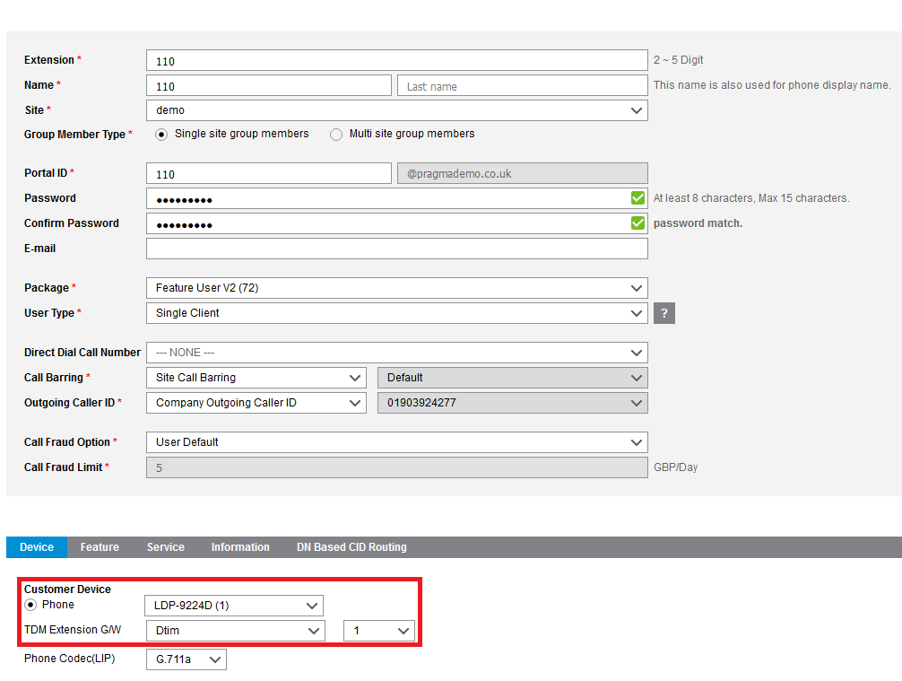
Module Support TDM Ext G/W Setup
When setting up the phone you will need to select the digital terminal and then the port on the module that you would like to use.

Slide 26
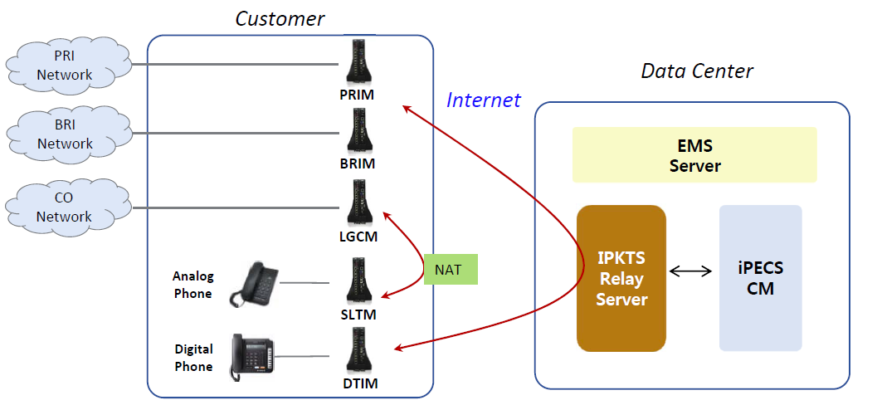
Local Media Processing
With Version 3 we are introducing the ability to utilize Local Media processing, this is available on both LIP handsets and the modules that will be supported.

Slide 27
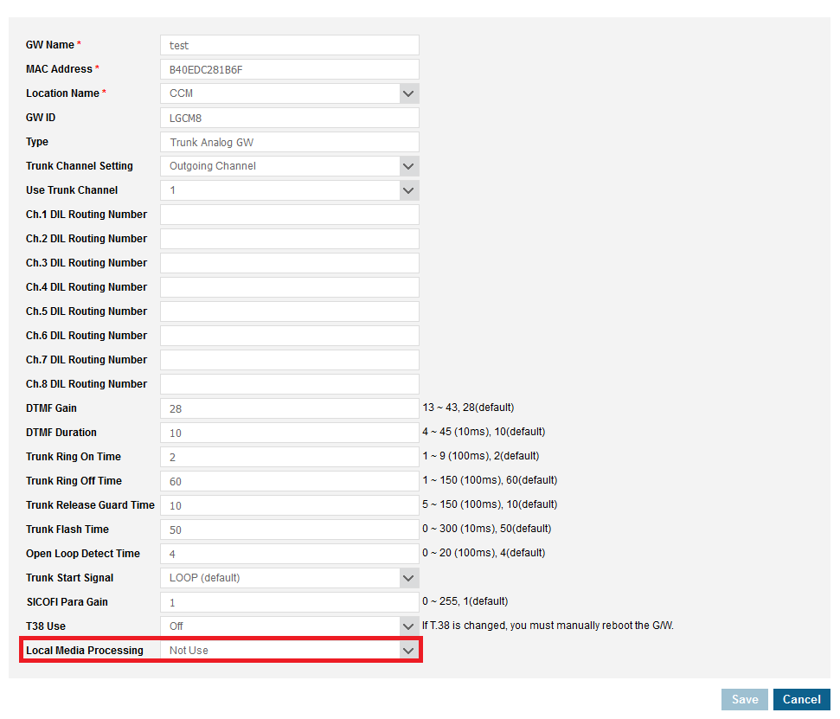
Local Media Processing
You are able to configure this on the modules by changing Local Media Processing to use

Slide 28
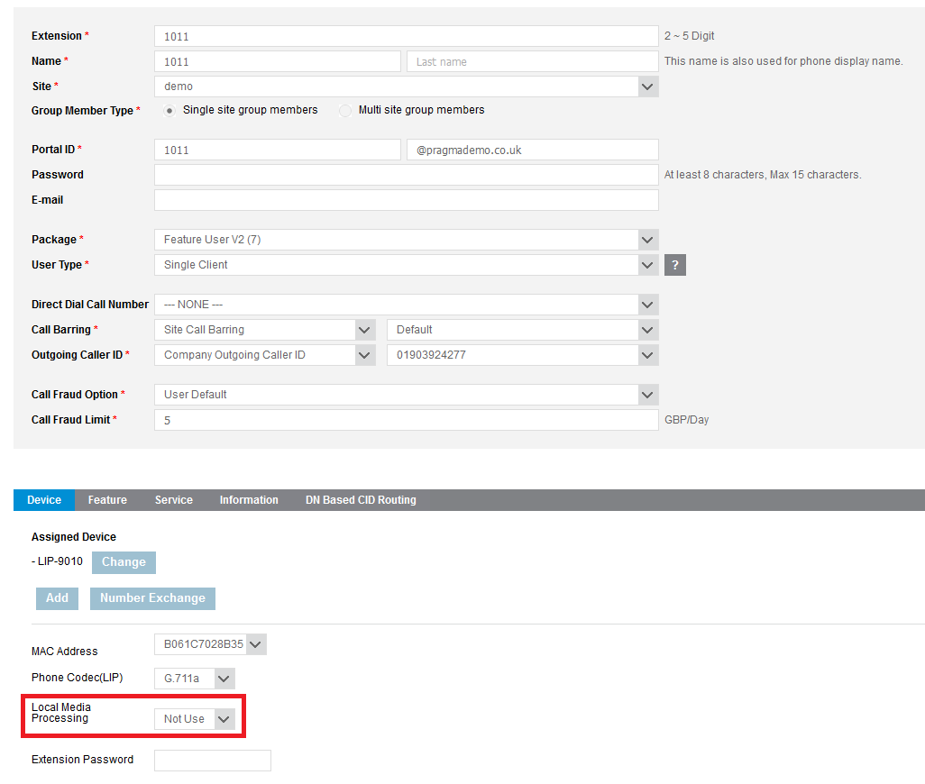
Local Media Processing
You are able to configure this on the phones by changing Local Media Processing to use

Slide 29
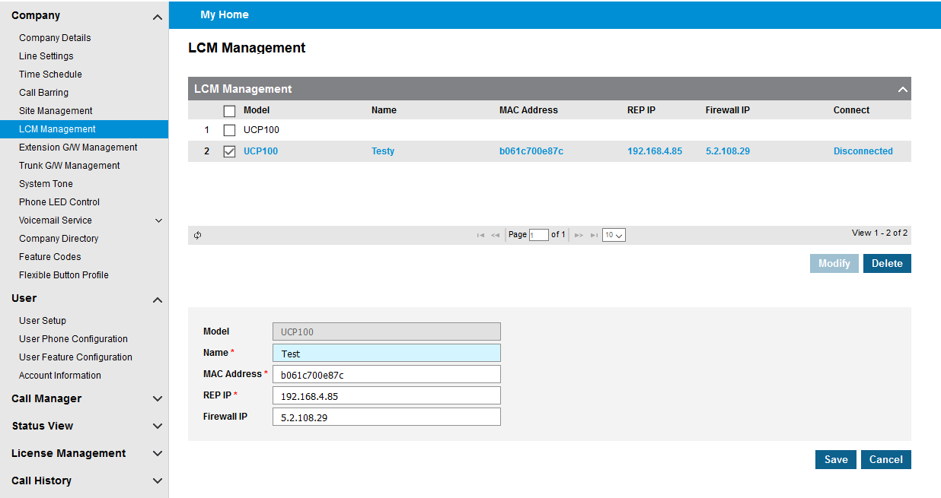
LCM Per Site
You are now able to set multiple LCM Per account tis can then be set up to use one LCM per site. You will need to enter the valid IP details linked with the LCM

Slide 30
Multiple LCM
To register a LCM in the Cloud system, the representative IP information must be entered in the LCM management menu.
1st IP and 2nd IP information are required for the LCM redundancy configuration and the firewall
IP must be entered if a firewall device is necessary.
Management

Slide 31
3rd Party Phones to be added to the platform
3rd Party devices can now be tested and approved by pragma if you have any devices that you would like to use please let us know.
This means if your device has a licence for it you will not need to wait for pragma to do a backend change to allow registration.

Slide 32
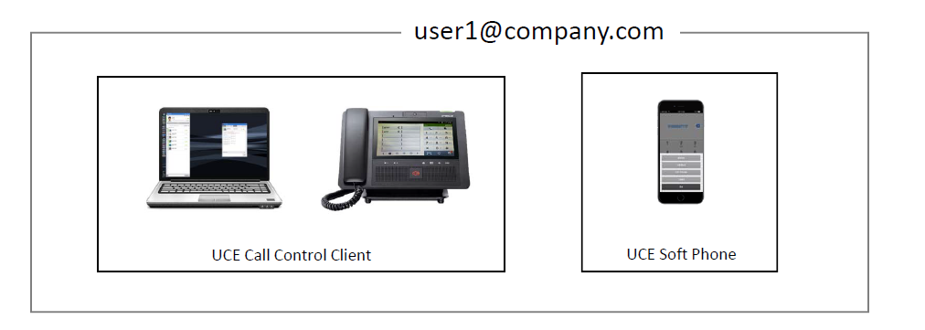
Multi Usage for UCE Call Control and Voice Client
With Version 3 you are now able to have both a voice and non voice UCE client linked with the same user, the only restriction is that the PC client will be forced to non voice and the mobile will be a voice client.
You will be able to login using the same login information and calls will be routed to all devices.

Slide 33
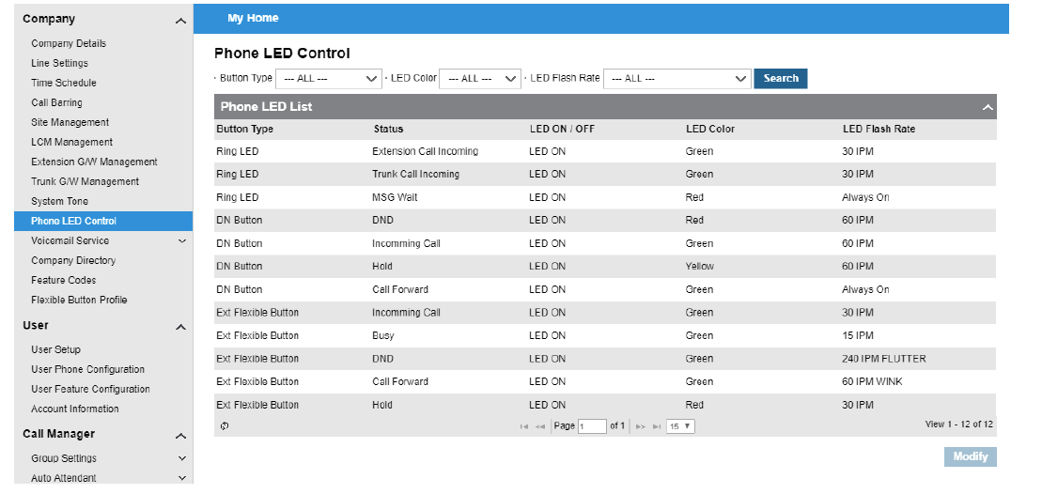
LIP Phone LED Control
You now have the ability to select the colour and LED Flash Rate as well as if the LED is on or off.

Slide 34
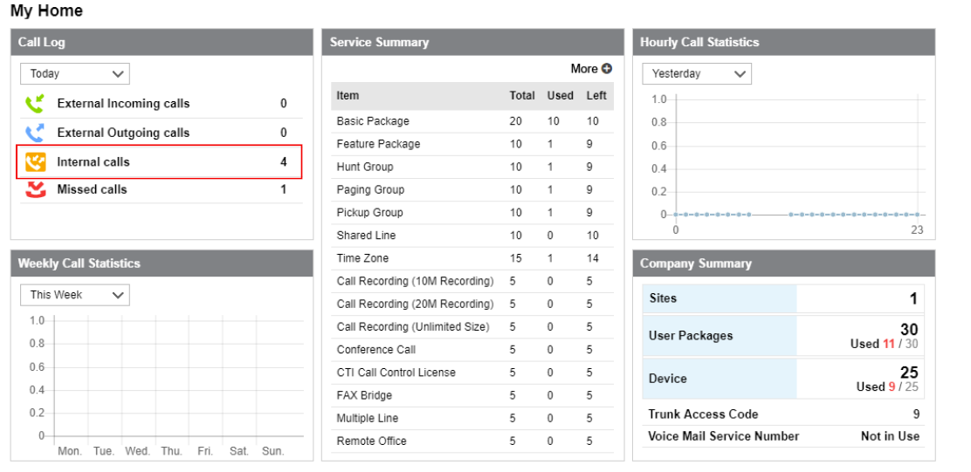
Internal Calls shown in My home Call Log
Internal Calls are now shown on the call log widget

Slide 35
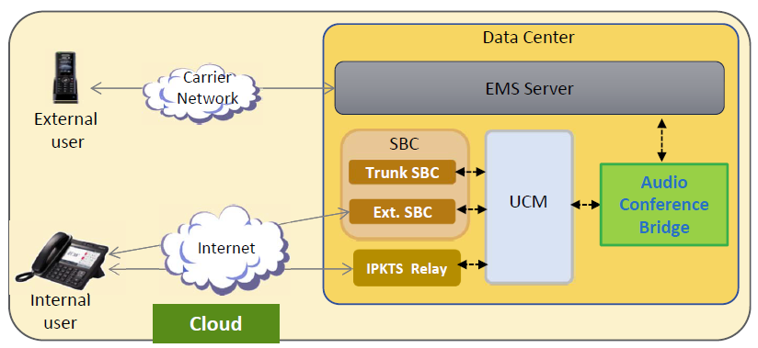
iPECS Audio Conferencing Bridge
Features
Authentication with Security Code
Participant Name Recording & Play Functionality
Support for Secure RTP
Conference Control
Conference Scheduling
Web‐based management
System Redundancy

Slide 36
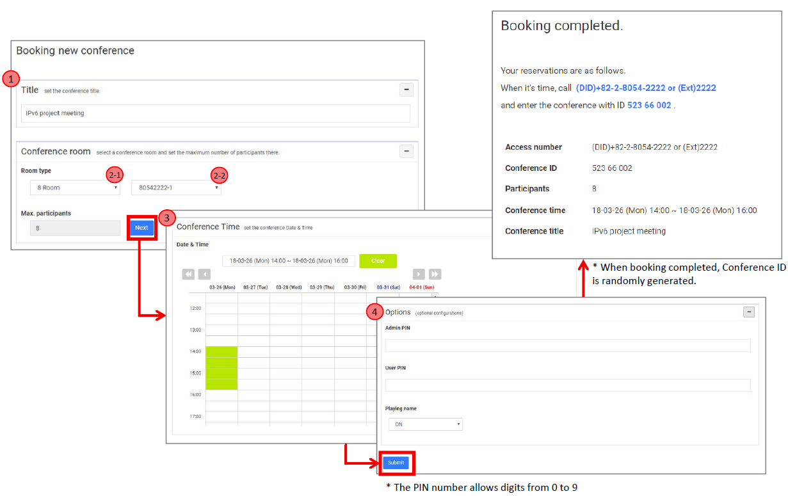
iPECS Audio Conferencing Bridge
Setting up conferences can be done once logged in you will be able to see a calendar view showing you the availability of the conference room and you will then be able to book a new meeting.

Slide 37
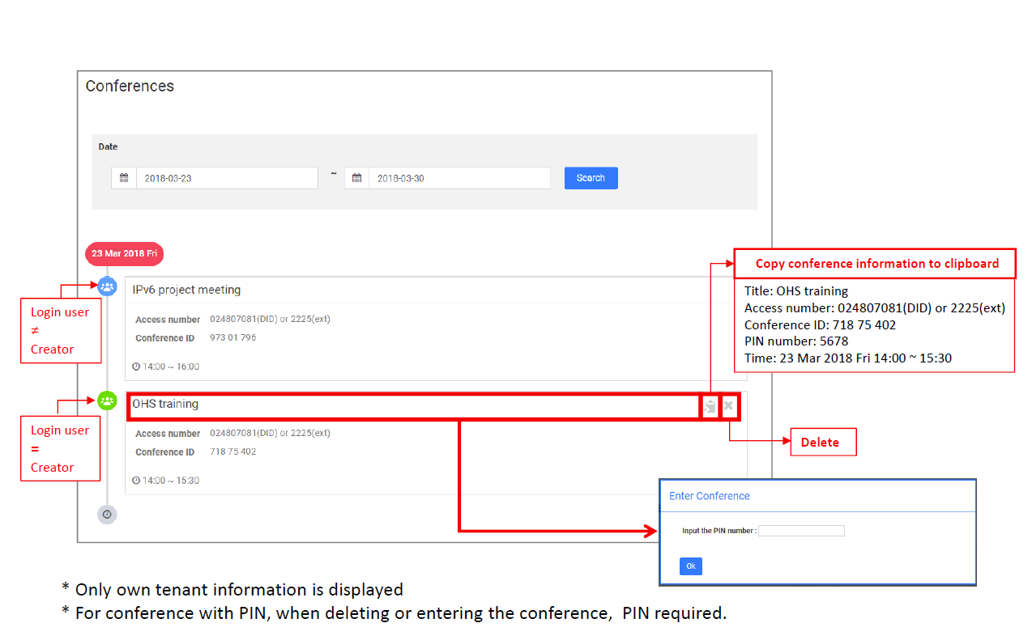
iPECS Audio Conferencing Bridge
Once this has been configured you will be able to see this in conference section as below. You will also be able to copy the conference details to then email out the conference details.

Slide 38
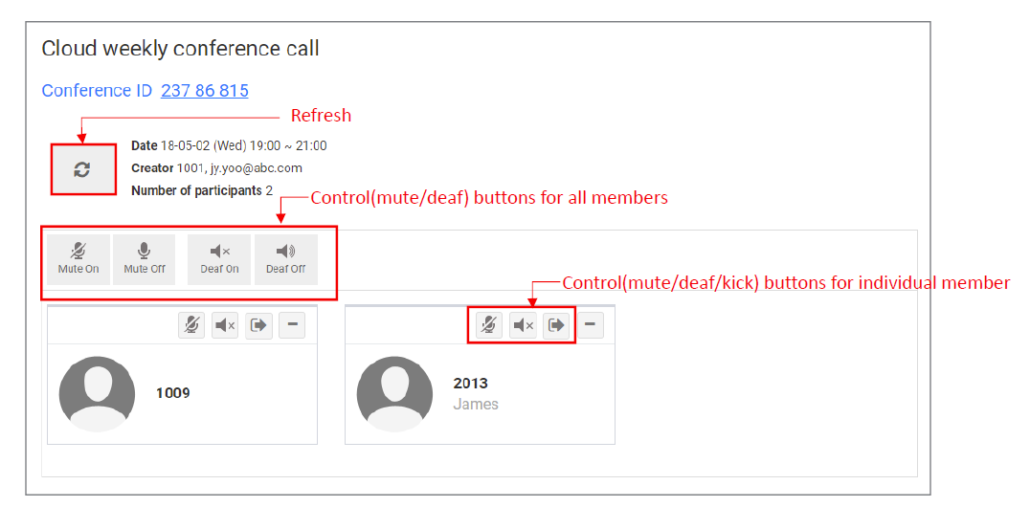
iPECS Audio Conferencing Bridge
If you have a pin set then you will be able to login with your admin or user pin.
If you are the admin then you will be able to mute or deafen other users on the conference. You are also able to kick users from the conference.

Slide 39
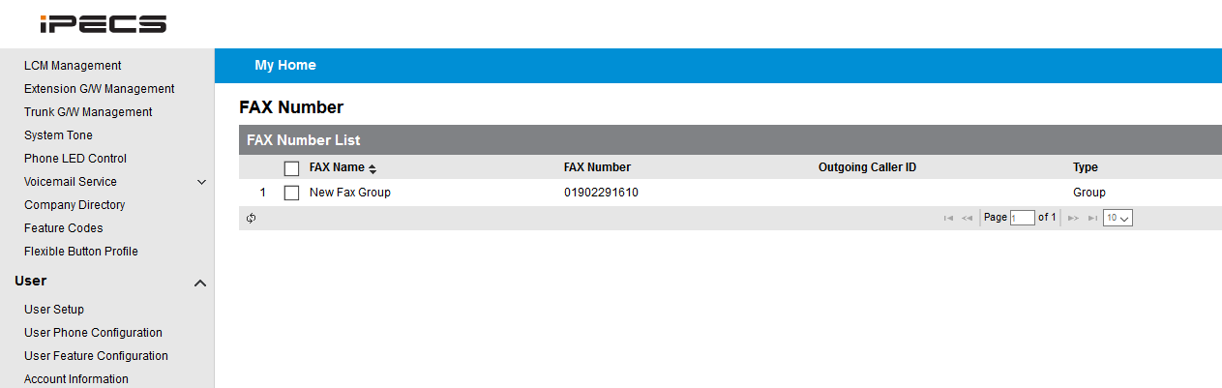
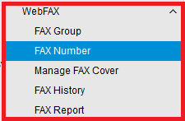
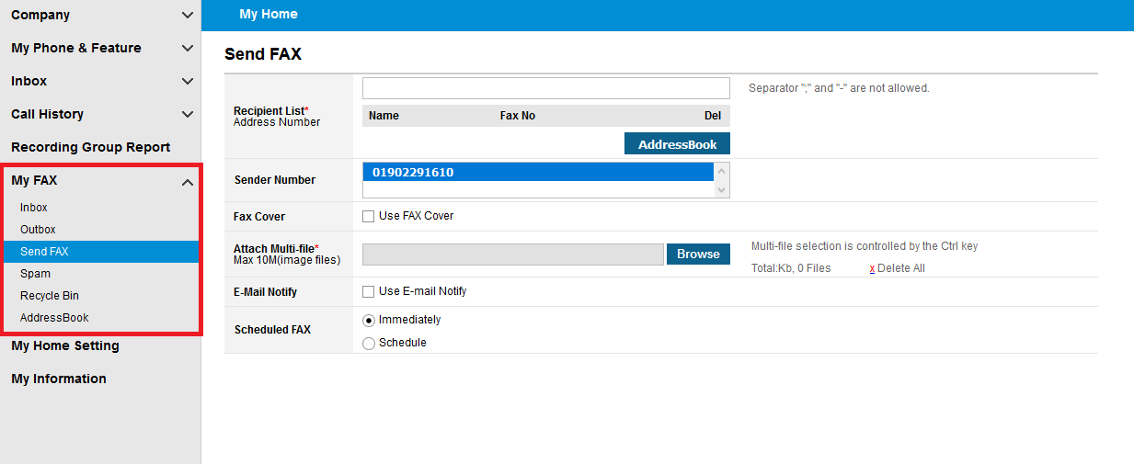
Web Fax
The new WebFax service is now available on the cloud and will allow you to manage both inbound and outbound faxing from the Reseller and User portal.

Slide 40
Fixes

Slide 41
AA Transfer shows group name
Previously you would see the AA’s number and not be able to tell the number that the call has come from when calls overflow to the basic dial destination.
This has now been rectified allowing you to see the customers number.
Notes:
Run through configuration of default settings.
Explain what this process is doing:
Setting up 9 for outside
Setting Default Feature Code
Setting Emergency Numbers

Slide 42
Searching Directory on 9010
You are now able to search the directory on a 9010 by using the hold button.
Notes:
Run through configuration of default settings.
Explain what this process is doing:
Setting up 9 for outside
Setting Default Feature Code
Setting Emergency Numbers

Slide 43
3rd Party Sip Phones not ringing in groups
There was an issue with 3rd party sip phones sometimes not ringing in groups when they had a forward enabled on them. This has now been resolved.
Notes:
Run through configuration of default settings.
Explain what this process is doing:
Setting up 9 for outside
Setting Default Feature Code
Setting Emergency Numbers

Slide 44
Issue with UCE Showing IP when call was from withheld caller
When UCE was receiving calls from withheld caller Id this was showing an IP address and not withheld this has now been amended.
Notes:
Run through configuration of default settings.
Explain what this process is doing:
Setting up 9 for outside
Setting Default Feature Code
Setting Emergency Numbers

Slide 45
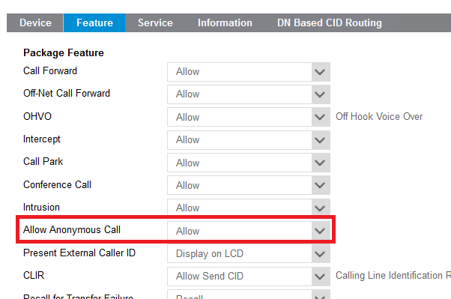
Issue with anonymous call block feature for extension
There was issues with some extensions not being able to block anonymous calls, this has now been resolved.
Notes:
Run through configuration of default settings.
Explain what this process is doing:
Setting up 9 for outside
Setting Default Feature Code
Setting Emergency Numbers

Slide 46
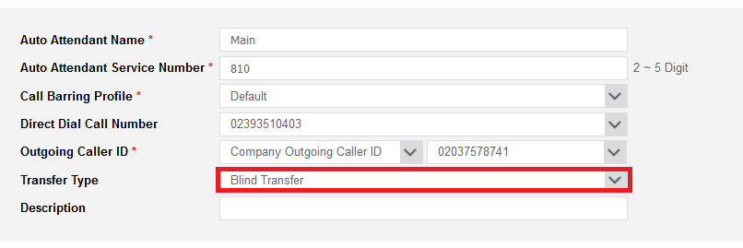
Issue with AA transfer type resetting after
Previously there was an issue with the auto attendant transfer type getting reset when a new order was final confirmed, this has now been fixed.
Notes:
Run through configuration of default settings.
Explain what this process is doing:
Setting up 9 for outside
Setting Default Feature Code
Setting Emergency Numbers

Slide 47
Issue with Iphones not notifying some calls have come in on UCE
We have now resolved issues that cased some calls not to correctly show to Iphones this was rectified with additional push service.
Notes:
Run through configuration of default settings.
Explain what this process is doing:
Setting up 9 for outside
Setting Default Feature Code
Setting Emergency Numbers

