Slide 1
iPECS Cloud
2.5 Update

Slide 2
New Features

Slide 3
Day Night Change Per Site
You now have the ability to change the day night option for an individual site or for the entire company, this will change the time zone linked with either the site or the default time schedule.
When entering the feature code you will be asked to enter 0 for company and 1 for site. As we can see below New Day Test has the default time schedule so if I am to select 0 it will change this time zone. If I select 1 then I will amend the time zone linked with my site.
Additionally you now have the ability to change from manual day night to auto ring mode from the handset by selecting option 0 after you have selected either company or site.

Slide 4
Group Name now shows on picked up calls
In the previous version if you were to pick up a group call you would not be able to see the group that had been rung. Now if you are to use the pickup feature you will see the external number and the group name.

Slide 5
Fixes

Slide 6
AA Transfer shows group name
Previously you would see the AA’s number and not be able to tell the number that the call has come from when calls overflow to the basic dial destination.
This has now been rectified allowing you to see the customers number.

Slide 7
Searching Directory on 9010
You are now able to search the directory on a 9010 by using the hold button.

Slide 8
3rd Party Sip Phones not ringing in groups
There was an issue with 3rd party sip phones sometimes not ringing in groups when they had a forward enabled on them. This has now been resolved.

Slide 9
Issue with UCE Showing IP when call was from withheld caller
When UCE was receiving calls from withheld caller Id this was showing an IP address and not withheld this has now been amended.

Slide 10
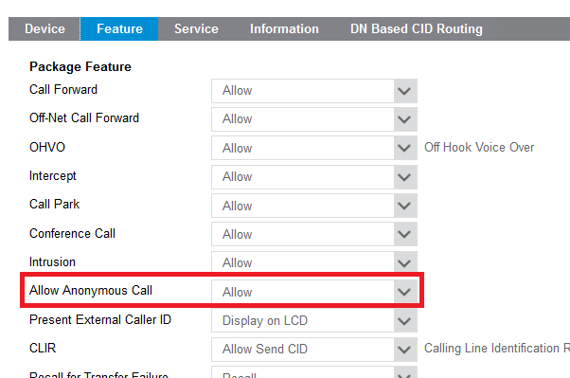
Issue with anonymous call block feature for extension
There was issues with some extensions not being able to block anonymous calls, this has now been resolved.

Slide 11
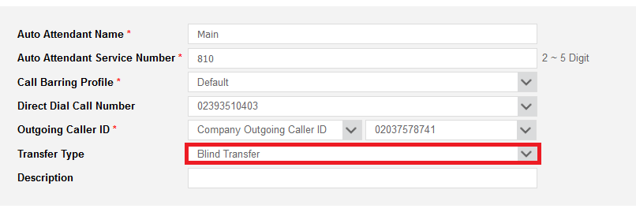
Issue with AA transfer type resetting after order final confirmed
Previously there was an issue with the auto attendant transfer type getting reset when a new order was final confirmed, this has now been fixed.

