Slide 2
2.3 Update
iPECs Cloud

Slide 3
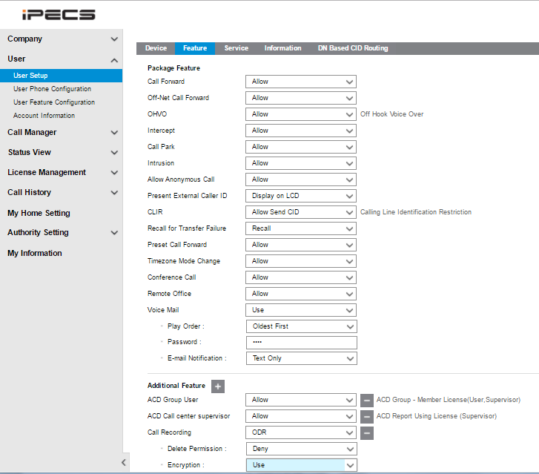
Call Recording file encryption
Customer Manager can change encryption option as user based.

Slide 4
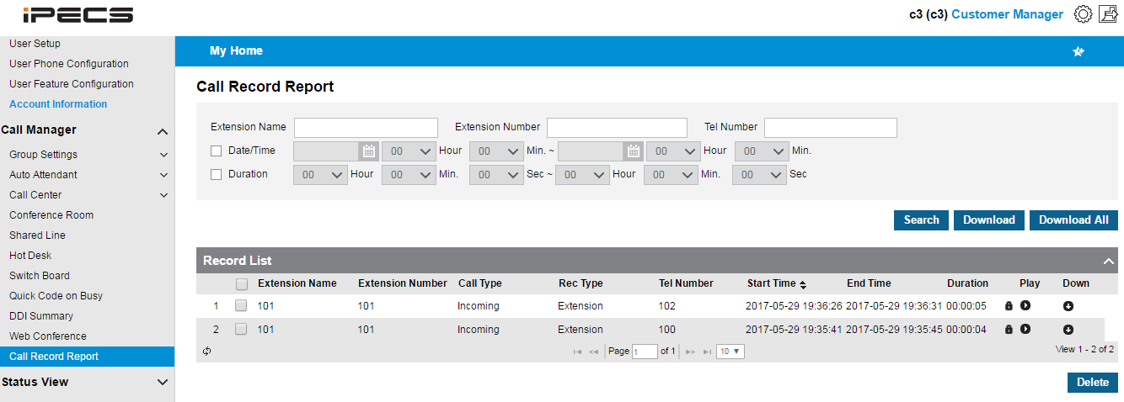
Call Recording file encryption
Customer Manager or Customer User can recognize which file is encrypted or not with encryption icon.
Encryption Icon

Slide 5
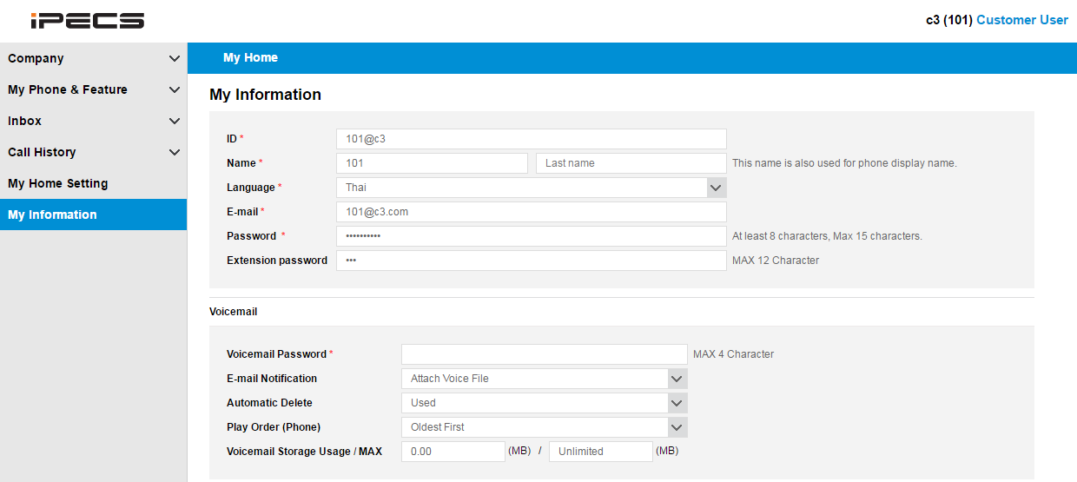
Voice Mail Auto Delete option
Customer User can select automatic voice mail deletion after sending e-mail attachment.

Slide 6
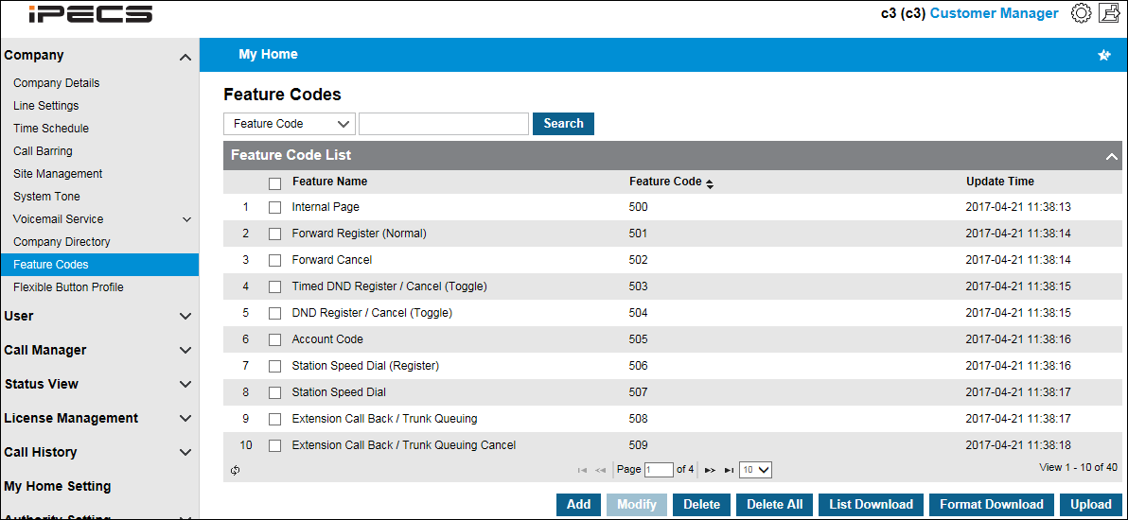
Feature code upload/download
List Download : The list excel file can be downloaded to PC, which includes the registered feature code list.
Format Download : The format excel file can be downloaded, which includes the unregistered feature code list.
Upload : The excel file for the feature code list can be uploaded from PC.

Slide 7
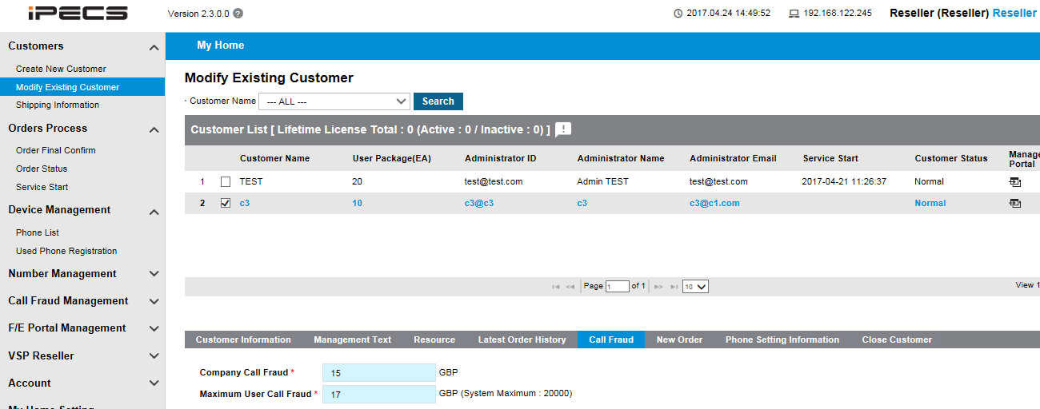
Call fraud limit – Company/User based
Reseller can set Call Fraud limit as bellow
1) Company Call Fraud
This value is applied to all users in the company as default.
It can be changed after creating new customer on bellow menu.
2) Maximum User Call Fraud
When customer manager change call fraud limit to specific users, it can’t exceed this value.
It can be changed after creating new customer on bellow menu.

Slide 8
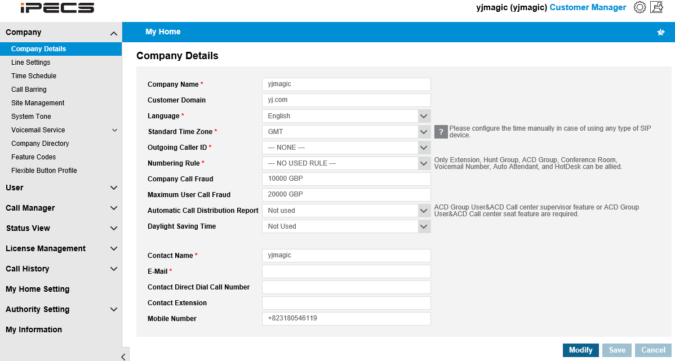
Call fraud limit – Company/User based
Customer manager can check available company basic call fraud, and maximum user call fraud limit.
If customer manager want to change this value, request reseller to change it.
15 GBP
17 GBP

Slide 9
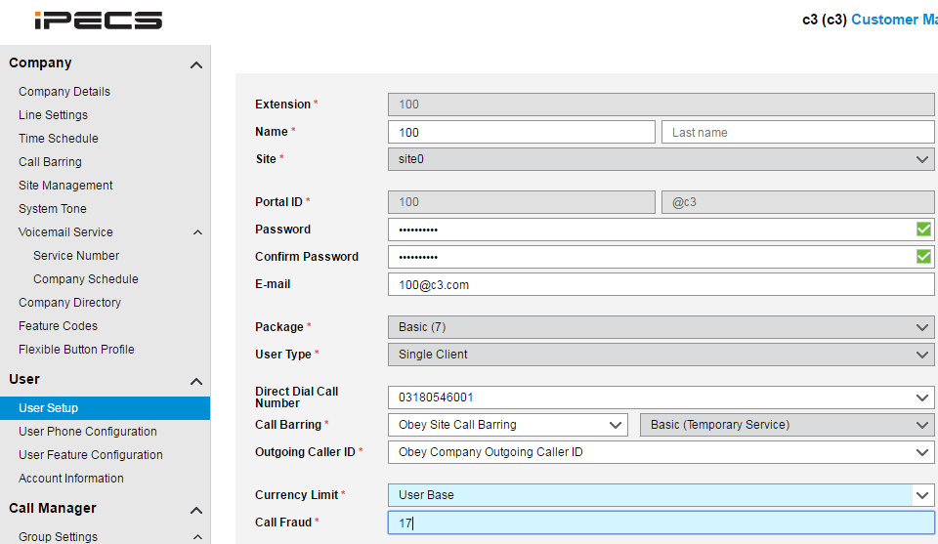
Call fraud limit – Company/User based
Customer manager can change individual user’s call fraud limit within maximum user call fraud limit.

Slide 10
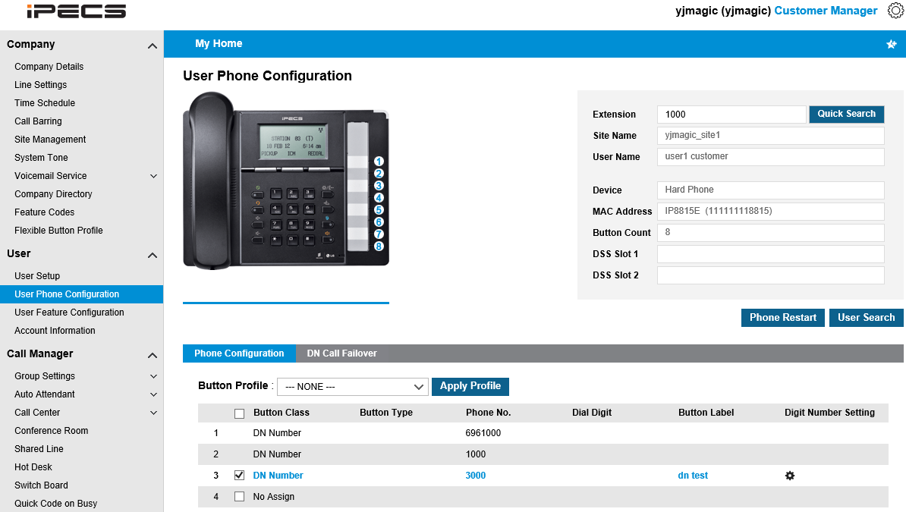
Call fraud limit – Company/User based
[Customer Manager Multiple Line Call Fraud Amount Setting]
The Call Fraud Setting in the User Phone Configuration Menu
User > User Phone Configuration
① Search the extension to find DN Number to set the call fraud amount of
② Click Digit Number Setting icon
③ Select Current Limit option (Company Base/User Base)
④ Set the Call Fraud amount if the Current Limit option is User Base
⑤ Save

Slide 11
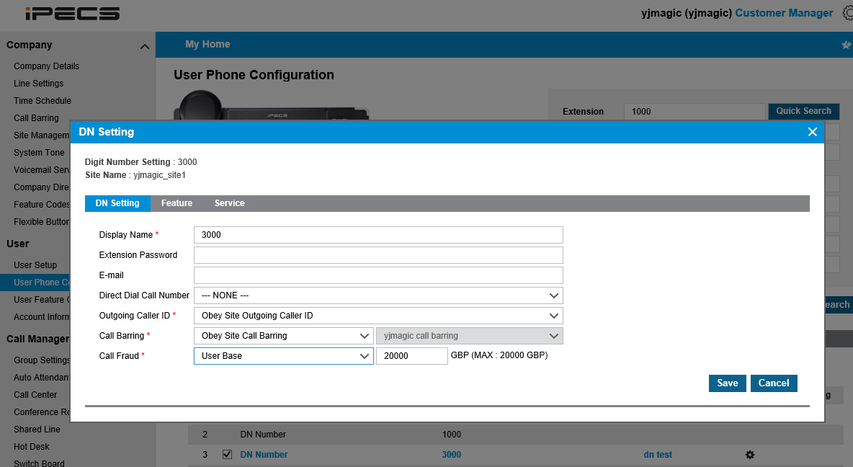
Call fraud limit – Company/User based

Slide 12
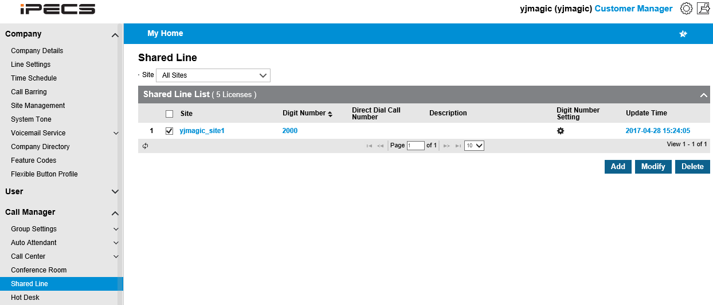
Call fraud limit – Company/User based
The Call Fraud Setting in the Shared Line Menu
Call Manager > Shared Line
① Click the Digit Number Setting of the shared line number
② Select Current Limit option (Company Base/User Base)
③ Set the Call Fraud amount if the Current Limit option is User Base
④ Save

Slide 13
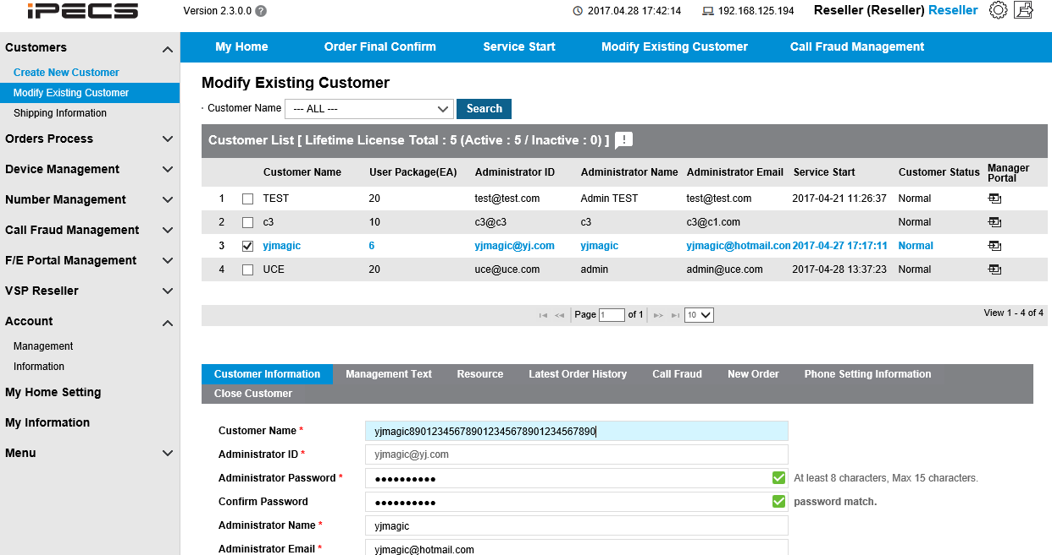
Account name name up to 40 characters
Administration name of the customer manager can be input up to 40 characters in
Reseller portal.

Slide 14
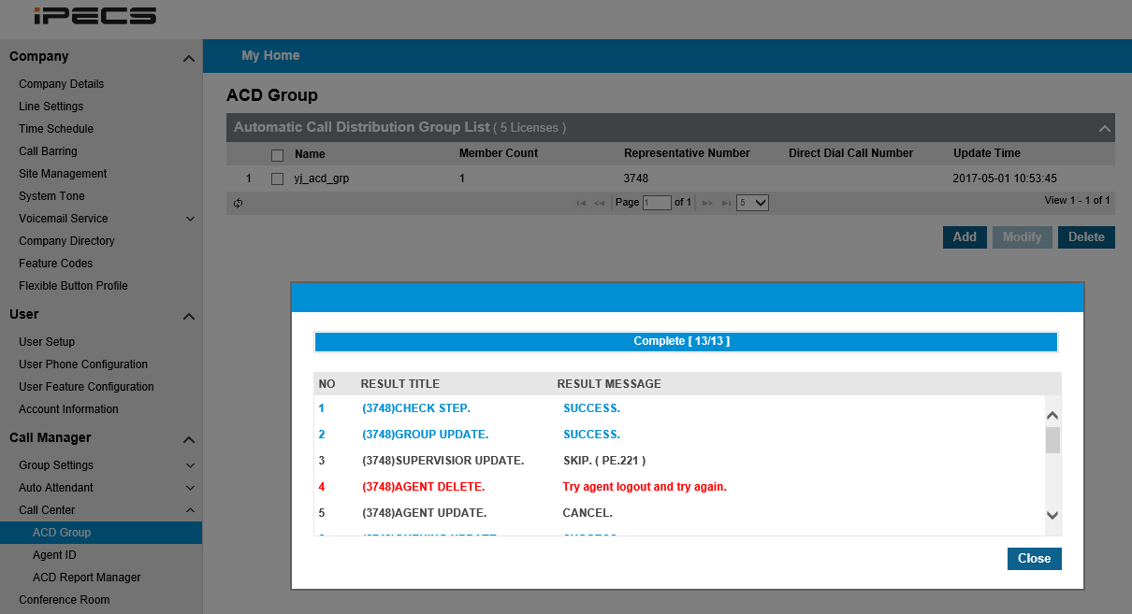
ACD logon status information
Bellow error message will be presented if you try to delete an acd group when agents are logged in.
Log off from ACD group, and delete again.

Slide 15
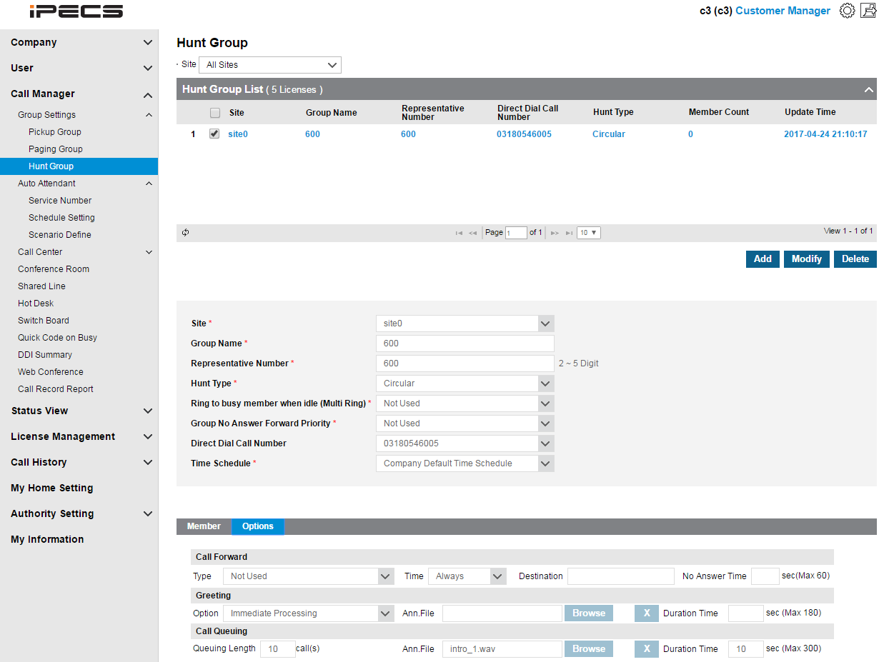
Hunt Group Queuing
In previous version, hunt group didn’t allow call queuing for all members busy.
Customer manager can upload queuing announcement and configure waiting time and waiting queue count as bellow.

Slide 16
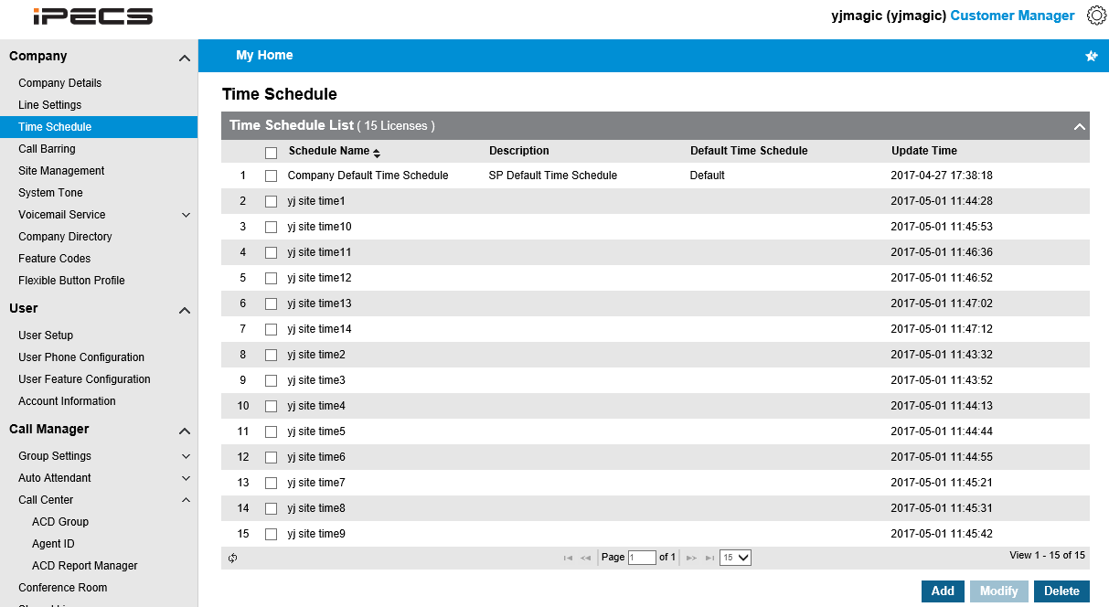
Time zone expansion(5 to 15)
Increase up to 15
5 Time schedules were automatically assigned to each company in previous version.
It was increased up to 15 in v2.3.
New customers which are generated after applying v2.3 will have 15 as default.
Existing customers which are generated before applying v2.3 will have additional 10 time schedule when any other additional order is done after applying v2.3.

Slide 17
System tone-related recall timer setting
Call Park, Camp On, System Hold, Transfer Recall and Paging Timeout Timer value can be set on customer manager portal.

Slide 18
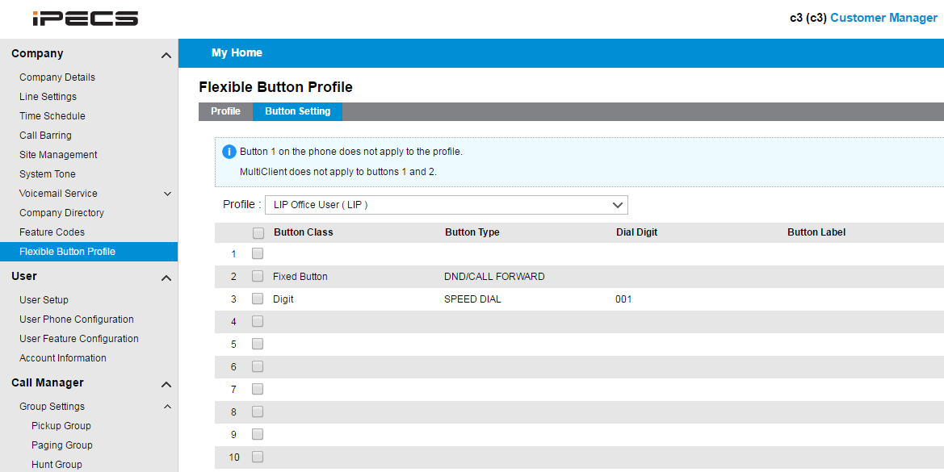
Flexible Button Profile
This is useful feature to assign same button information on multiple terminals.
Customer manager can predefine flexible button profile for LIP or SIP phone.
Assign button information on defined profile.

Slide 19
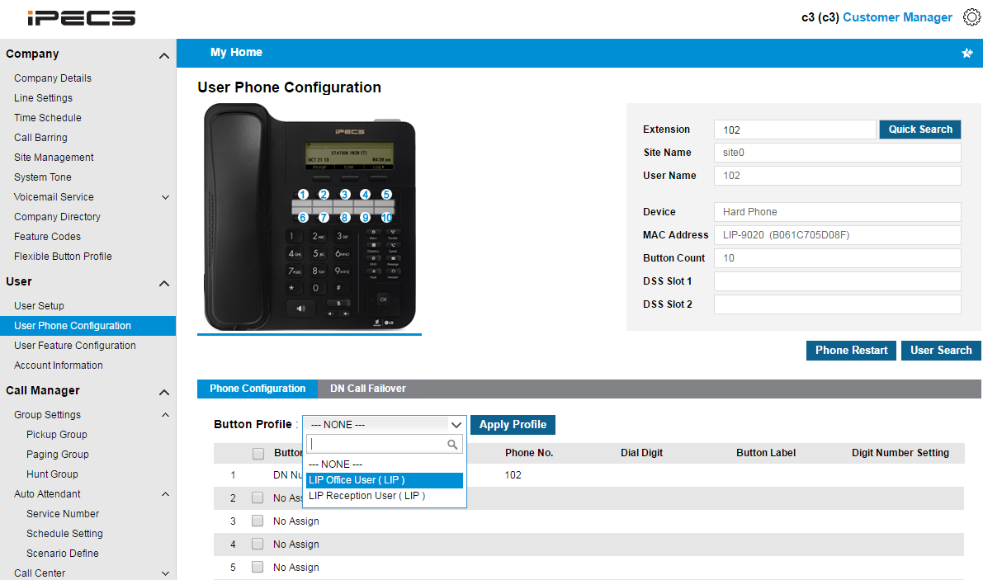
Flexible button Profile
The defined profile can be assigned on terminals.
When applying the profile, there is option to select skip or overwrite for existing button information

Slide 20
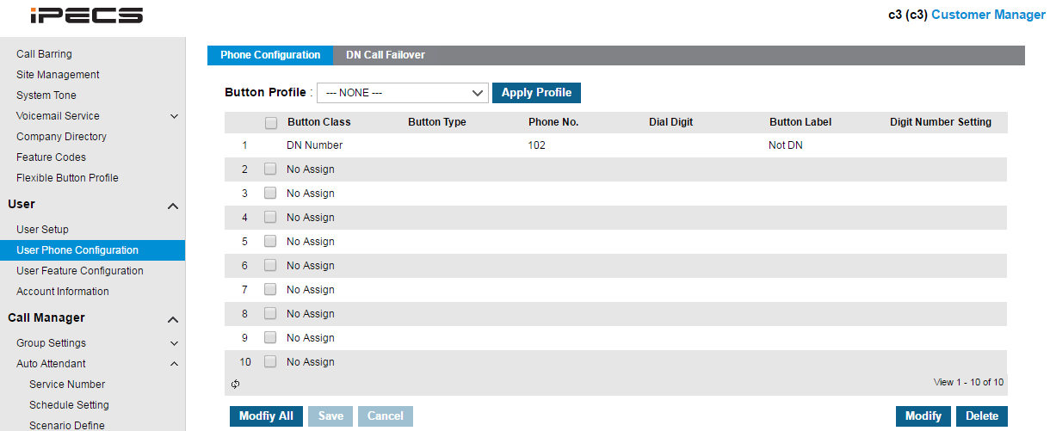
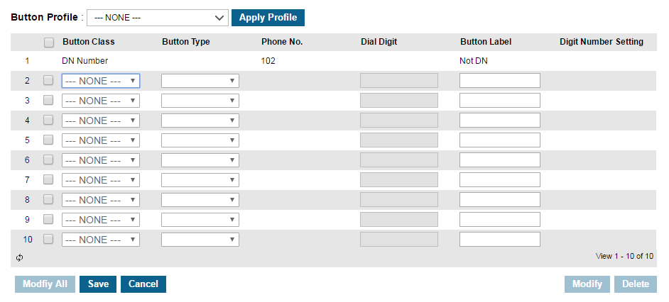
Multiple Flexible button change
If customer want to change multiple button at once,
click ‘Modify All’, set button information and click ‘save’.

Slide 21
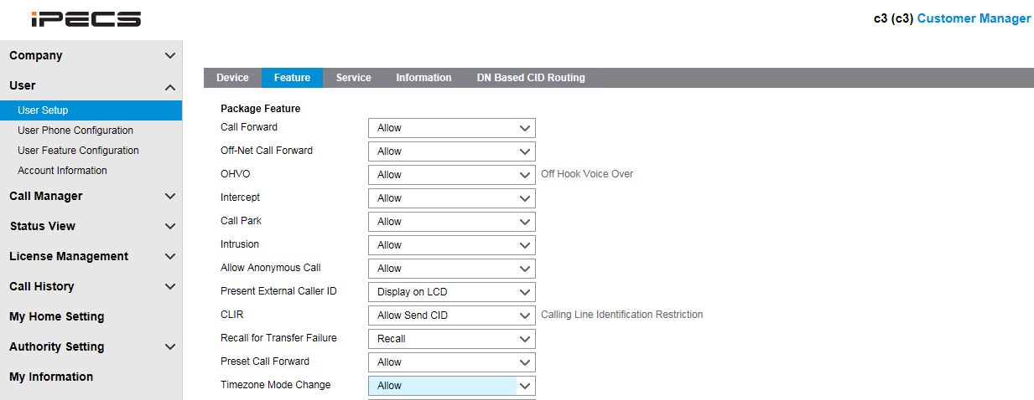
Change Night mode on handset
LED indication for Day/Night/Timed
A user who wants to change the Time schedule mode by a feature code should have bellow authority.
All users who use same time schedule are affected.
Only LIP terminals can change the Time schedule mode.
If a user register “System Service Time Mode Change” feature code in flexible button, day/night/timed mode is presented as bellow LED color on the flexible button.
Day – Off, Night – Red, Timed - Yellow

Slide 22
LIP-8000D Support
Limitation of LIP-8000D
LIP-8000D Series have bellow feature limitation, and it is not possible to develop any further feature because it is discontinued model.
Geo-graphical redundancy
. In geo-redundancy configuration,
. When Data center 1 is down and Data center 2 become active, call server send reconnect
message to LIP phones.
. But, LIP 8000D phone can’t recognize it. So it can’t connect to call server.
Call server IP address change
. When call server IP address is changed, new IP address should be manually changed on desktop phone.
Virtual Desk
Virtual desk is some kind of hot desk but it is little different.
In case of hot desk, dummy terminal and hot desk number should be pre-defined.
But, virtual desk can use any other phone with its extension number.
8000D terminal can’t use other extension number with virtual desk feature, and
other extension also can’t use 8000D terminal number with virtual desk feature.
If 8000D terminal use virtual desk feature, terminal can be unregistered.

Slide 23
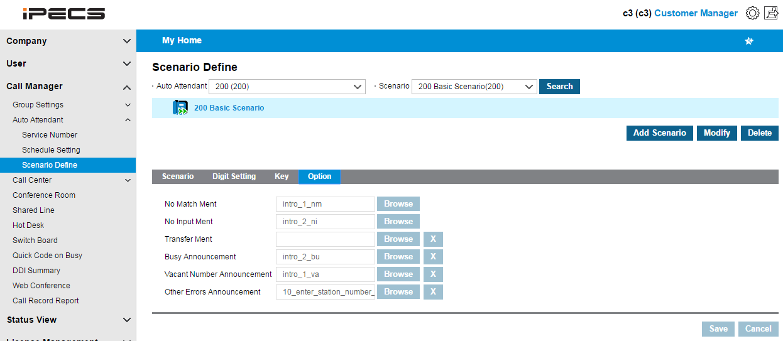
Auto Attendant Vacant Announcement
Busy, vacant, other error announcement is added.
After this announcement, original announcement is repeated.

Slide 24
Auto Attendant Call Through
When a call placed on AA and AA reroute the call to a extension, and incoming caller ID is same as Mobile CLI of the extension, Call through feature is activated.
Then caller hear dial tone, and dial out as call through.

Slide 25
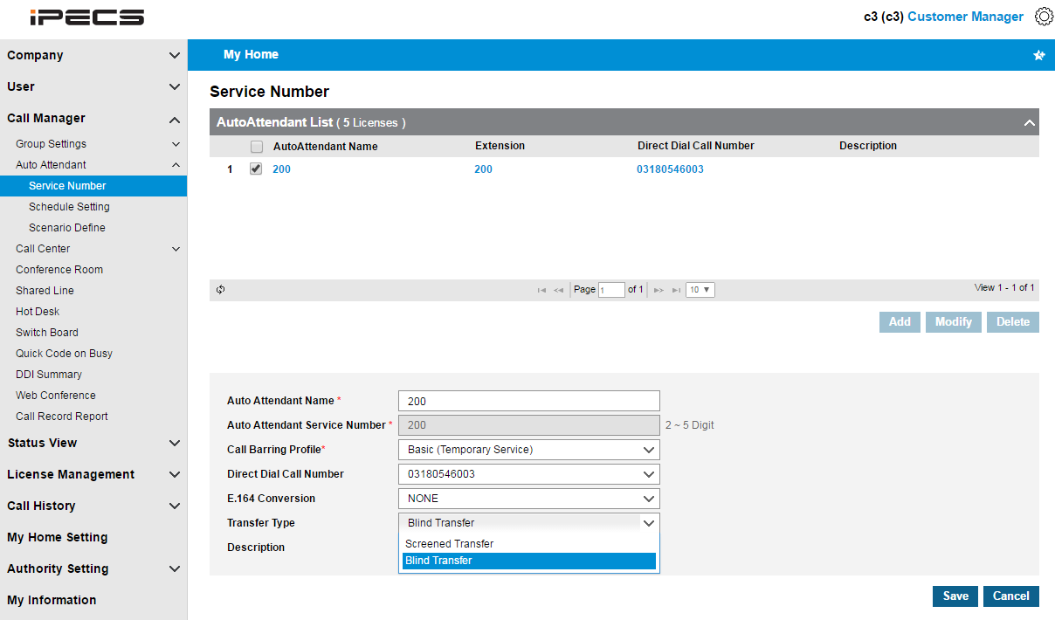
Auto Attendant Call Baring Profile
When AA dial out to trunk by customer selection of registered number, bellow AA call barring profile is applied.

Slide 26
Auto Attendant Blind Transfer Option
In previous version, AA always working with consultation transfer.
Blind transfer option is added.
When blind transfer is selected, error handling (busy, no answer, vacant announcement) is not supported because call was already transferred to caller before detecting error case.

Slide 27
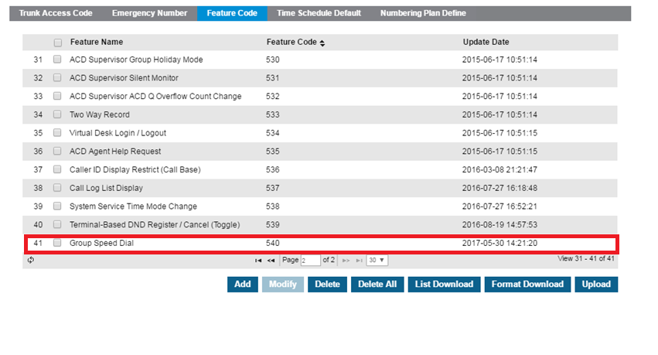
Group Speed Dial Feature Code

Slide 28
Company Directory Synchronization with UC
If UCE service activated after service starting and company directory setting, company directory information should be synchronized to UCE by clicking bellow button.

Slide 29
VSP
iPECS Cloud

Slide 30
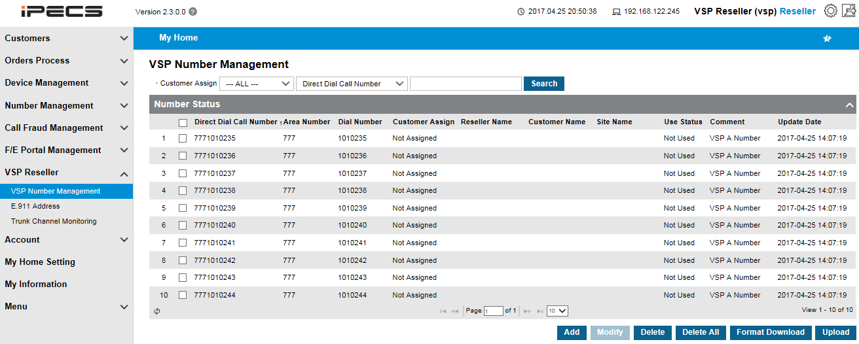
VSP (Virtual Service Provider)
VSP can register DDI number which was assigned from carrier.
DDI should be allocated in final confirm stage by VSP instead of SP.
VSP can manage their own DDI number as bellow.

Slide 31
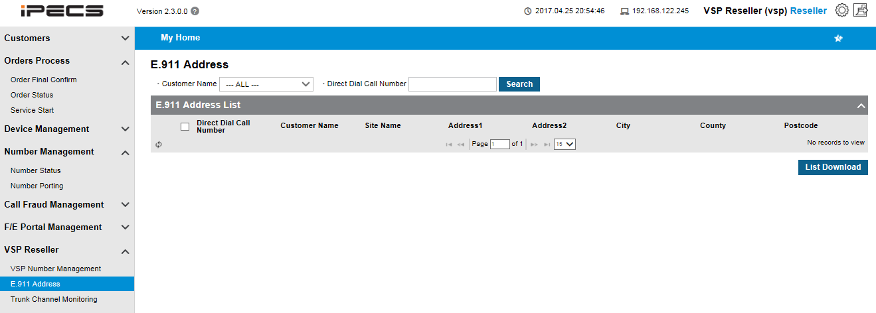
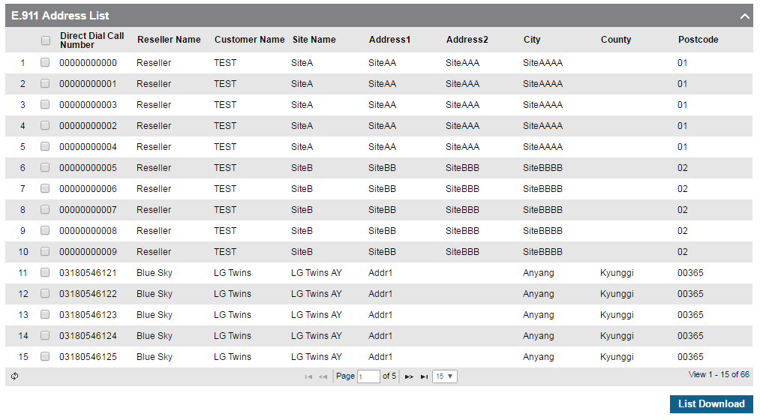
VSP (Virtual Service Provider)
VSP can download own customer’s E911 information as bellow.

Slide 32
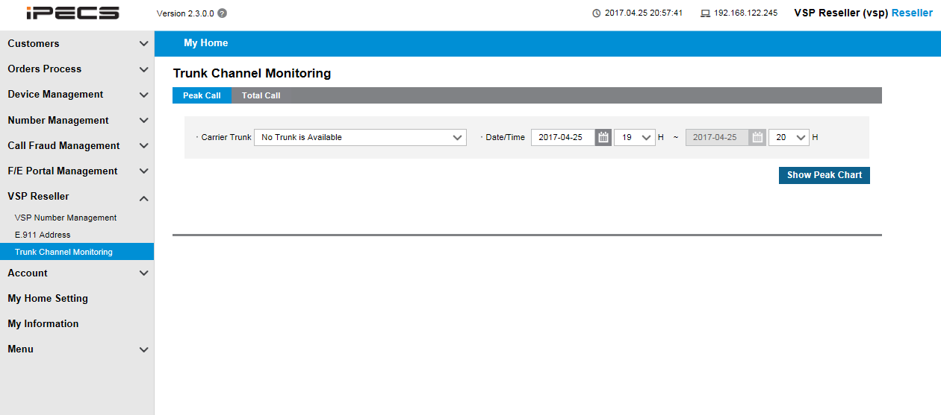
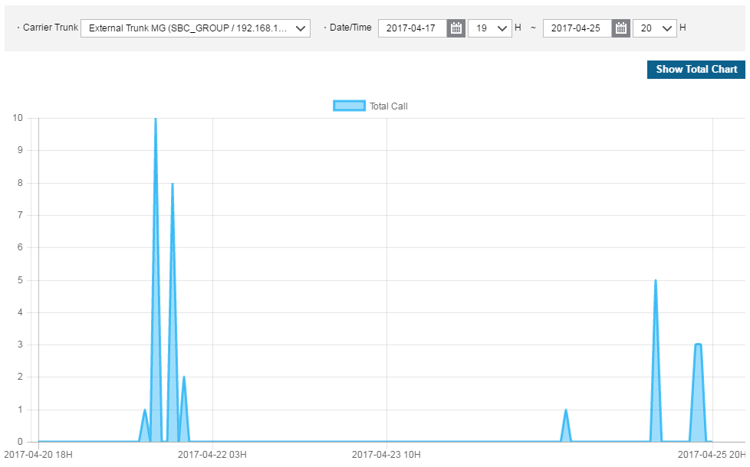
VSP (Virtual Service Provider)
VSP can check trunk channel usage for own SBC as bellow.

