Slide 2
Voicemail On a Extension
Configuring

Slide 3
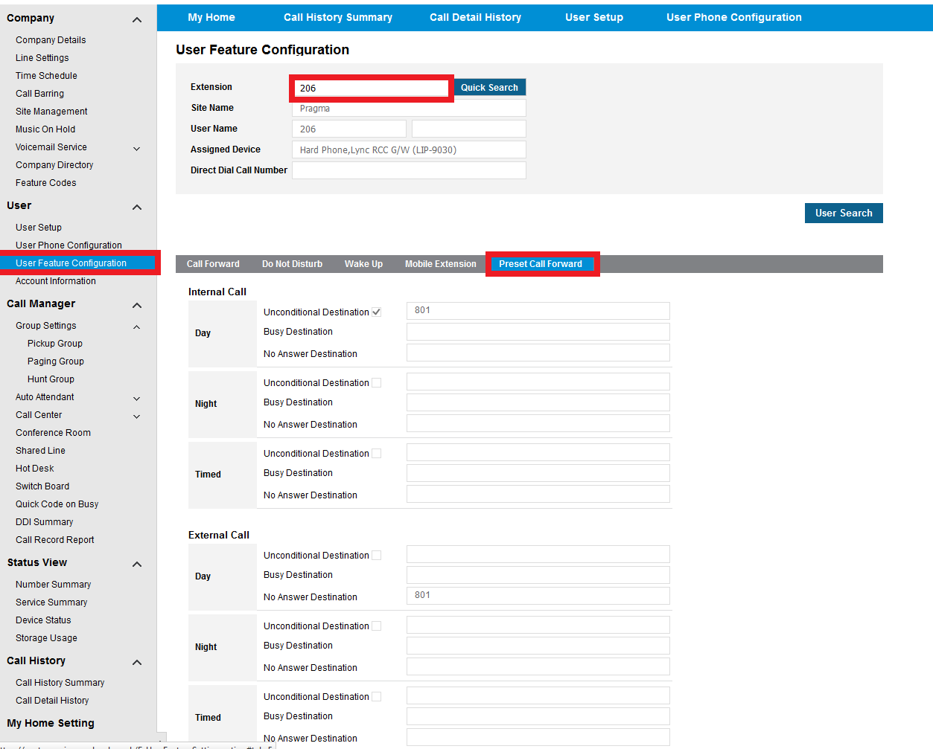
Voicemail
You will need to go to the station you would like to configure within user feature configuration then Preset Call Forward. You will now need to choose when you would like to forward to voicemail.

Slide 4
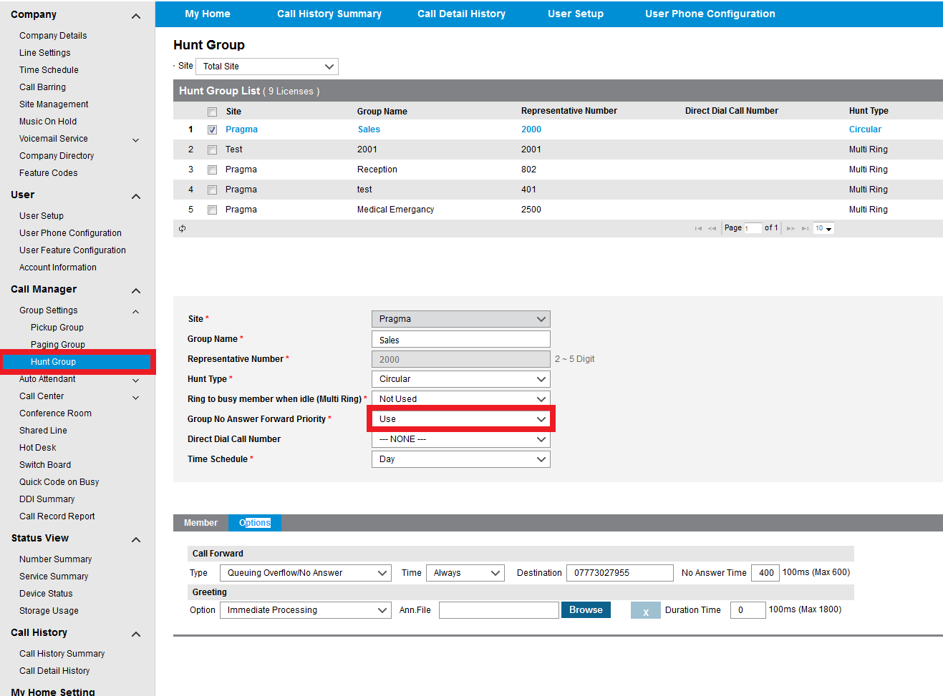
Voicemail
You will now need to amend the Group no answer forward priority setting to ON for any ring groups that you are using.

Slide 5
Thank you
Go to www.wearepragma.co.uk for more information

