Slide 2
TNET
Configuring

Slide 3
LCM
Before Attempting to configure LCM for Cloud please make sure that you have attended one of the below courses.
LCM Cloud Training Course
Cloud Advanced Course

Slide 4
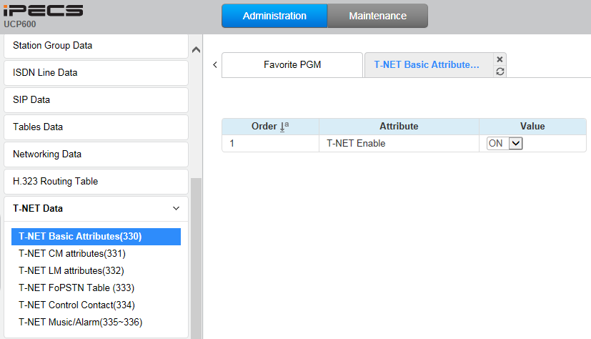
LCM – Enable TNET
Enable TNET in the UCP

Slide 5
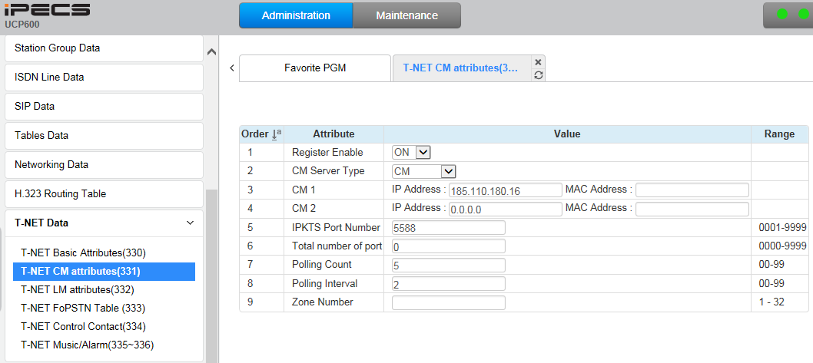
LCM - CM Attributes
Register Enable → Select “CM” in CM Server Type → Enter “IPKTS Relay Public Representative IP Address” in IP Address

Slide 6
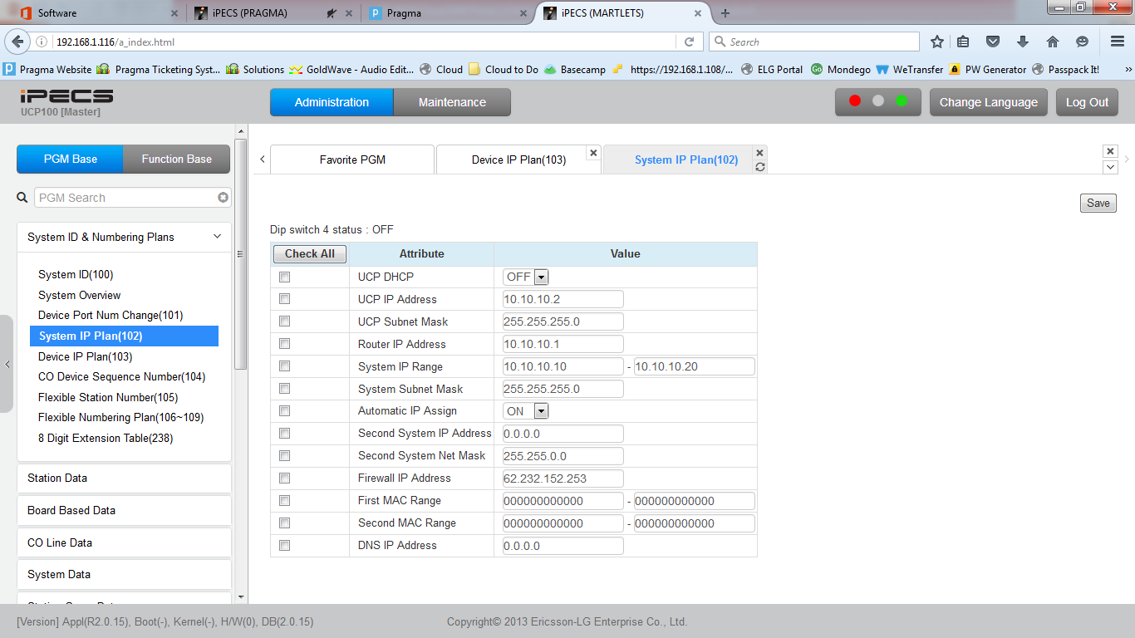
LCM – Registering Phones to LCM
Register Phones to the LCM system first(NOTE MAKE SURE THAT THE HANDSETS ARE SET TO REMOTE).
When Phones are registered to LCM, make sure that gateway IP of the router(ie .10.10.10.1) is set to the phones.
If not, set it on the phones.

Slide 7
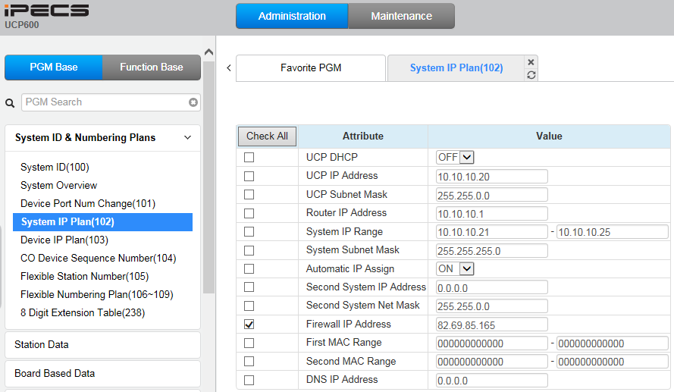
LCM – Registering Phones to LCM
In case that the LCM is located behind the NAT, enter Firewall IP Address.

Slide 8
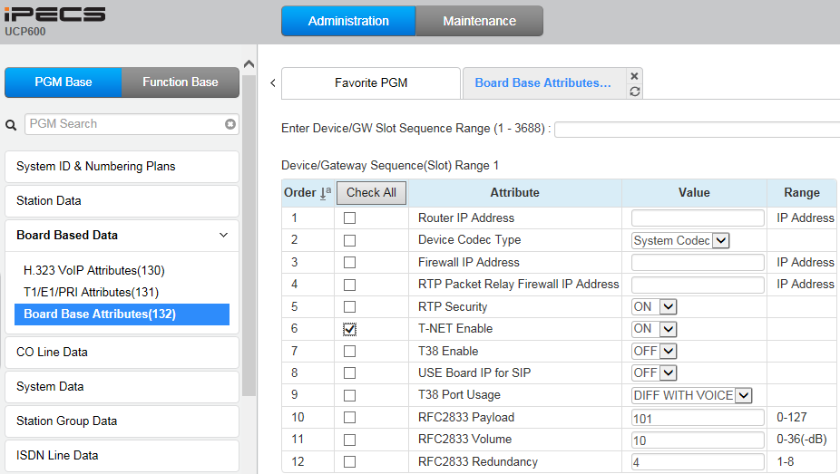
LCM – Enable TNET for Phones
Enable TNET for all phones to connect to the Cloud automatically when TNET connection is normal between LCM and Cloud.

Slide 9
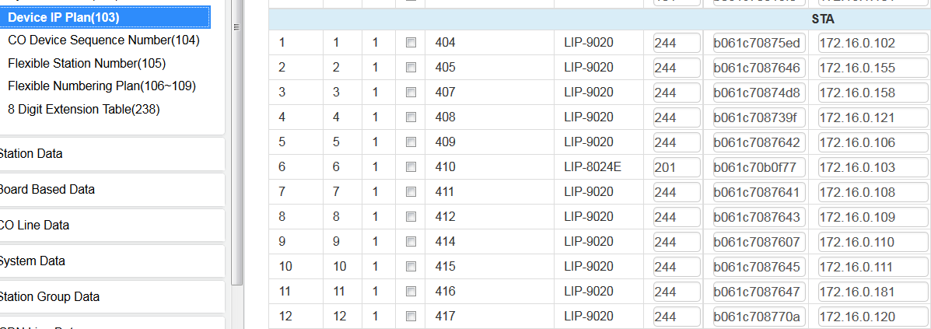
LCM – Users
Phones are normally connected to the UCP and this will then connect to Cloud
And should be displayed as below in the UCP device

Slide 10
LCM – Users
Setup users on the cloud platform

Slide 11
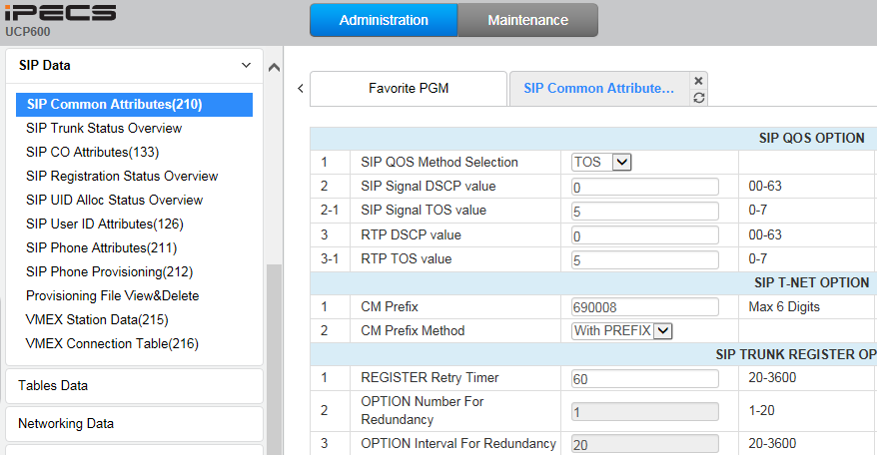
LCM – Tennant Prefix
Enter the customer tenant prefix in CM Prefix. (This will be provided by Pragma)
Select “With PREFIX” in CM Prefix Method.

Slide 12
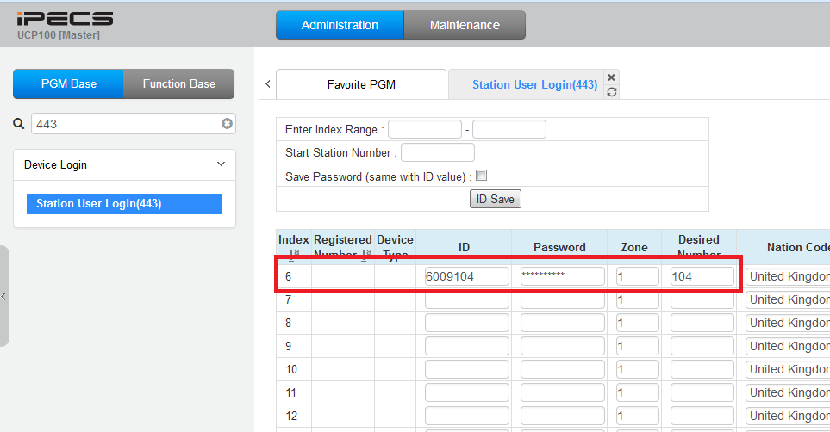
LCM – Station Authentication
Enter the Stations Authentication ID and Password that has been configured on the Cloud Portal

Slide 13
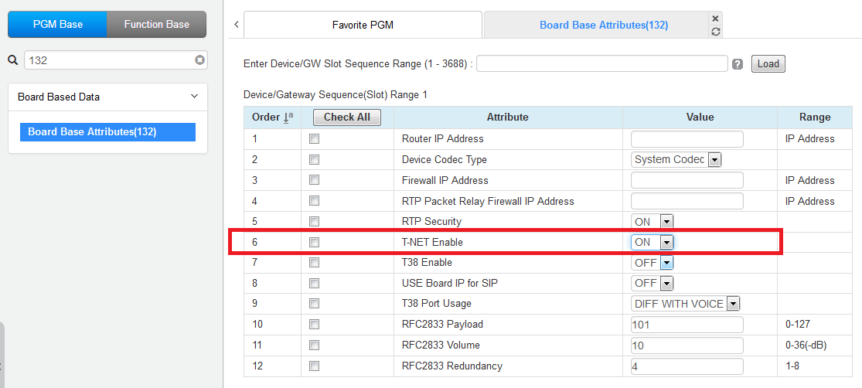
LCM – TNET
You will also need to enable T-NET for the handset

Slide 14
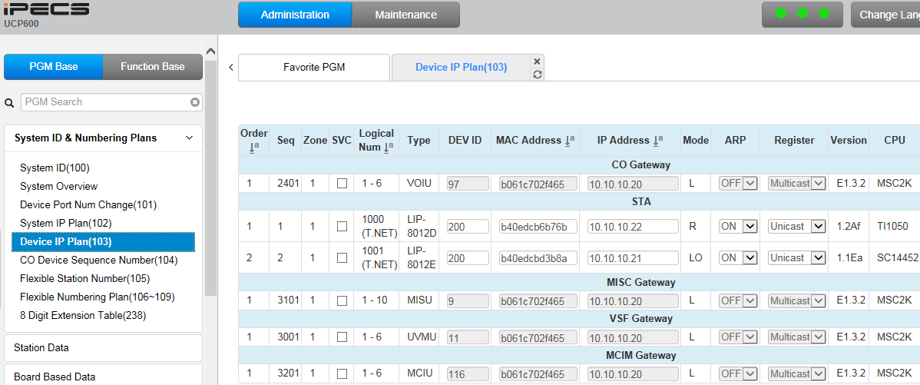
LCM – Complete
You will now see the below configuration in PGM103, as you can see the handsets are connected to the cloud platform Via T-NET

Slide 15
LCM – Trouble Shooting
If you have any issues with this please make sure that you have double checked the below.
Handset is set to remote
Correct IP and subnet are on the phone.
You have a Gateway Address on the handset.

Slide 16
Thanks for listening
Go to www.wearepragma.co.uk for more information

