Slide 1
wqh

Slide 2
Call Recording Additional Storage

Slide 3
Increasing Call Recording Package

Slide 4
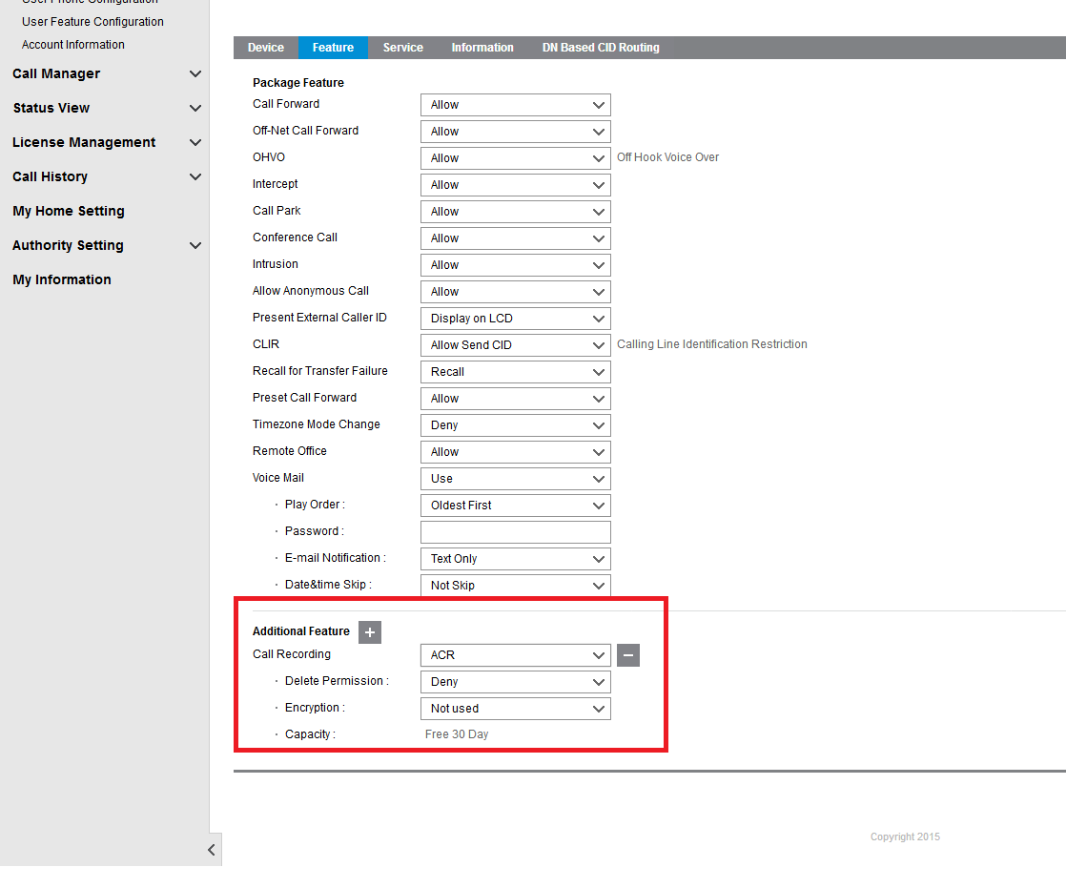
Find the Current Call Recording Package
Check the recording package assigned to the user

Slide 5
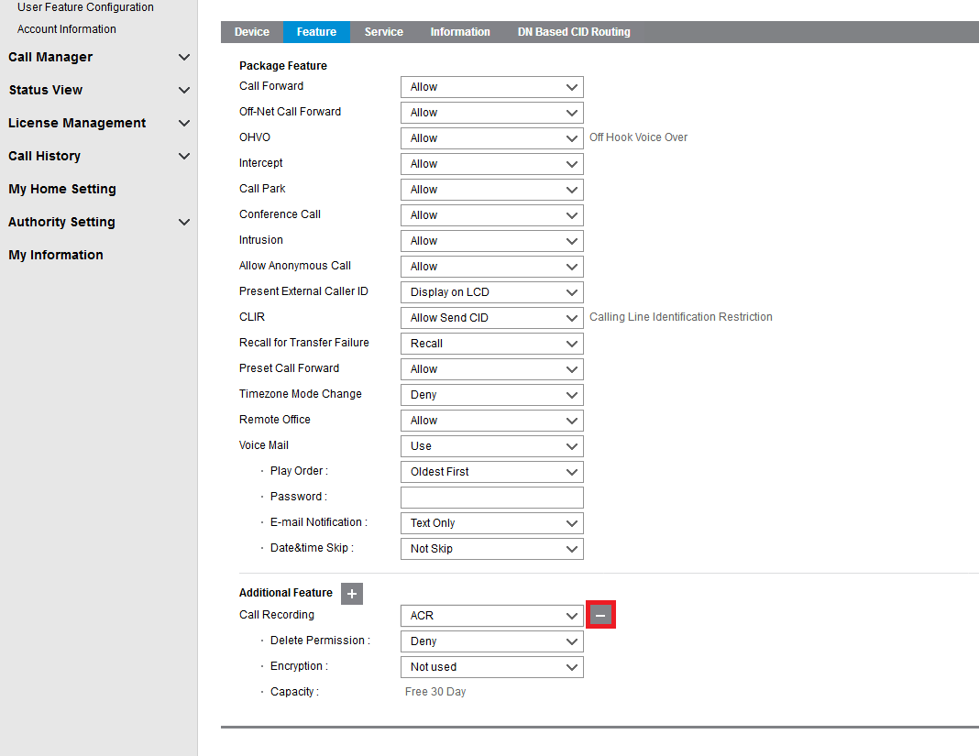
Amending Recording Package
Click the – button to remove the current package
PLEASE NOTE DO NOT SAVE AT THIS POINT OR YOU WILL LOOSE ALL RECORDINGS !!!!!!!

Slide 6
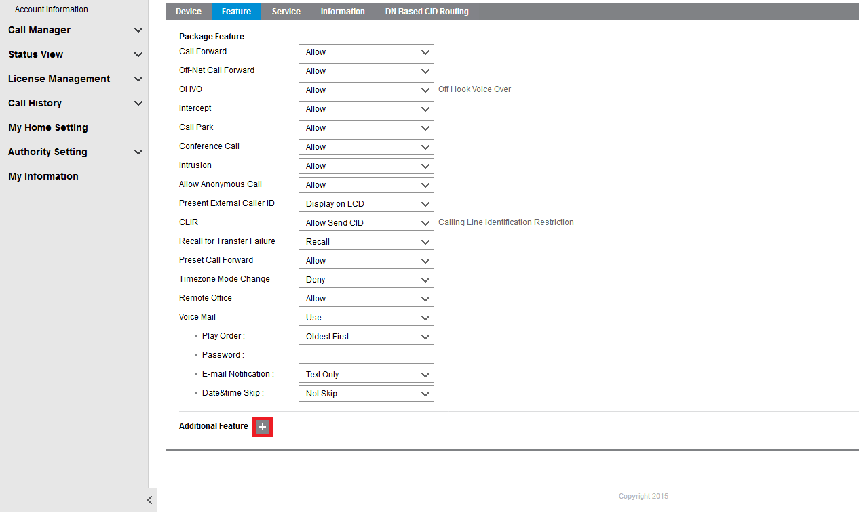
Adding New Package
PLEASE NOTE DO NOT SAVE AT THIS POINT OR YOU WILL LOOSE ALL RECORDINGS !!!!!!!
Click additional features

Slide 7
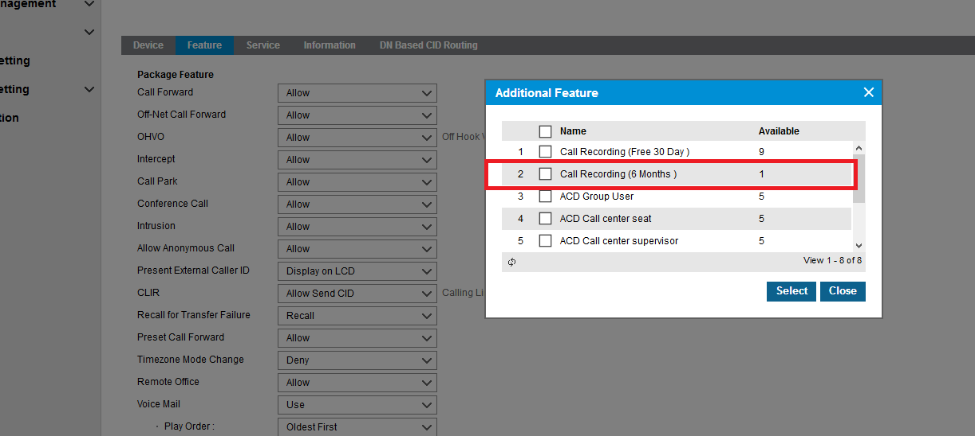
Adding New Package
PLEASE NOTE DO NOT SAVE AT THIS POINT OR YOU WILL LOOSE ALL RECORDINGS !!!!!!!
Select the new package

Slide 8
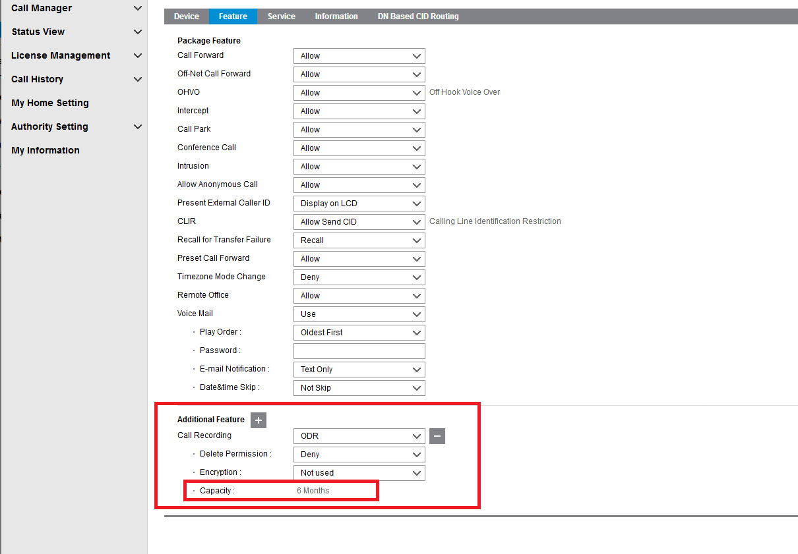
Adding New Package
You can now see that the new package has been added

Slide 9
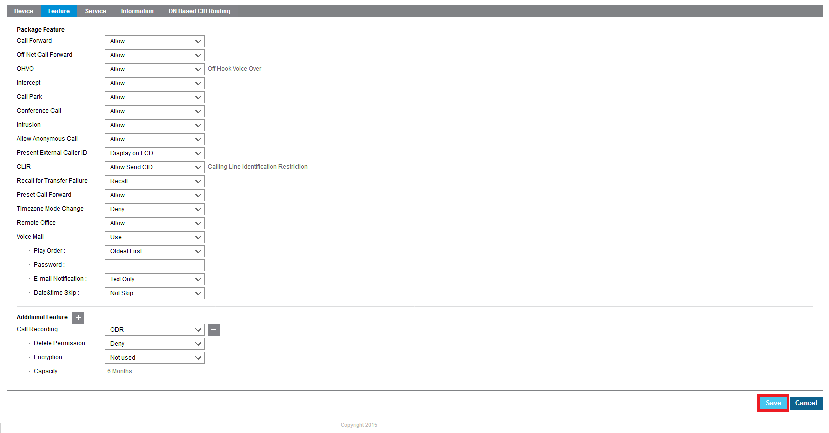
Adding New Package
You can now save to move to the new storage package

Slide 10
Thanks for watching
Go to www.wearepragma.co.uk for more information

